Slide 1
Chapter 13
Vibrations
and
Waves

Slide 2
Hooke’s Law
F_{s} = - k x
F_{s} is the spring force
k is the spring constant
It is a measure of the stiffness of the spring
A large k indicates a stiff spring and a small k indicates a soft spring
x is the displacement of the object from its equilibrium position
x = 0 at the equilibrium position
The negative sign indicates that the force is always directed opposite to the displacement

Slide 3
Hooke’s Law Force
The force always acts toward the equilibrium position
It is called the restoring force
The direction of the restoring force is such that the object is being either pushed or pulled toward the equilibrium position

Slide 4
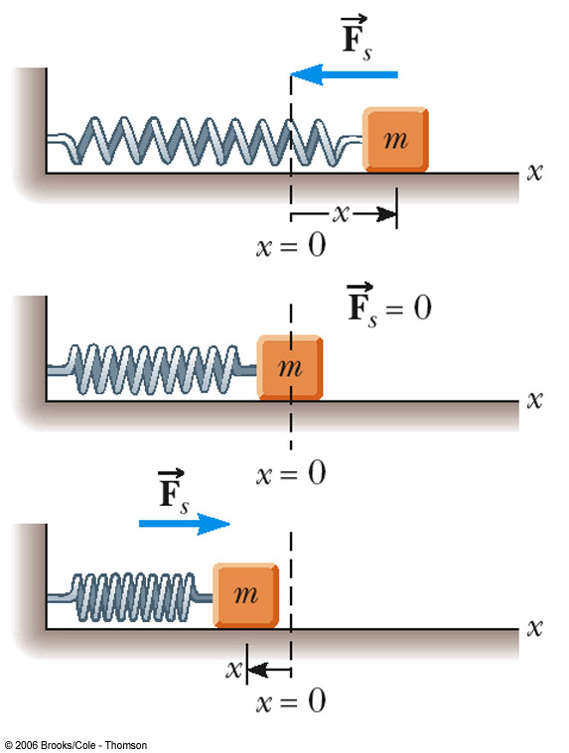
Hooke’s Law Applied to a Spring – Mass System
When x is positive (to the right), F is negative (to the left)
When x = 0 (at equilibrium), F is 0
When x is negative (to the left), F is positive (to the right)

Slide 5
Motion of the Spring-Mass System
Assume the object is initially pulled to a distance A and released from rest
As the object moves toward the equilibrium position, F and a decrease, but v increases
At x = 0, F and a are zero, but v is a maximum
The object’s momentum causes it to overshoot the equilibrium position

Slide 6
Motion of the Spring-Mass System, cont
The force and acceleration start to increase in the opposite direction and velocity decreases
The motion momentarily comes to a stop at x = - A
It then accelerates back toward the equilibrium position
The motion continues indefinitely

Slide 7
Simple Harmonic Motion
Motion that occurs when the net force along the direction of motion obeys Hooke’s Law
The force is proportional to the displacement and always directed toward the equilibrium position
The motion of a spring mass system is an example of Simple Harmonic Motion

Slide 8
Simple Harmonic Motion, cont.
Not all periodic motion over the same path can be considered Simple Harmonic motion
To be Simple Harmonic motion, the force needs to obey Hooke’s Law

Slide 9
Amplitude
Amplitude, A
The amplitude is the maximum position of the object relative to the equilibrium position
In the absence of friction, an object in simple harmonic motion will oscillate between the positions x = ±A

Slide 10
Period and Frequency
The period, T, is the time that it takes for the object to complete one complete cycle of motion
From x = A to x = - A and back to x = A
The frequency, ƒ, is the number of complete cycles or vibrations per unit time
ƒ = 1 / T
Frequency is the reciprocal of the period

Slide 11
Acceleration of an Object in Simple Harmonic Motion
Newton’s second law will relate force and acceleration
The force is given by Hooke’s Law
F = - k x = m a
a = -kx / m
The acceleration is a function of position
Acceleration is not constant and therefore the uniformly accelerated motion equation cannot be applied

Slide 12
Elastic Potential Energy
A compressed spring has potential energy
The compressed spring, when allowed to expand, can apply a force to an object
The potential energy of the spring can be transformed into kinetic energy of the object

Slide 13
Elastic Potential Energy, cont
The energy stored in a stretched or compressed spring or other elastic material is called elastic potential energy
PE_{s} = ½kx²
The energy is stored only when the spring is stretched or compressed
Elastic potential energy can be added to the statements of Conservation of Energy and Work-Energy

Slide 14
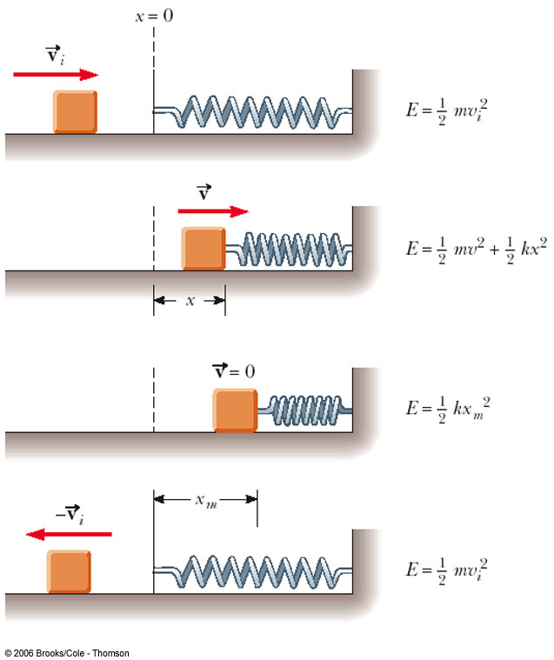
Energy in a Spring Mass System
A block sliding on a frictionless system collides with a light spring
The block attaches to the spring
The system oscillates in Simple Harmonic Motion

Slide 15
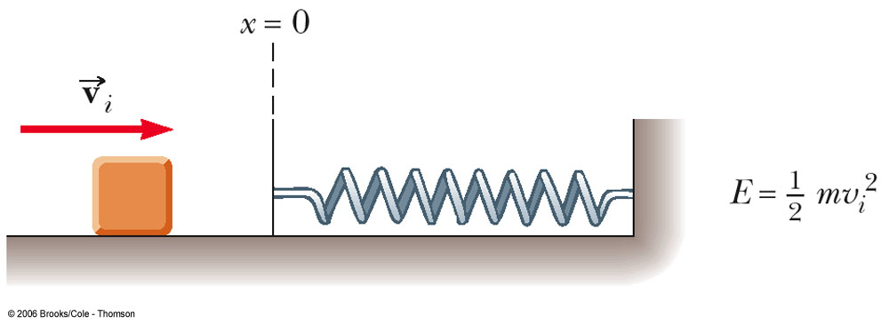
Energy Transformations
The block is moving on a frictionless surface
The total mechanical energy of the system is the kinetic energy of the block

Slide 16
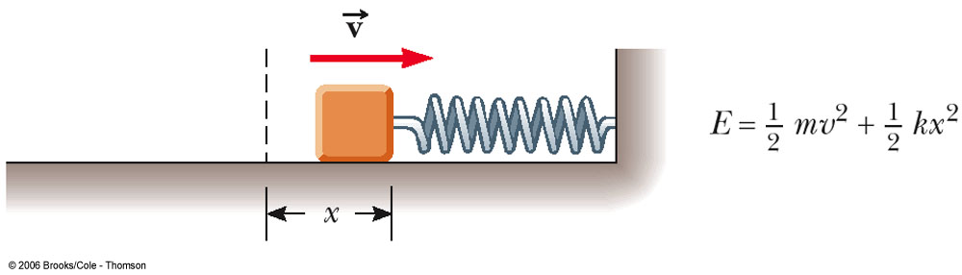
Energy Transformations, 2
The spring is partially compressed
The energy is shared between kinetic energy and elastic potential energy
The total mechanical energy is the sum of the kinetic energy and the elastic potential energy

Slide 17
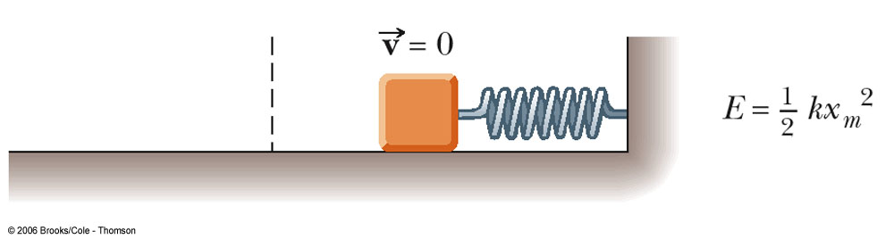
Energy Transformations, 3
The spring is now fully compressed
The block momentarily stops
The total mechanical energy is stored as elastic potential energy of the spring

Slide 18
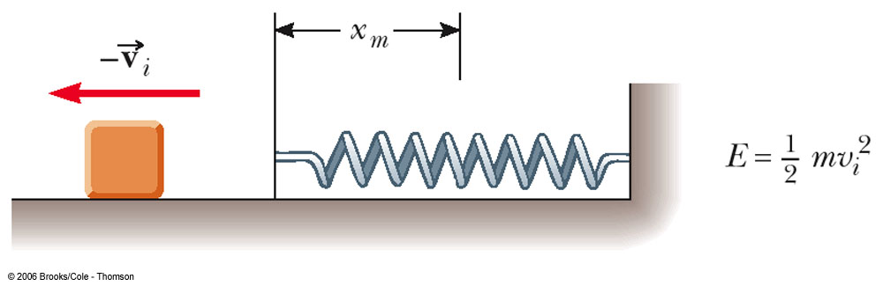
Energy Transformations, 4
When the block leaves the spring, the total mechanical energy is in the kinetic energy of the block
The spring force is conservative and the total energy of the system remains constant

Slide 19
Velocity as a Function of Position
Conservation of Energy allows a calculation of the velocity of the object at any position in its motion
Speed is a maximum at x = 0
Speed is zero at x = ±A
The ± indicates the object can be traveling in either direction

Slide 20
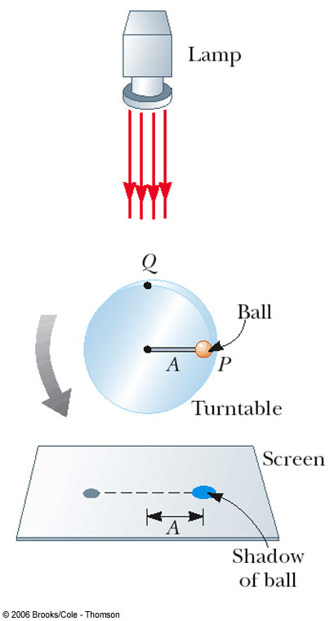
Simple Harmonic Motion and Uniform Circular Motion
A ball is attached to the rim of a turntable of radius A
The focus is on the shadow that the ball casts on the screen
When the turntable rotates with a constant angular speed, the shadow moves in simple harmonic motion

Slide 21
Period and Frequency from Circular Motion
Period
This gives the time required for an object of mass m attached to a spring of constant k to complete one cycle of its motion
Frequency
Units are cycles/second or Hertz, Hz

Slide 22
Angular Frequency
The angular frequency is related to the frequency
The frequency gives the number of cycles per second
The angular frequency gives the number of radians per second

Slide 23
Effective Spring Mass
A graph of T² versus m does not pass through the origin
The spring has mass and oscillates
For a cylindrical spring, the effective additional mass of a light spring is 1/3 the mass of the spring

Slide 24
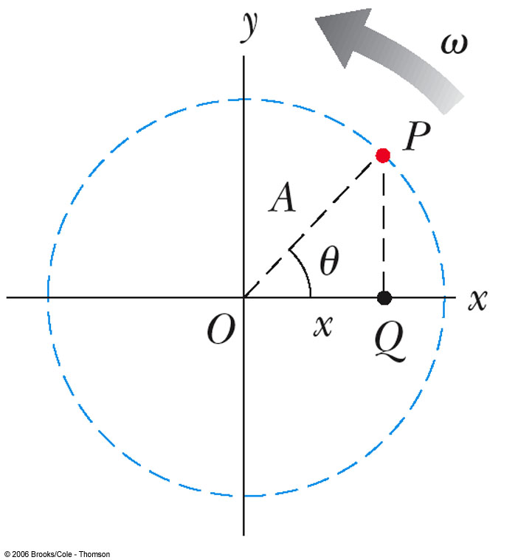
Motion as a Function of Time
Use of a reference circle allows a description of the motion
x = A cos (2πƒt)
x is the position at time t
x varies between +A and -A

Slide 25
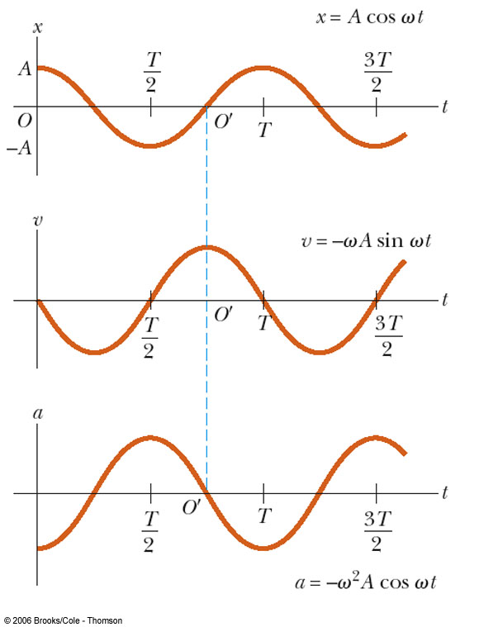
Graphical Representation of Motion
When x is a maximum or minimum, velocity is zero
When x is zero, the velocity is a maximum
When x is a maximum in the positive direction, a is a maximum in the negative direction

Slide 26
Motion Equations
Remember, the uniformly accelerated motion equations cannot be used
x = A cos (2πƒt) = A cos ωt
v = -2πƒA sin (2πƒt) = -A ω sin ωt
a = -4π²ƒ²A cos (2πƒt) =
-Aω² cos ωt

Slide 27
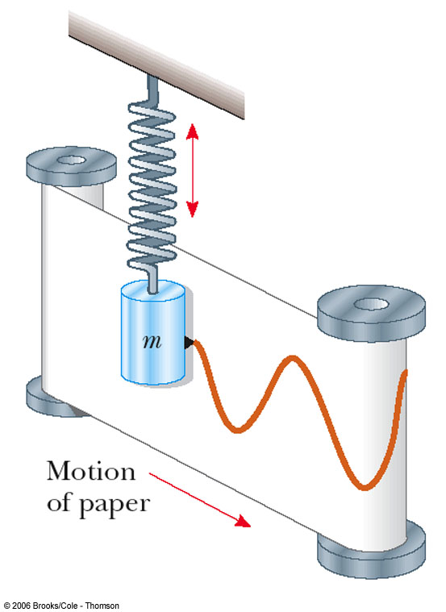
Verification of Sinusoidal Nature
This experiment shows the sinusoidal nature of simple harmonic motion
The spring mass system oscillates in simple harmonic motion
The attached pen traces out the sinusoidal motion

Slide 28
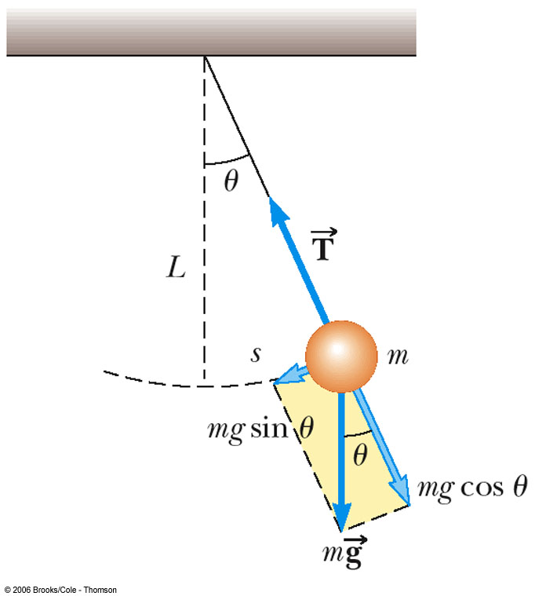
Simple Pendulum
The simple pendulum is another example of simple harmonic motion
The force is the component of the weight tangent to the path of motion
F_{t} = - m g sin θ

Slide 29
Simple Pendulum, cont
In general, the motion of a pendulum is not simple harmonic
However, for small angles, it becomes simple harmonic
In general, angles < 15° are small enough
sin θ = θ
F_{t} = - m g θ
This force obeys Hooke’s Law

Slide 30
Period of Simple Pendulum
This shows that the period is independent of the amplitude
The period depends on the length of the pendulum and the acceleration of gravity at the location of the pendulum

Slide 31
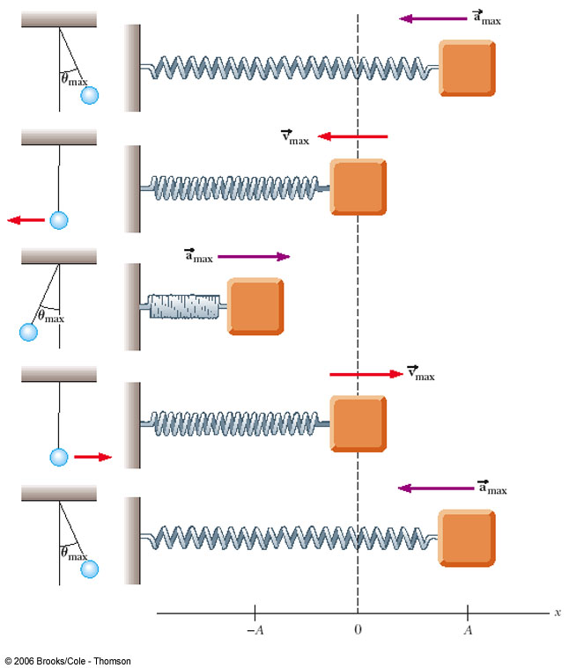
Simple Pendulum Compared to a Spring-Mass System

Slide 32
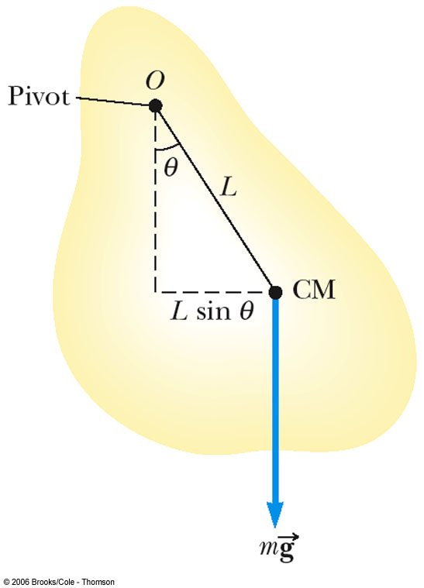
Physical Pendulum
A physical pendulum can be made from an object of any shape
The center of mass oscillates along a circular arc

Slide 33
Period of a Physical Pendulum
The period of a physical pendulum is given by
I is the object’s moment of inertia
m is the object’s mass
For a simple pendulum, I = mL² and the equation becomes that of the simple pendulum as seen before

Slide 34
Damped Oscillations
Only ideal systems oscillate indefinitely
In real systems, friction retards the motion
Friction reduces the total energy of the system and the oscillation is said to be damped

Slide 35
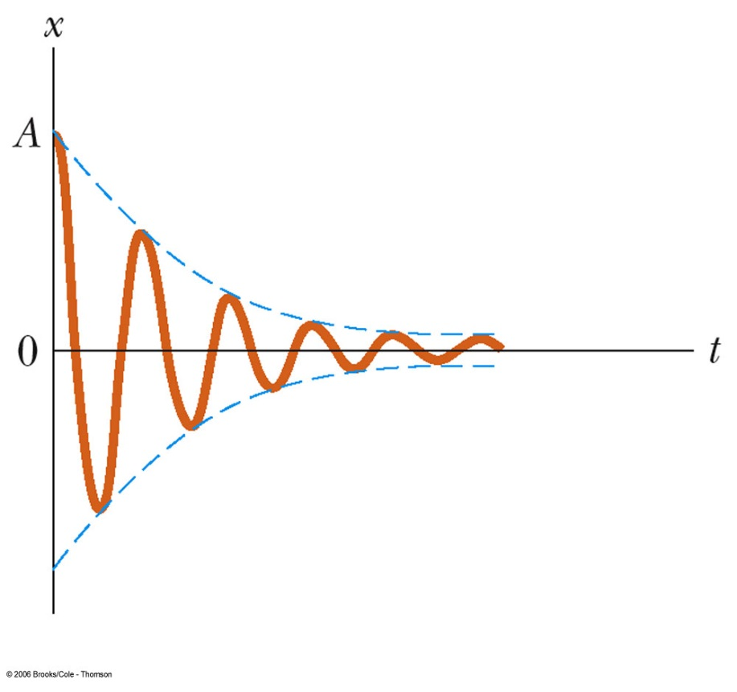
Damped Oscillations, cont.
Damped motion varies depending on the fluid used
With a low viscosity fluid, the vibrating motion is preserved, but the amplitude of vibration decreases in time and the motion ultimately ceases
This is known as underdamped oscillation

Slide 36
More Types of Damping
With a higher viscosity, the object returns rapidly to equilibrium after it is released and does not oscillate
The system is said to be critically damped
With an even higher viscosity, the piston returns to equilibrium without passing through the equilibrium position, but the time required is longer
This is said to be over damped

Slide 37
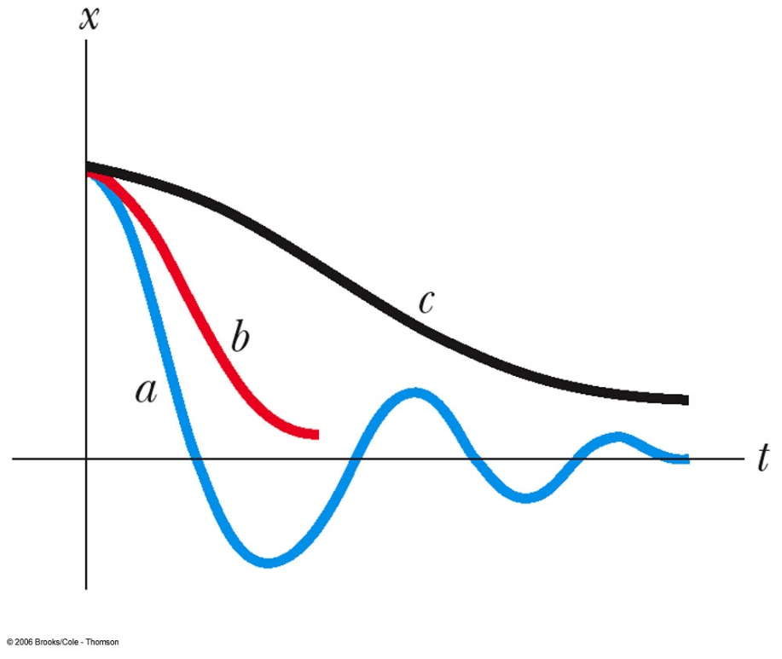
Graphs of Damped Oscillators
Plot a shows an underdamped oscillator
Plot b shows a critically damped oscillator
Plot c shows an overdamped oscillator

Slide 38
Wave Motion
A wave is the motion of a disturbance
Mechanical waves require
Some source of disturbance
A medium that can be disturbed
Some physical connection between or mechanism though which adjacent portions of the medium influence each other
All waves carry energy and momentum

Slide 39
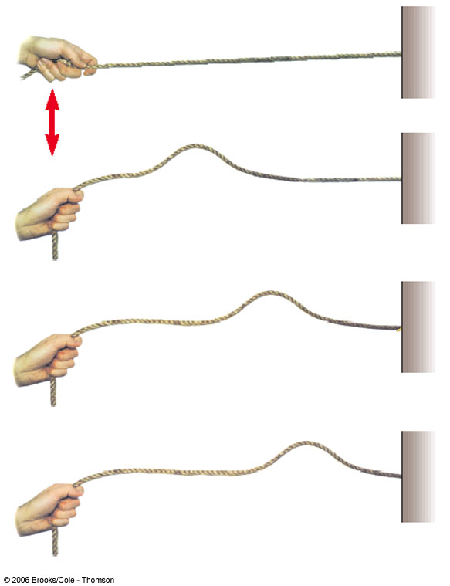
Types of Waves – Traveling Waves
Flip one end of a long rope that is under tension and fixed at one end
The pulse travels to the right with a definite speed
A disturbance of this type is called a traveling wave

Slide 40
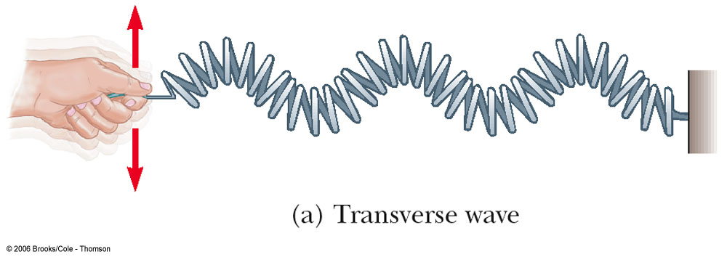
Types of Waves – Transverse
In a transverse wave, each element that is disturbed moves in a direction perpendicular to the wave motion

Slide 41
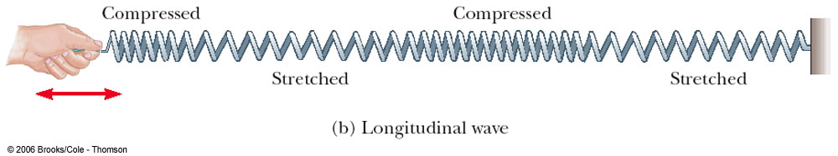
Types of Waves – Longitudinal
In a longitudinal wave, the elements of the medium undergo displacements parallel to the motion of the wave
A longitudinal wave is also called a compression wave

Slide 42
Other Types of Waves
Waves may be a combination of transverse and longitudinal
A soliton consists of a solitary wave front that propagates in isolation
First studied by John Scott Russell in 1849
Now used widely to model physical phenomena

Slide 43
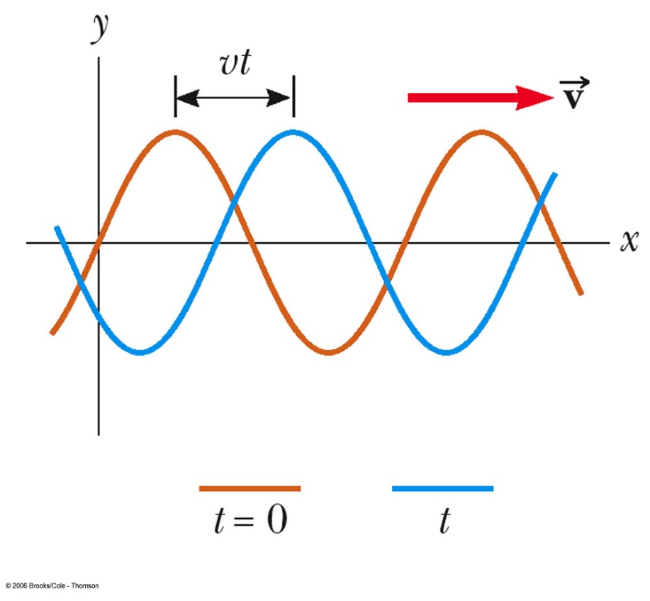
Waveform – A Picture of a Wave
The brown curve is a “snapshot” of the wave at some instant in time
The blue curve is later in time
The high points are crests of the wave
The low points are troughs of the wave

Slide 44
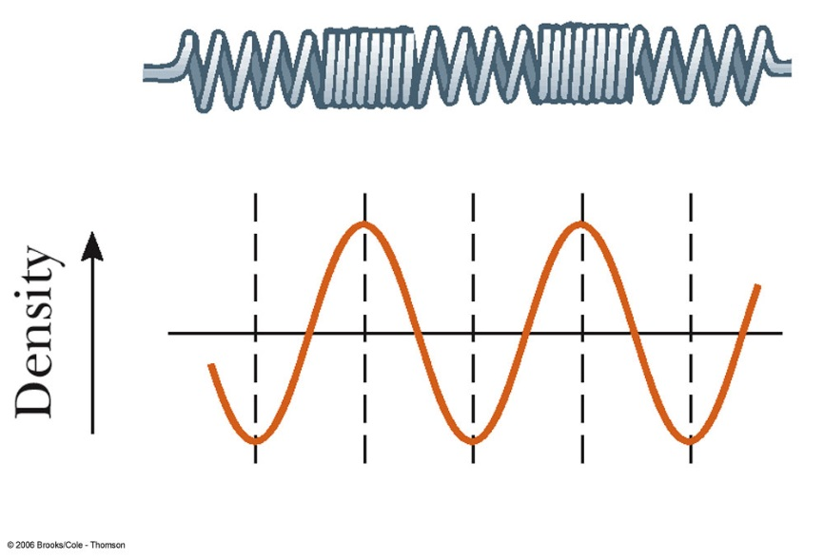
Longitudinal Wave Represented as a Sine Curve
A longitudinal wave can also be represented as a sine curve
Compressions correspond to crests and stretches correspond to troughs
Also called density waves or pressure waves

Slide 45
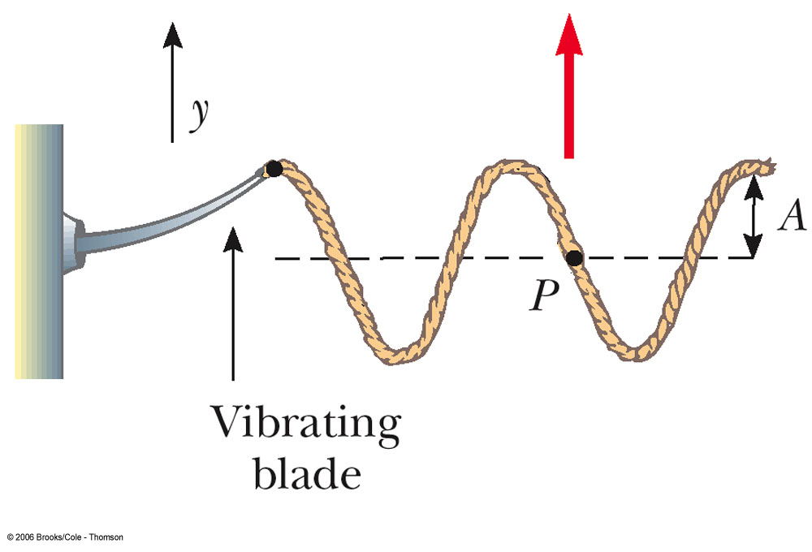
Description of a Wave
A steady stream of pulses on a very long string produces a continuous wave
The blade oscillates in simple harmonic motion
Each small segment of the string, such as P, oscillates with simple harmonic motion

Slide 46
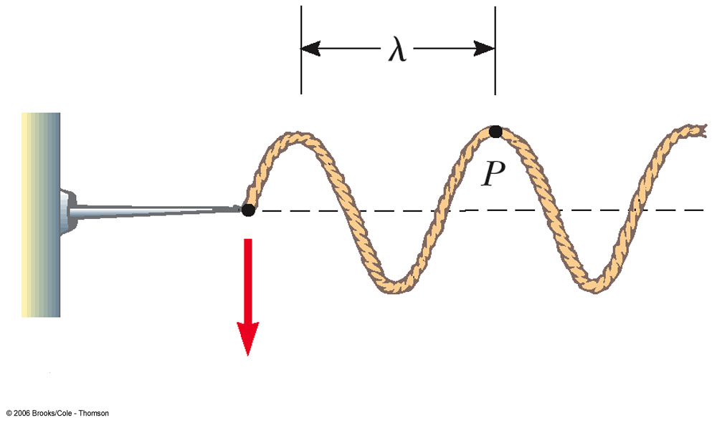
Amplitude and Wavelength
Amplitude is the maximum displacement of string above the equilibrium position
Wavelength, λ, is the distance between two successive points that behave identically

Slide 47
Speed of a Wave
v = ƒ λ
Is derived from the basic speed equation of distance/time
This is a general equation that can be applied to many types of waves

Slide 48
Speed of a Wave on a String
The speed on a wave stretched under some tension, F
μ is called the linear density
The speed depends only upon the properties of the medium through which the disturbance travels

Slide 49
Interference of Waves
Two traveling waves can meet and pass through each other without being destroyed or even altered
Waves obey the Superposition Principle
If two or more traveling waves are moving through a medium, the resulting wave is found by adding together the displacements of the individual waves point by point
Actually only true for waves with small amplitudes

Slide 50
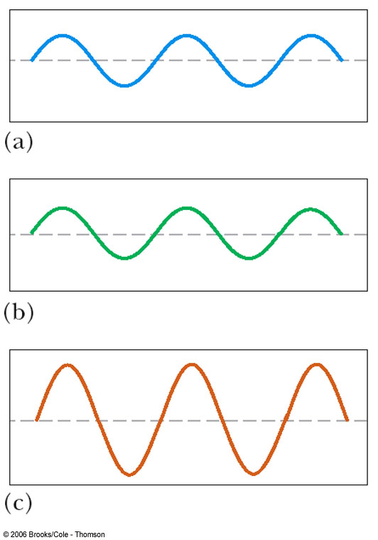
Constructive Interference
Two waves, a and b, have the same frequency and amplitude
Are in phase
The combined wave, c, has the same frequency and a greater amplitude

Slide 51
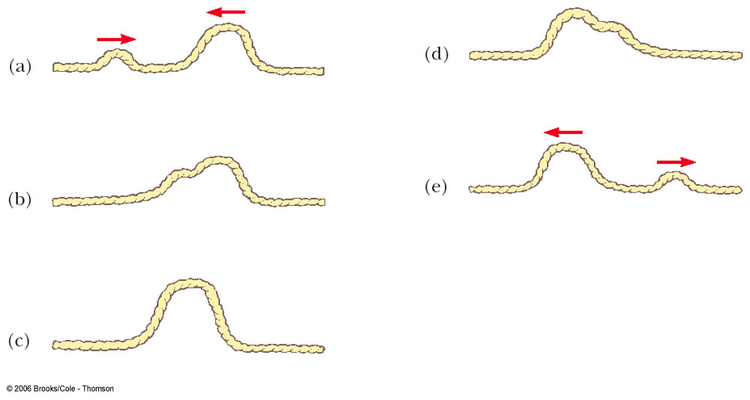
Constructive Interference in a String
Two pulses are traveling in opposite directions
The net displacement when they overlap is the sum of the displacements of the pulses
Note that the pulses are unchanged after the interference

Slide 52
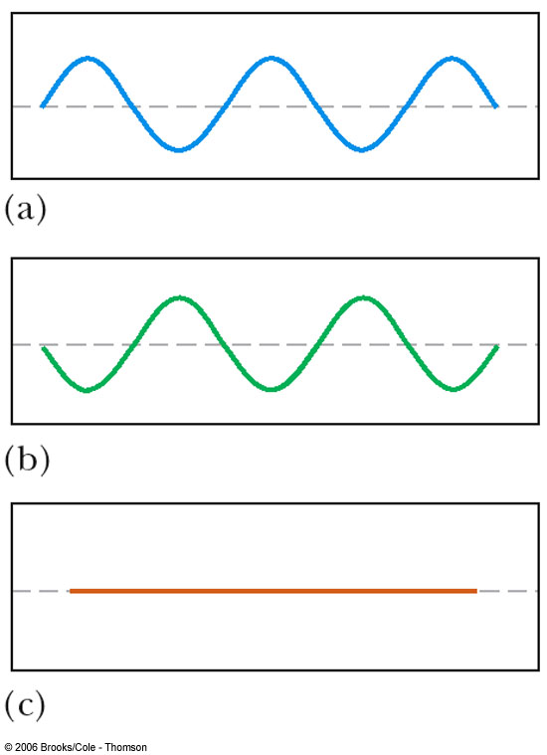
Destructive Interference
Two waves, a and b, have the same amplitude and frequency
They are 180° out of phase
When they combine, the waveforms cancel

Slide 53
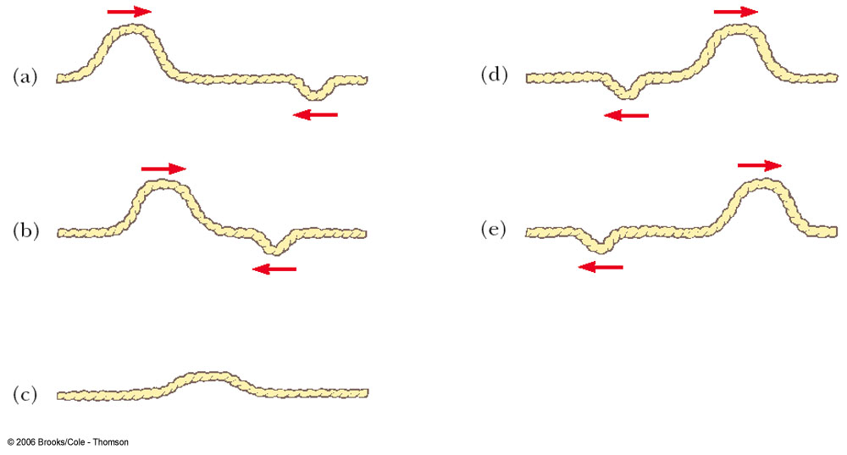
Destructive Interference in a String
Two pulses are traveling in opposite directions
The net displacement when they overlap is decreased since the displacements of the pulses subtract
Note that the pulses are unchanged after the interference

Slide 54
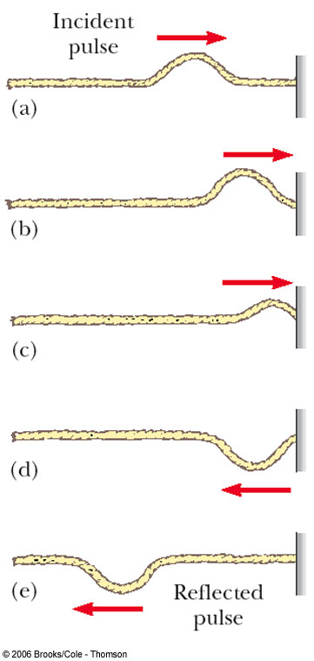
Reflection of Waves – Fixed End
Whenever a traveling wave reaches a boundary, some or all of the wave is reflected
When it is reflected from a fixed end, the wave is inverted
The shape remains the same

Slide 55
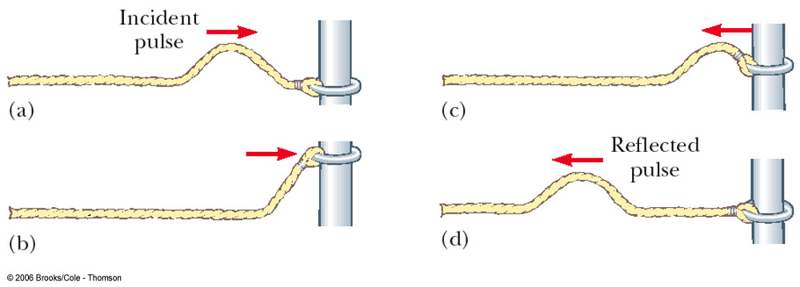
Reflected Wave – Free End
When a traveling wave reaches a boundary, all or part of it is reflected
When reflected from a free end, the pulse is not inverted

