Slide 1
Chapter 14
Sound

Slide 2
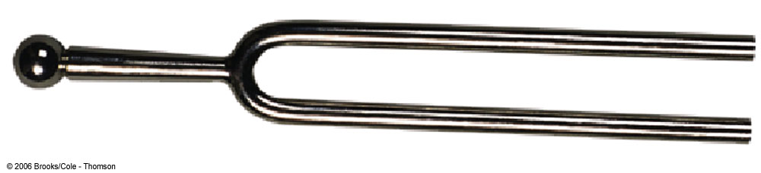
Producing a Sound Wave
Sound waves are longitudinal waves traveling through a medium
A tuning fork can be used as an example of producing a sound wave

Slide 3
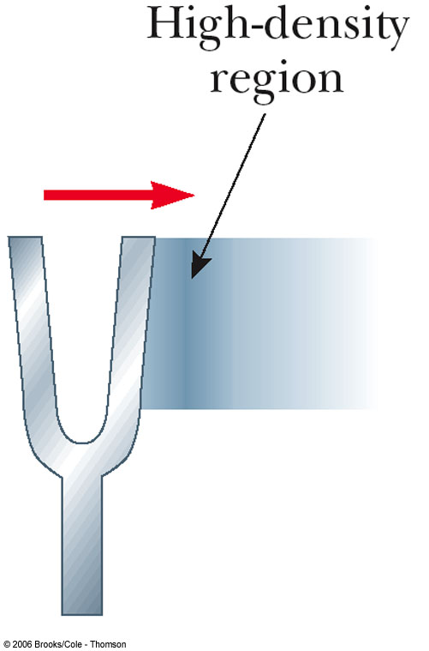
Using a Tuning Fork to Produce a Sound Wave
A tuning fork will produce a pure musical note
As the tines vibrate, they disturb the air near them
As the tine swings to the right, it forces the air molecules near it closer together
This produces a high density area in the air
This is an area of compression

Slide 4
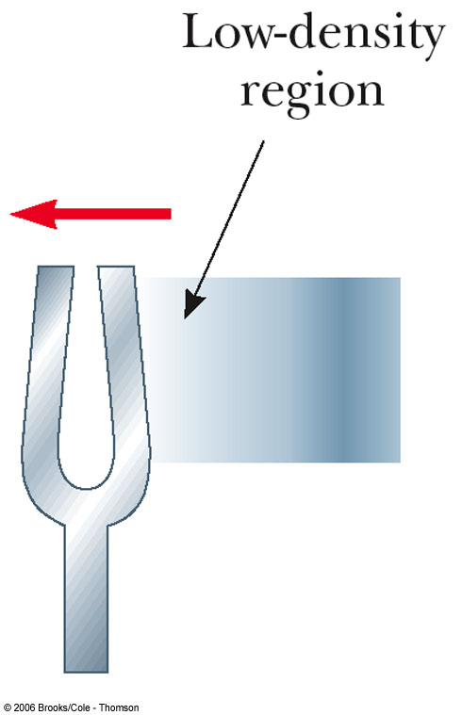
Using a Tuning Fork, cont.
As the tine moves toward the left, the air molecules to the right of the tine spread out
This produces an area of low density
This area is called a rarefaction

Slide 5
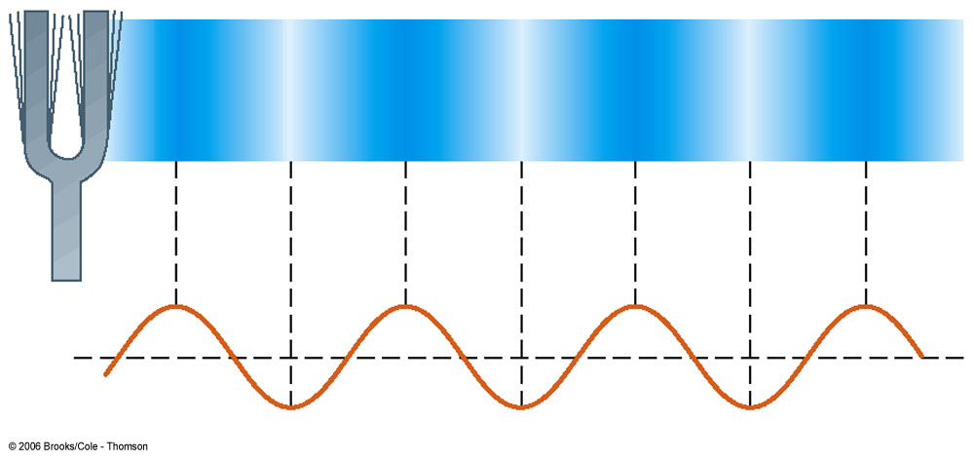
Using a Tuning Fork, final
As the tuning fork continues to vibrate, a succession of compressions and rarefactions spread out from the fork
A sinusoidal curve can be used to represent the longitudinal wave
Crests correspond to compressions and troughs to rarefactions

Slide 6
Categories of Sound Waves
Audible waves
Lay within the normal range of hearing of the human ear
Normally between 20 Hz to 20,000 Hz
Infrasonic waves
Frequencies are below the audible range
Earthquakes are an example
Ultrasonic waves
Frequencies are above the audible range
Dog whistles are an example

Slide 7
Applications of Ultrasound
Can be used to produce images of small objects
Widely used as a diagnostic and treatment tool in medicine
Ultrasonic flow meter to measure blood flow
May use piezoelectric devices that transform electrical energy into mechanical energy
Reversible: mechanical to electrical
Ultrasounds to observe babies in the womb
Cavitron Ultrasonic Surgical Aspirator (CUSA) used to surgically remove brain tumors
Ultrasonic ranging unit for cameras

Slide 8
Speed of Sound in a Liquid
In a liquid, the speed depends on the liquid’s compressibility and inertia
B is the Bulk Modulus of the liquid
ρ is the density of the liquid
Compares with the equation for a transverse wave on a string

Slide 9
Speed of Sound in a Solid Rod
The speed depends on the rod’s compressibility and inertial properties
Y is the Young’s Modulus of the material
ρ is the density of the material

Slide 10
Speed of Sound, General
The speed of sound is higher in solids than in gases
The molecules in a solid interact more strongly
The speed is slower in liquids than in solids
Liquids are more compressible

Slide 11
Speed of Sound in Air
331 m/s is the speed of sound at 0° C
T is the absolute temperature

Slide 12
Intensity of Sound Waves
The average intensity of a wave is the rate at which the energy flows through a unit area, A, oriented perpendicular to the direction of travel of the wave
The rate of energy transfer is the power
Units are W/m²

Slide 13
Various Intensities of Sound
Threshold of hearing
Faintest sound most humans can hear
About 1 x 10⁻¹² W/m²
Threshold of pain
Loudest sound most humans can tolerate
About 1 W/m²
The ear is a very sensitive detector of sound waves
It can detect pressure fluctuations as small as about 3 parts in 10¹⁰

Slide 14
Intensity Level of Sound Waves
The sensation of loudness is logarithmic in the human hear
β is the intensity level or the decibel level of the sound
I_{o} is the threshold of hearing

Slide 15
Various Intensity Levels
Threshold of hearing is 0 dB
Threshold of pain is 120 dB
Jet airplanes are about 150 dB
Table 14.2 lists intensity levels of various sounds
Multiplying a given intensity by 10 adds 10 dB to the intensity level

Slide 16
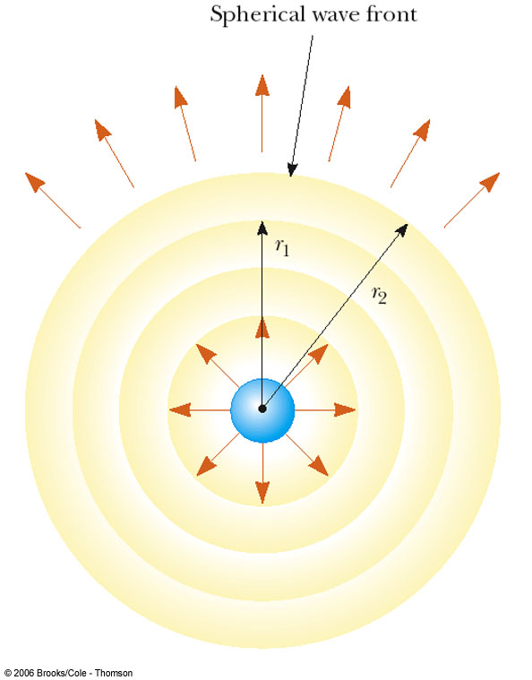
Spherical Waves
A spherical wave propagates radially outward from the oscillating sphere
The energy propagates equally in all directions
The intensity is

Slide 17
Intensity of a Point Source
Since the intensity varies as 1/r², this is an inverse square relationship
The average power is the same through any spherical surface centered on the source
To compare intensities at two locations, the inverse square relationship can be used

Slide 18
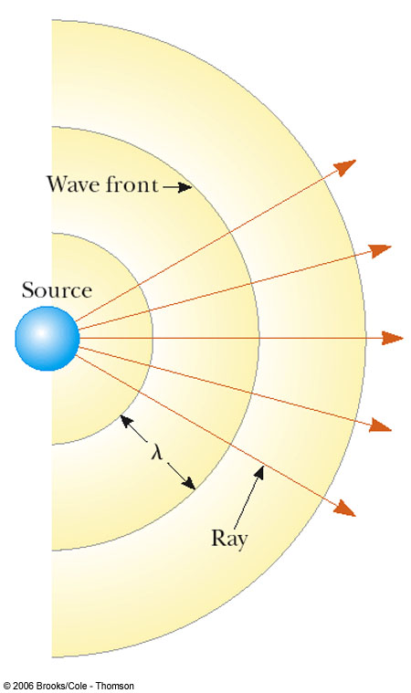
Representations of Waves
Wave fronts are the concentric arcs
The distance between successive wave fronts is the wavelength
Rays are the radial lines pointing out from the source and perpendicular to the wave fronts

Slide 19
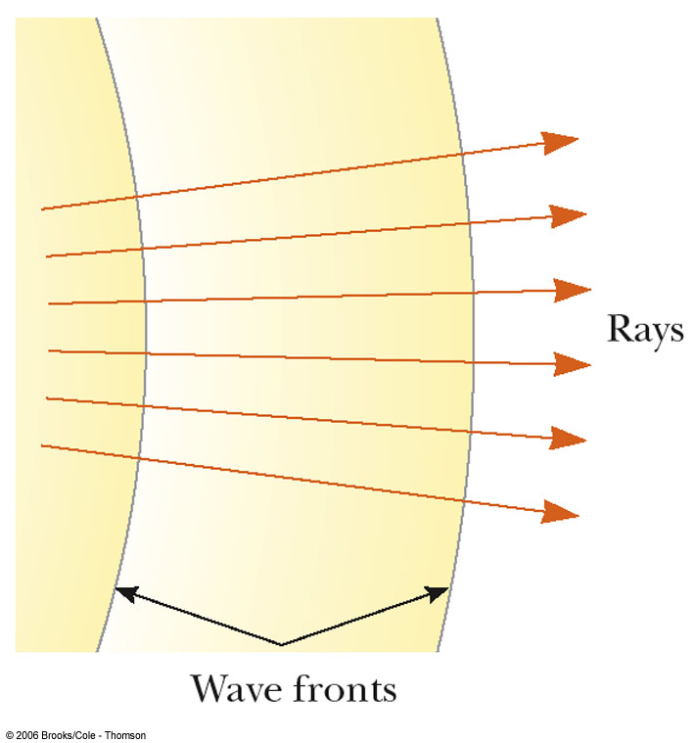
Plane Wave
Far away from the source, the wave fronts are nearly parallel planes
The rays are nearly parallel lines
A small segment of the wave front is approximately a plane wave

Slide 20
Doppler Effect
A Doppler effect is experienced whenever there is relative motion between a source of waves and an observer.
When the source and the observer are moving toward each other, the observer hears a higher frequency
When the source and the observer are moving away from each other, the observer hears a lower frequency

Slide 21
Doppler Effect, cont.
Although the Doppler Effect is commonly experienced with sound waves, it is a phenomena common to all waves
Assumptions:
The air is stationary
All speed measurements are made relative to the stationary medium

Slide 22
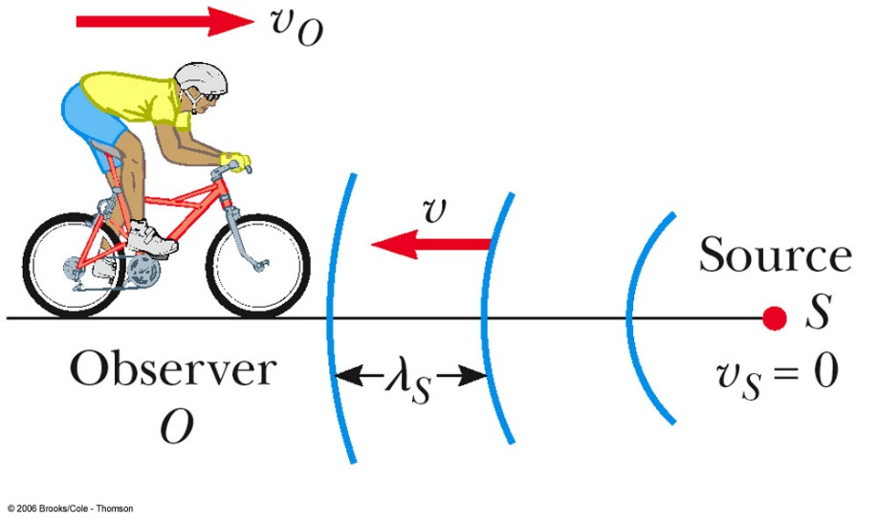
Doppler Effect, Case 1 (Observer Toward Source)
An observer is moving toward a stationary source
Due to his movement, the observer detects an additional number of wave fronts
The frequency heard is increased

Slide 23
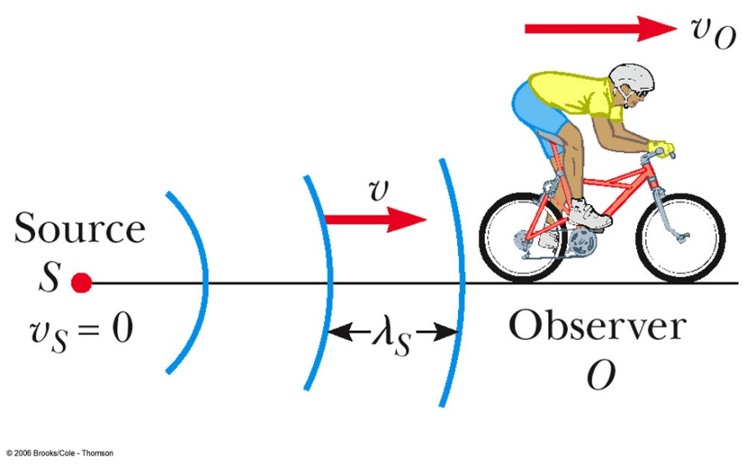
Doppler Effect, Case 1 (Observer Away from Source)
An observer is moving away from a stationary source
The observer detects fewer wave fronts per second
The frequency appears lower

Slide 24
Doppler Effect, Case 1 – Equation
When moving toward the stationary source, the observed frequency is
When moving away from the stationary source, substitute –v_{o} for v_{o} in the above equation

Slide 25
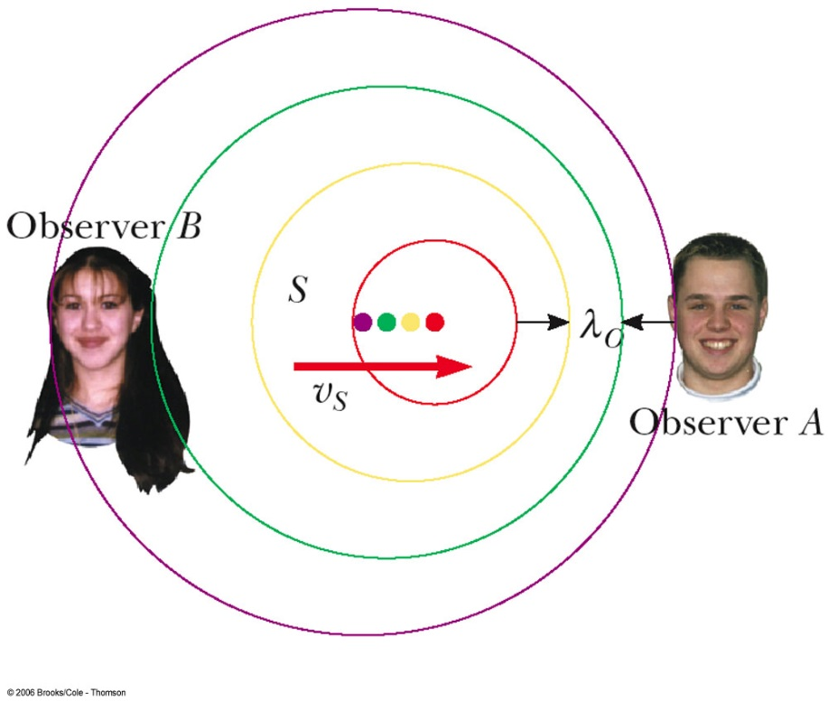
Doppler Effect, Case 2 (Source in Motion)
As the source moves toward the observer (A), the wavelength appears shorter and the frequency increases
As the source moves away from the observer (B), the wavelength appears longer and the frequency appears to be lower

Slide 26
Doppler Effect, Source Moving – Equation
Use the –v_{s} when the source is moving toward the observer and +v_{s} when the source is moving away from the observer

Slide 27
Doppler Effect, General Case
Both the source and the observer could be moving
Use positive values of v_{o} and v_{s} if the motion is toward
Frequency appears higher
Use negative values of v_{o} and v_{s} if the motion is away
Frequency appears lower

Slide 28
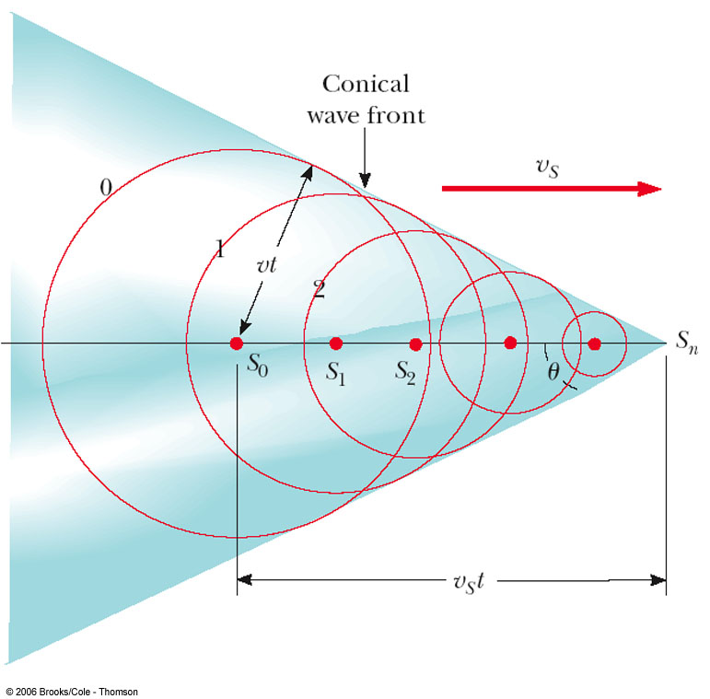
Shock Waves
A shock wave results when the source velocity exceeds the speed of the wave itself
The circles represent the wave fronts emitted by the source

Slide 29
Shock Waves, cont
Tangent lines are drawn from S_{n} to the wave front centered on S_{o}
The angle between one of these tangent lines and the direction of travel is given by sin θ = v / v_{s}
The ratio v/v_{s} is called the Mach Number
The conical wave front is the shock wave

Slide 30
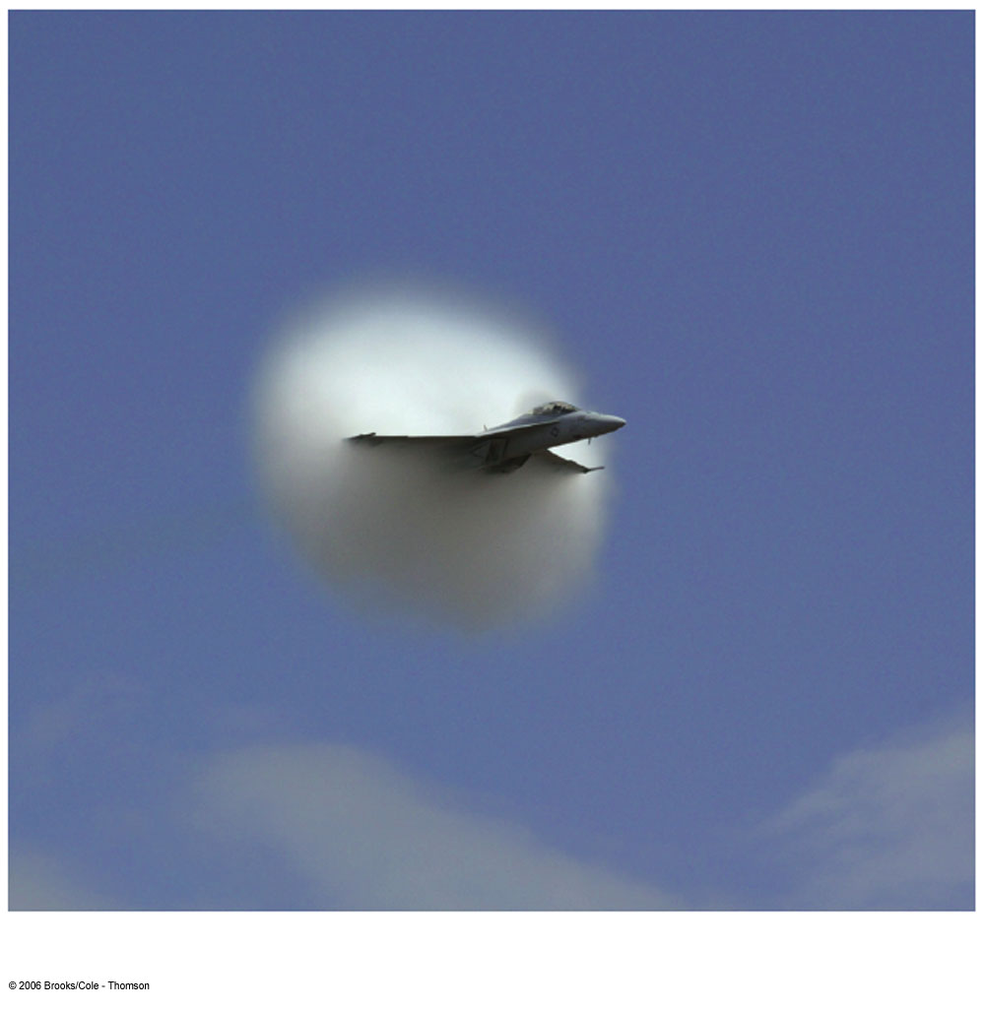
Shock Waves, final
Shock waves carry energy concentrated on the surface of the cone, with correspondingly great pressure variations
A jet produces a shock wave seen as a fog

Slide 31
Interference of Sound Waves
Sound waves interfere
Constructive interference occurs when the path difference between two waves’ motion is zero or some integer multiple of wavelengths
path difference = nλ
Destructive interference occurs when the path difference between two waves’ motion is an odd half wavelength
path difference = (n + ½)λ

Slide 32
Standing Waves
When a traveling wave reflects back on itself, it creates traveling waves in both directions
The wave and its reflection interfere according to the superposition principle
With exactly the right frequency, the wave will appear to stand still
This is called a standing wave

Slide 33
Standing Waves, cont
A node occurs where the two traveling waves have the same magnitude of displacement, but the displacements are in opposite directions
Net displacement is zero at that point
The distance between two nodes is ½λ
An antinode occurs where the standing wave vibrates at maximum amplitude

Slide 34
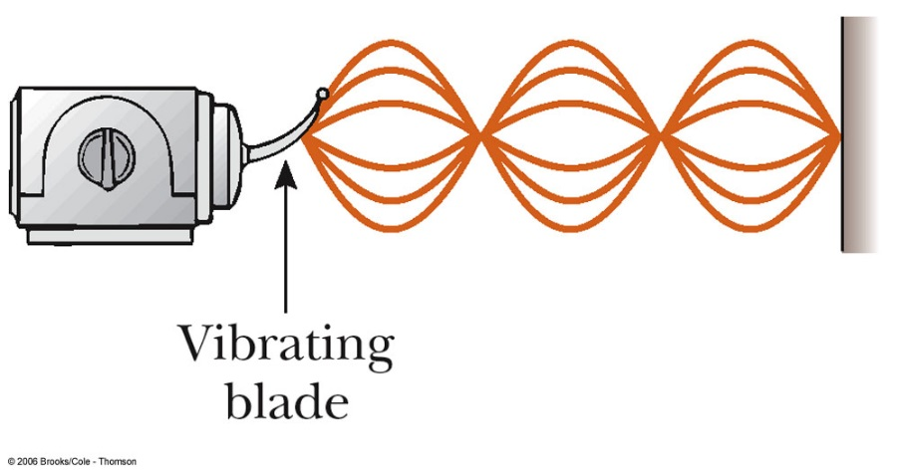
Standing Waves on a String
Nodes must occur at the ends of the string because these points are fixed

Slide 35
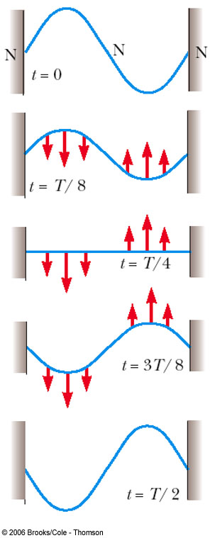
Standing Waves, cont.
The pink arrows indicate the direction of motion of the parts of the string
All points on the string oscillate together vertically with the same frequency, but different points have different amplitudes of motion

Slide 36
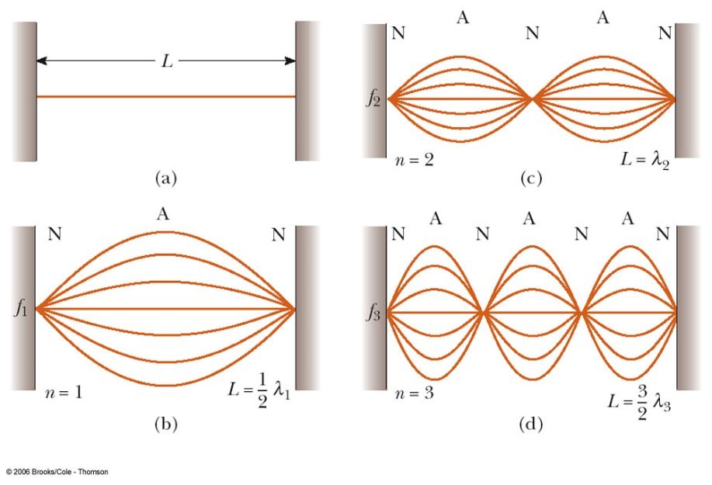
Standing Waves on a String, final
The lowest frequency of vibration (b) is called the fundamental frequency

Slide 37
Standing Waves on a String – Frequencies
ƒ₁, ƒ₂, ƒ₃ form a harmonic series
ƒ₁ is the fundamental and also the first harmonic
ƒ₂ is the second harmonic
Waves in the string that are not in the harmonic series are quickly damped out
In effect, when the string is disturbed, it “selects” the standing wave frequencies

Slide 38
Forced Vibrations
A system with a driving force will force a vibration at its frequency
When the frequency of the driving force equals the natural frequency of the system, the system is said to be in resonance

Slide 39
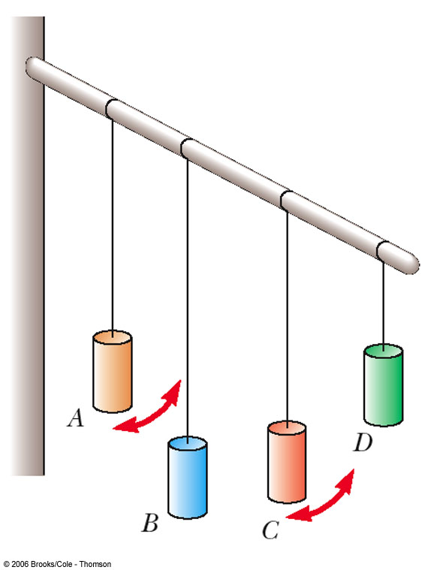
An Example of Resonance
Pendulum A is set in motion
The others begin to vibrate due to the vibrations in the flexible beam
Pendulum C oscillates at the greatest amplitude since its length, and therefore frequency, matches that of A

Slide 40
Other Examples of Resonance
Child being pushed on a swing
Shattering glasses
Tacoma Narrows Bridge collapse due to oscillations by the wind
Upper deck of the Nimitz Freeway collapse due to the Loma Prieta earthquake

Slide 41
Standing Waves in Air Columns
If one end of the air column is closed, a node must exist at this end since the movement of the air is restricted
If the end is open, the elements of the air have complete freedom of movement and an antinode exists

Slide 42
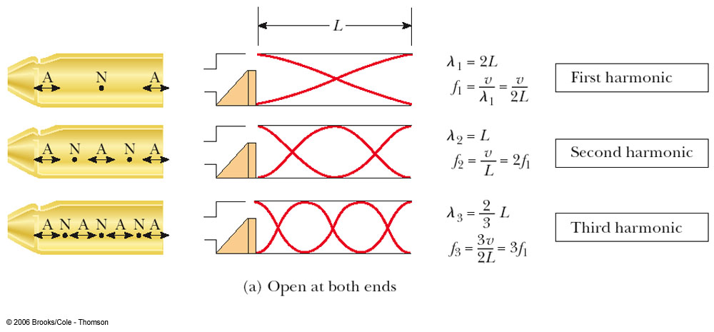
Tube Open at Both Ends

Slide 43
Resonance in Air Column Open at Both Ends
In a pipe open at both ends, the natural frequency of vibration forms a series whose harmonics are equal to integral multiples of the fundamental frequency

Slide 44
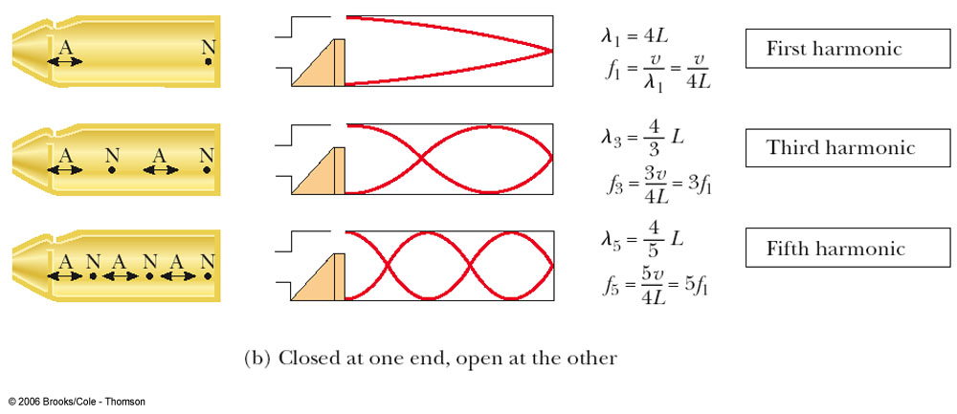
Tube Closed at One End

Slide 45
Resonance in an Air Column Closed at One End
The closed end must be a node
The open end is an antinode
There are no even multiples of the fundamental harmonic

Slide 46
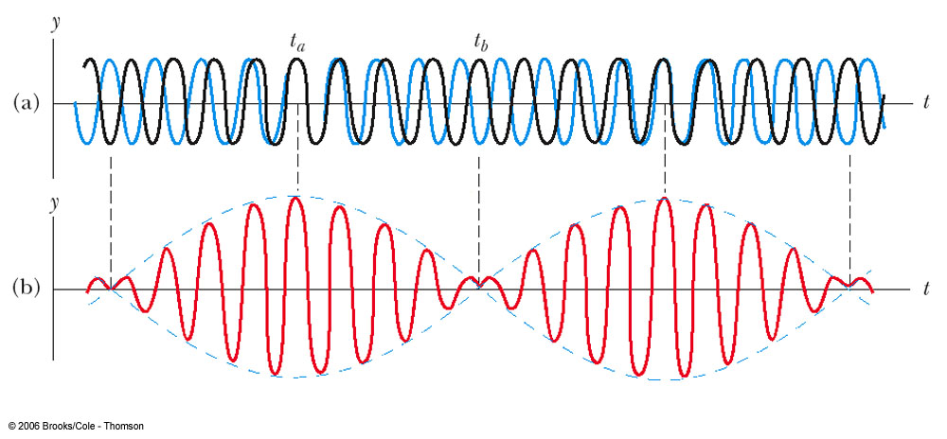
Beats
Beats are alternations in loudness, due to interference
Waves have slightly different frequencies and the time between constructive and destructive interference alternates
The beat frequency equals the difference in frequency between the two sources:

Slide 47
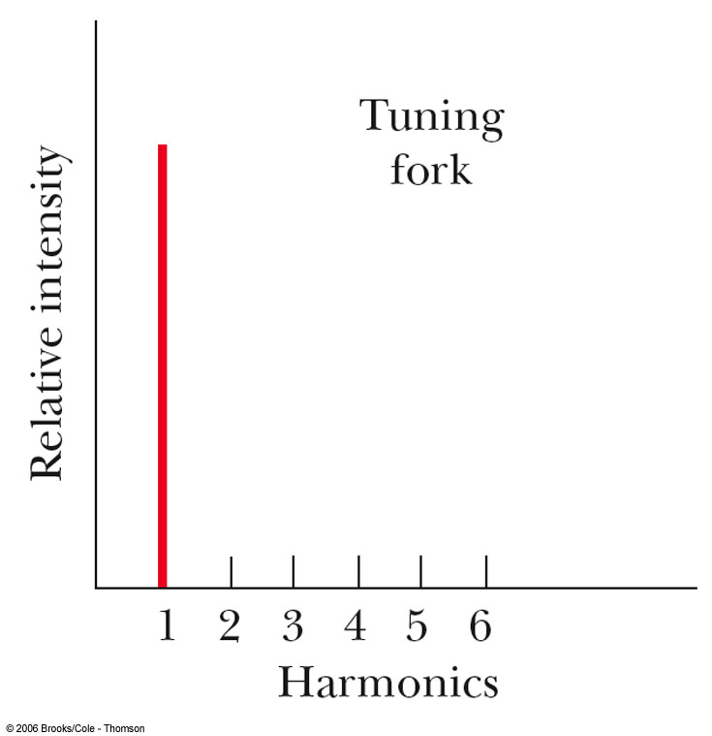
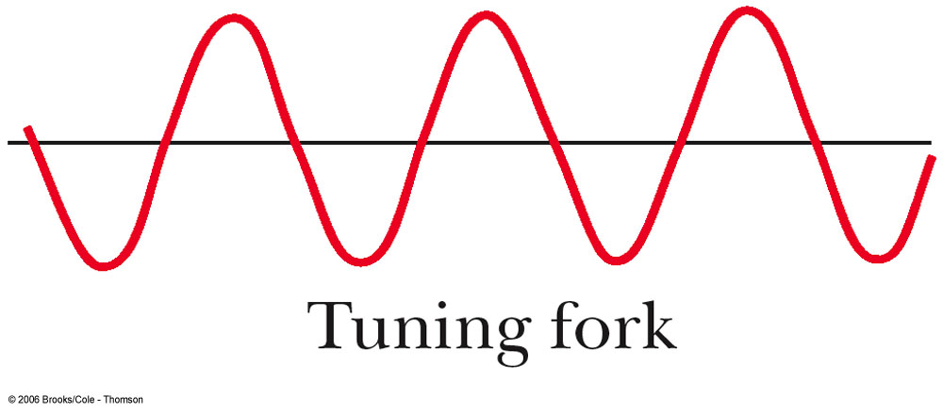
Quality of Sound – Tuning Fork
Tuning fork produces only the fundamental frequency

Slide 48
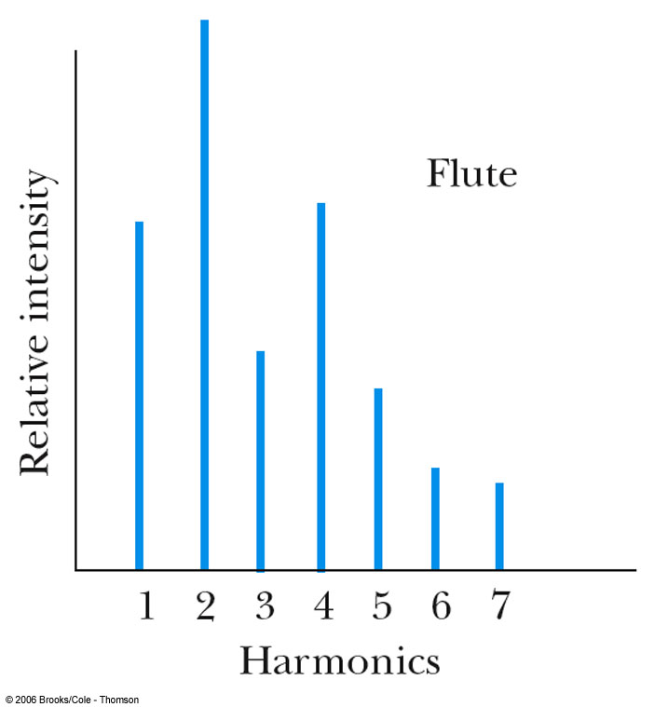
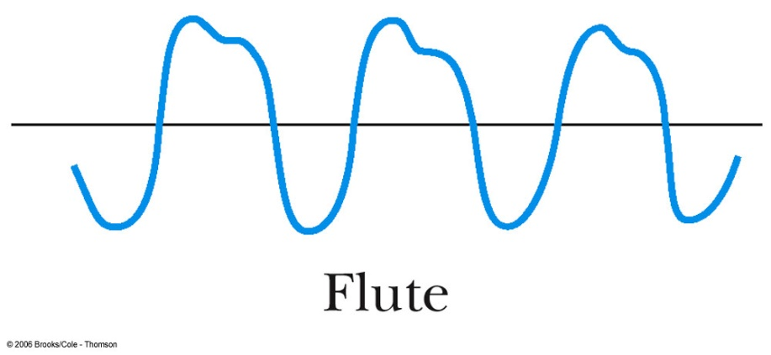
Quality of Sound – Flute
The same note played on a flute sounds differently
The second harmonic is very strong
The fourth harmonic is close in strength to the first

Slide 49
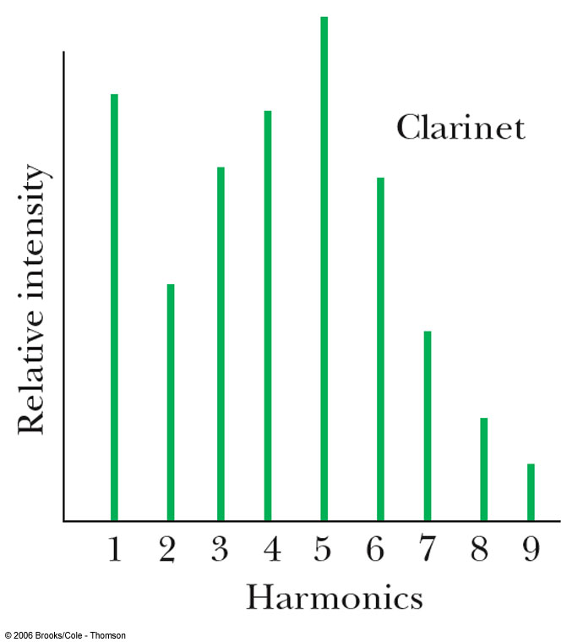
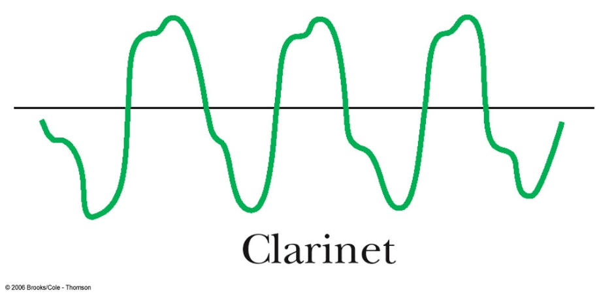
Quality of Sound – Clarinet
The fifth harmonic is very strong
The first and fourth harmonics are very similar, with the third being close to them

Slide 50
Timbre
In music, the characteristic sound of any instrument is referred to as the quality of sound, or the timbre, of the sound
The quality depends on the mixture of harmonics in the sound

Slide 51
Pitch
Pitch is related mainly, although not completely, to the frequency of the sound
Pitch is not a physical property of the sound
Frequency is the stimulus and pitch is the response
It is a psychological reaction that allows humans to place the sound on a scale

Slide 52
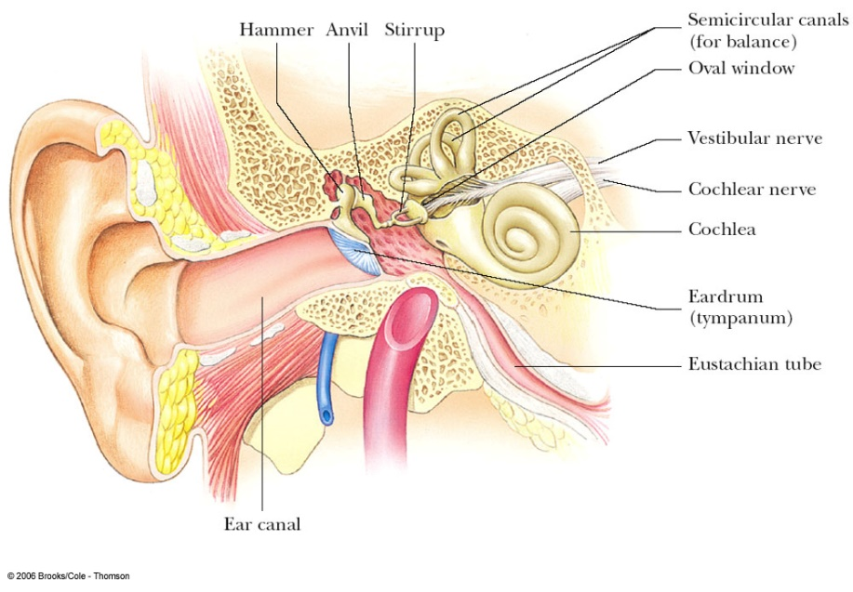
The Ear
The outer ear consists of the ear canal that terminates at the eardrum
Just behind the eardrum is the middle ear
The bones in the middle ear transmit sounds to the inner ear

Slide 53
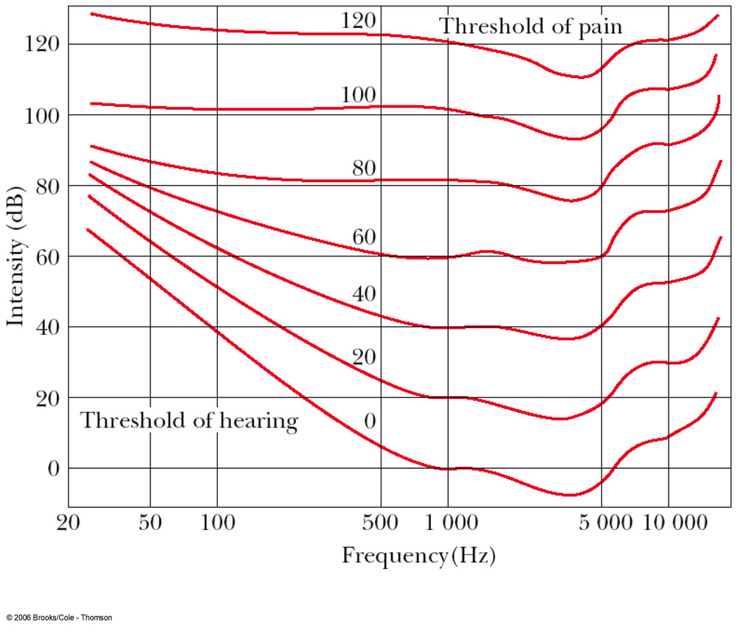
Frequency Response Curves
Bottom curve is the threshold of hearing
Threshold of hearing is strongly dependent on frequency
Easiest frequency to hear is about 3300 Hz
When the sound is loud (top curve, threshold of pain) all frequencies can be heard equally well

