Slide 1
Chapter 15
Electric Forces and
Electric Fields

Slide 2
Properties of Electric Charges
Two types of charges exist
They are called positive and negative.
Like charges repel and unlike charges attract one another
Nature’s basic carrier of positive charge is the proton
Protons do not move from one material to another because they are held firmly in the nucleus

Slide 3
More Properties of Charge
Nature’s basic carrier of negative charge is the electron
Gaining or losing electrons is how an object becomes charged
Electric charge is always conserved
Charge is not created, only exchanged
Objects become charged because negative charge is transferred from one object to another.

Slide 4
Properties of Charge, final
Charge is quantized
All charge is a multiple of a fundamental unit of charge, symbolized by e.
Electrons have a charge of –e
Protons have a charge of +e
The SI unit of charge is the Coulomb (C)
e = 1.6 x 10⁻¹⁹ C

Slide 5
Conductors
Conductors are materials in which the electric charges move freely in response to an electric force
Copper, aluminum and silver are good conductors
When a conductor is charged in a small region, the charge readily distributes itself over the entire surface of the material

Slide 6
Insulators
Insulators are materials in which electric charges do not move freely
Glass and rubber are examples of insulators
When insulators are charged by rubbing, only the rubbed area becomes charged
There is no tendency for the charge to move into other regions of the material

Slide 7
Semiconductors
The characteristics of semiconductors are between those of insulators and conductors
Silicon and germanium are examples of semiconductors

Slide 8
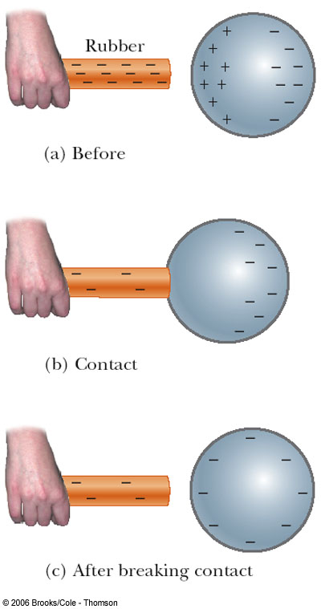
Charging by Conduction
A charged object (the rod) is placed in contact with another object (the sphere)
Some electrons on the rod can move to the sphere
When the rod is removed, the sphere is left with a charge
The object being charged is always left with a charge having the same sign as the object doing the charging

Slide 9
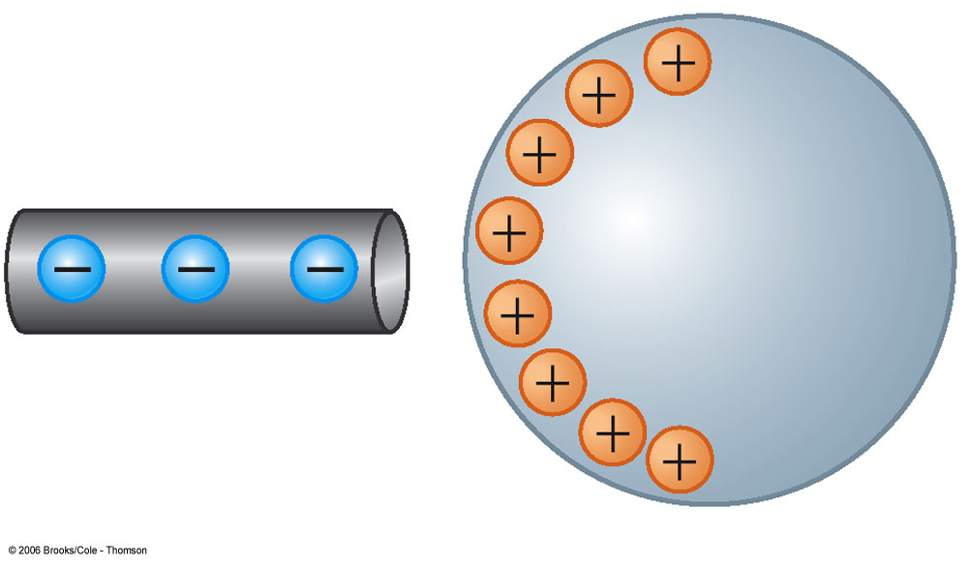
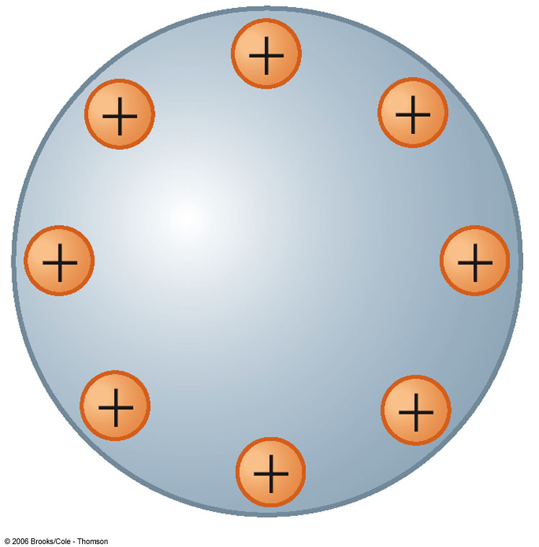
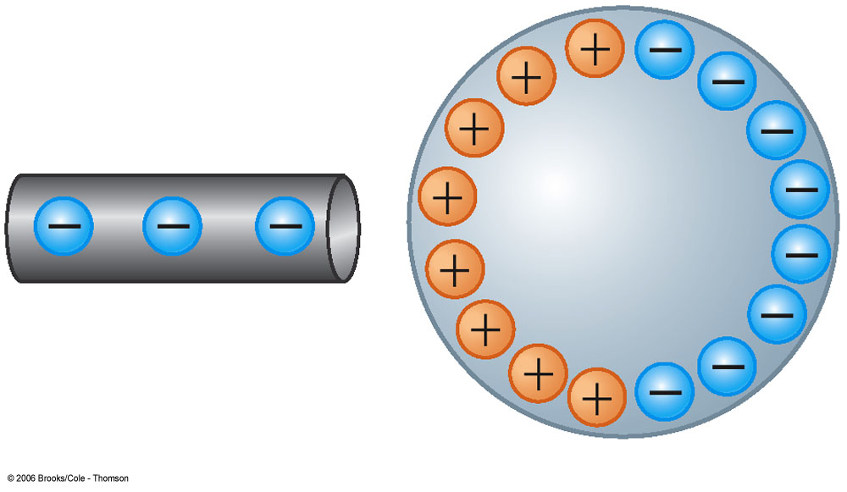
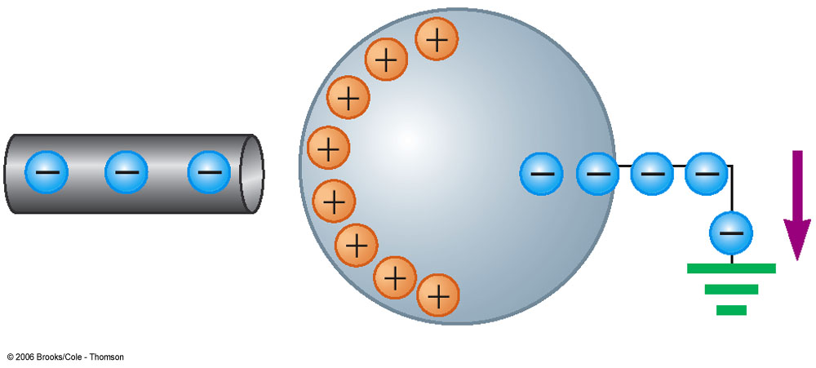
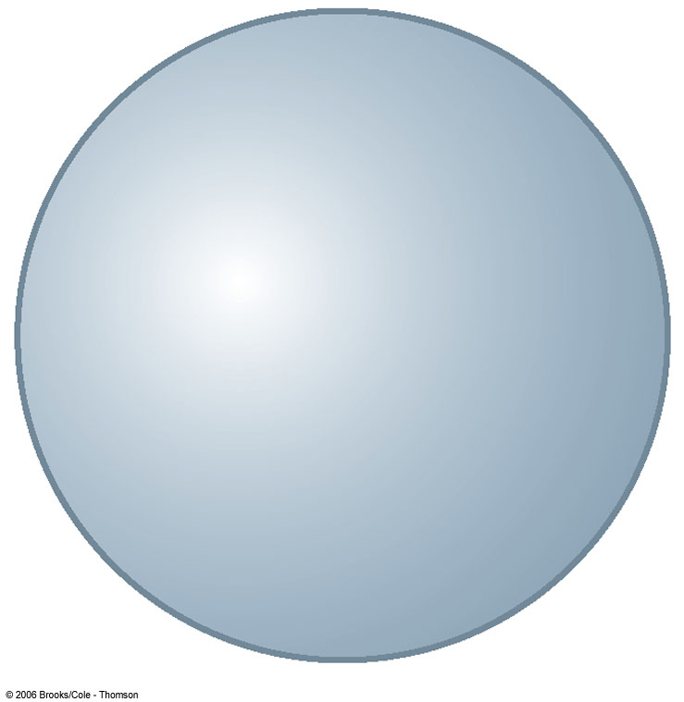
Charging by Induction
When an object is connected to a conducting wire or pipe buried in the earth, it is said to be grounded
A negatively charged rubber rod is brought near an uncharged sphere

Slide 10
Charging by Induction, 2
The charges in the sphere are redistributed
Some of the electrons in the sphere are repelled from the electrons in the rod

Slide 11
Charging by Induction, 3
The region of the sphere nearest the negatively charged rod has an excess of positive charge because of the migration of electrons away from this location
A grounded conducting wire is connected to the sphere
Allows some of the electrons to move from the sphere to the ground

Slide 12
Charging by Induction, final
The wire to ground is removed, the sphere is left with an excess of induced positive charge
The positive charge on the sphere is evenly distributed due to the repulsion between the positive charges
Charging by induction requires no contact with the object inducing the charge

Slide 13
Polarization
In most neutral atoms or molecules, the center of positive charge coincides with the center of negative charge
In the presence of a charged object, these centers may separate slightly
This results in more positive charge on one side of the molecule than on the other side
This realignment of charge on the surface of an insulator is known as polarization

Slide 14
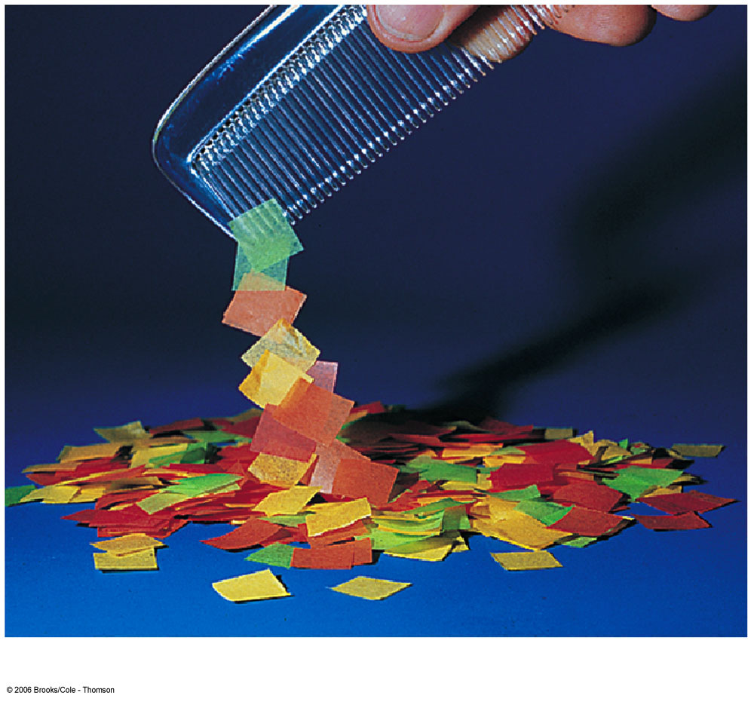
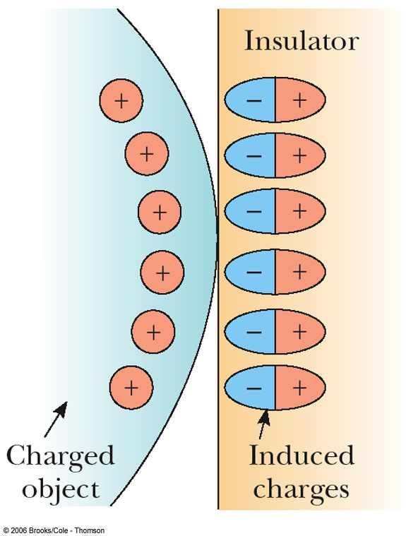
Examples of Polarization
The charged object (on the left) induces charge on the surface of the insulator
A charged comb attracts bits of paper due to polarization of the paper

Slide 15
Coulomb’s Law
Coulomb shows that an electrical force has the following properties:
It is along the line joining the two particles and inversely proportional to the square of the separation distance, r, between them
It is proportional to the product of the magnitudes of the charges, |q₁|and |q₂|on the two particles
It is attractive if the charges are of opposite signs and repulsive if the charges have the same signs

Slide 16
Coulomb’s Law, cont.
Mathematically,
k_{e} is called the Coulomb Constant
k_{e} = 8.9875 x 10⁹ N m²/C²
Typical charges can be in the µC range
Remember, Coulombs must be used in the equation
Remember that force is a vector quantity
Applies only to point charges

Slide 17
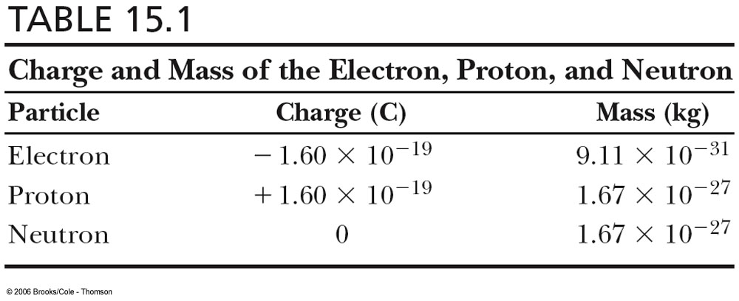
Characteristics of Particles

Slide 18
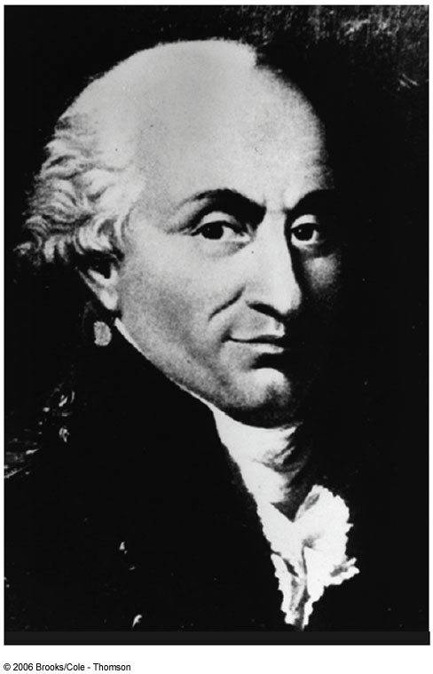
Charles Coulomb
1736 – 1806
Studied electrostatics and magnetism
Investigated strengths of materials
Identified forces acting on beams

Slide 19
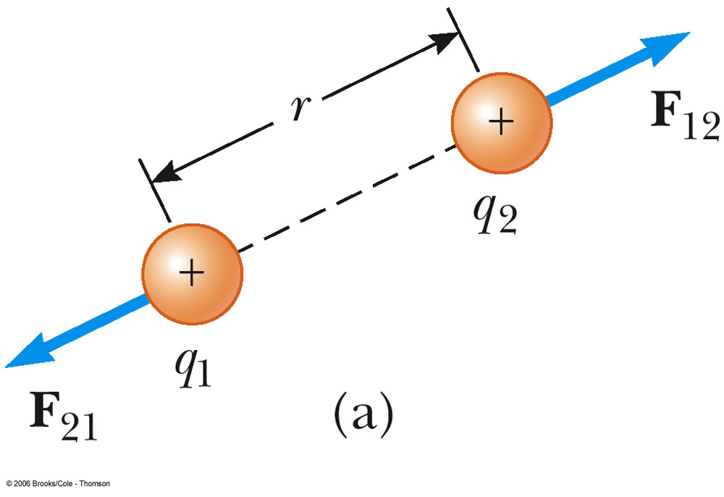
Vector Nature of Electric Forces
Two point charges are separated by a distance r
The like charges produce a repulsive force between them
The force on q₁ is equal in magnitude and opposite in direction to the force on q₂

Slide 20
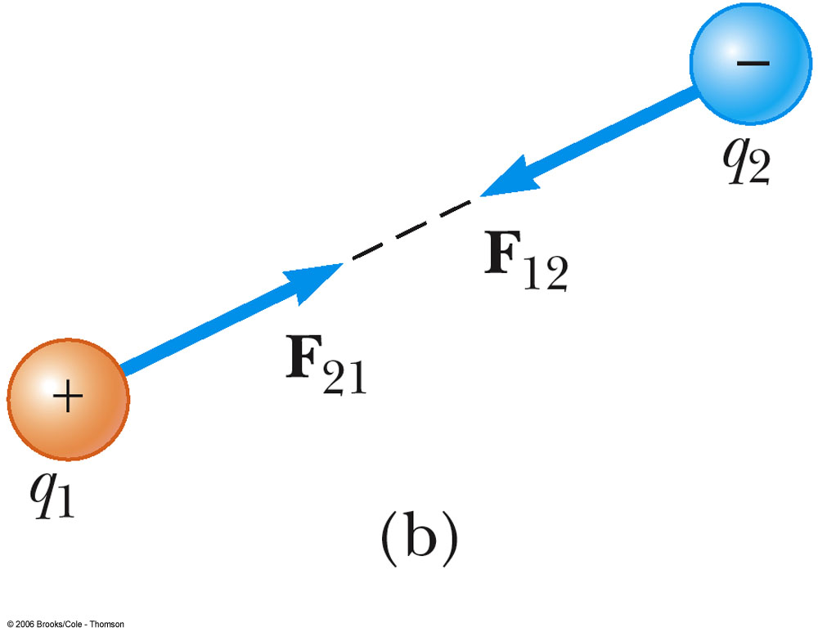
Vector Nature of Forces, cont.
Two point charges are separated by a distance r
The unlike charges produce a attractive force between them
The force on q₁ is equal in magnitude and opposite in direction to the force on q₂

Slide 21
Electrical Forces are Field Forces
This is the second example of a field force
Gravity was the first
Remember, with a field force, the force is exerted by one object on another object even though there is no physical contact between them
There are some important similarities and differences between electrical and gravitational forces

Slide 22
Electrical Force Compared to Gravitational Force
Both are inverse square laws
The mathematical form of both laws is the same
Masses replaced by charges
Electrical forces can be either attractive or repulsive
Gravitational forces are always attractive
Electrostatic force is stronger than the gravitational force

Slide 23
The Superposition Principle
The resultant force on any one charge equals the vector sum of the forces exerted by the other individual charges that are present.
Remember to add the forces as vectors

Slide 24
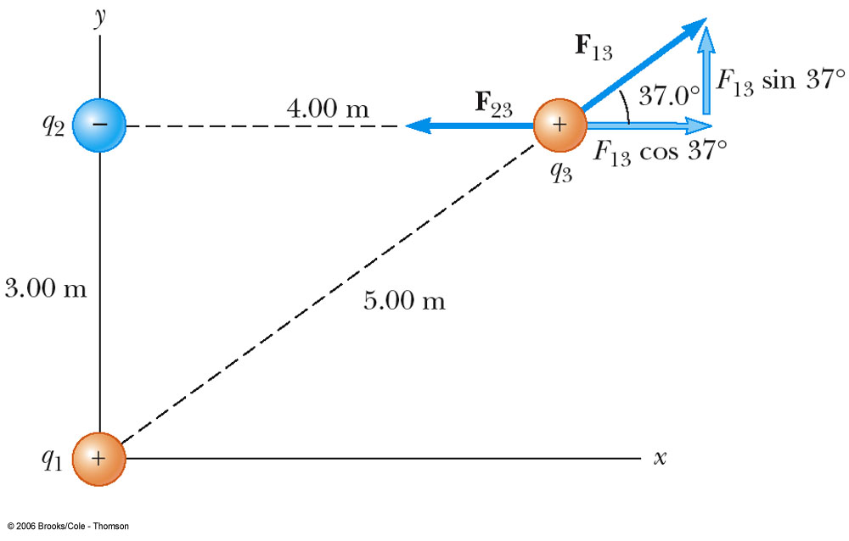
Superposition Principle Example
The force exerted by q₁ on q₃ is
The force exerted by q₂ on q₃ is
The total force exerted on q₃ is the vector sum of
and

Slide 25
Electrical Field
An electric field is said to exist in the region of space around a charged object. When another charged object enters this electric field, the field exerts a force on the second charged object

Slide 26
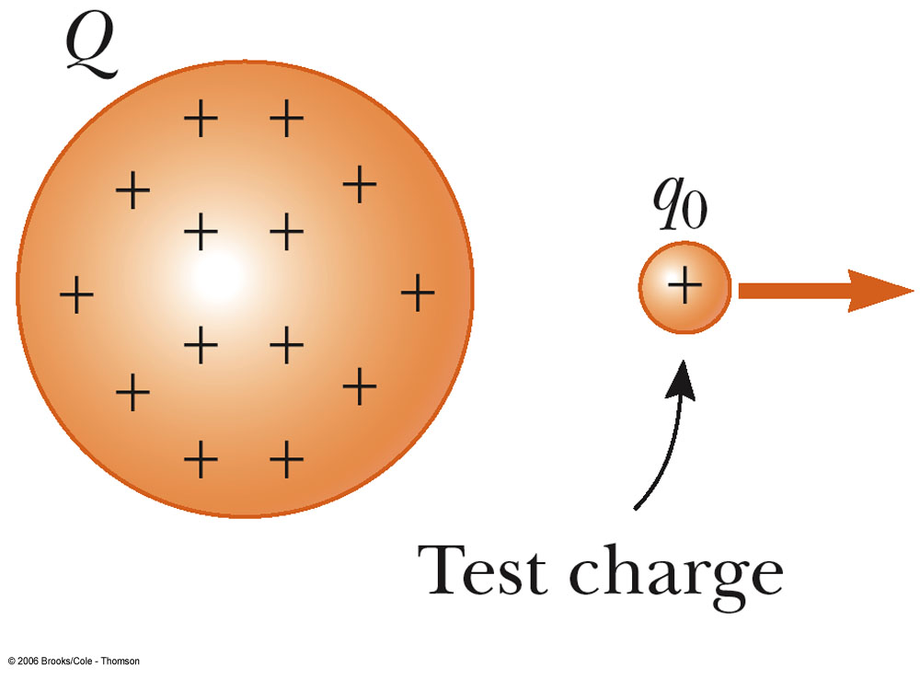
A charged particle, with charge Q, produces an electric field in the region of space around it
A small test charge, q_{o}, placed in the field, will experience a force

Slide 27
Mathematically,
SI units are N / C
vector quantity
The direction of the field is the direction of the electric force that would be exerted on a small positive charge placed at that point

Slide 28
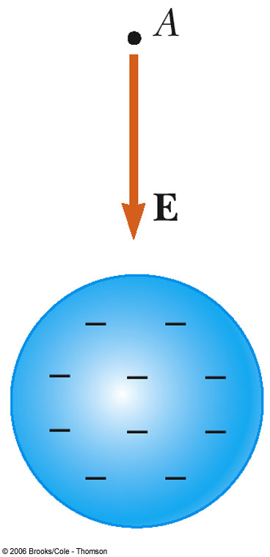
Direction of Electric Field
The electric field produced by a negative charge is directed toward the charge
A positive test charge would be attracted to the negative source charge

Slide 29
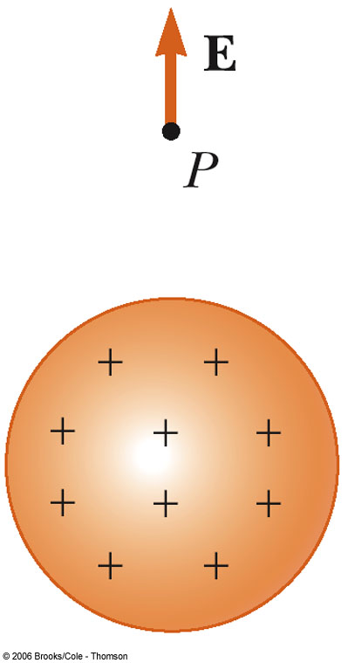
The electric field produced by a positive charge is directed away from the charge
A positive test charge would be repelled from the positive source charge

Slide 30
The Superposition Principle can be applied to the electric field if a group of charges is present

Slide 31
Problem Solving Strategy
Draw a diagram of the charges in the problem
Identify the charge of interest
You may want to circle it
Units – Convert all units to SI
Need to be consistent with k_{e}

Slide 32
Problem Solving Strategy, cont
Apply Coulomb’s Law
For each charge, find the force on the charge of interest
Determine the direction of the force
Sum all the x- and y- components
This gives the x- and y-components of the resultant force
Find the resultant force by using the Pythagorean theorem and trig

Slide 33
Problem Solving Strategy, Electric Fields
Calculate Electric Fields of point charges
Use the equation to find the electric field due to the individual charges
The direction is given by the direction of the force on a positive test charge
The Superposition Principle can be applied if more than one charge is present

Slide 34
Electric Field Lines
Electric field lines are draw pointing in the direction of the field vector at any point.

Slide 35
The number of lines per unit area is proportional to the strength of the electric field in a given region.

Slide 36
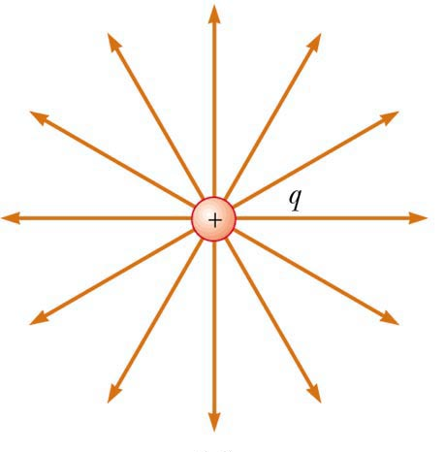
Electric Field Line Patterns
For a positive source charge, the lines will radiate outward

Slide 37
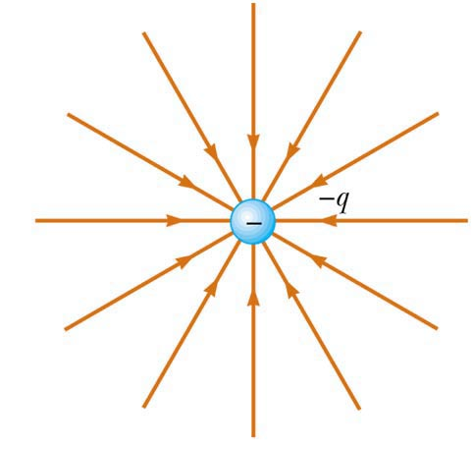
Electric Field Line Patterns
For a negative source charge, the lines will point inward

Slide 38
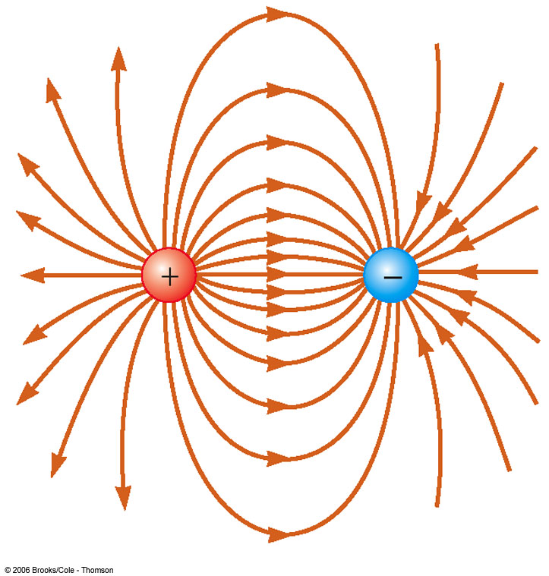
Electric Field Line Patterns
An electric dipole consists of two equal and opposite charges

Slide 39
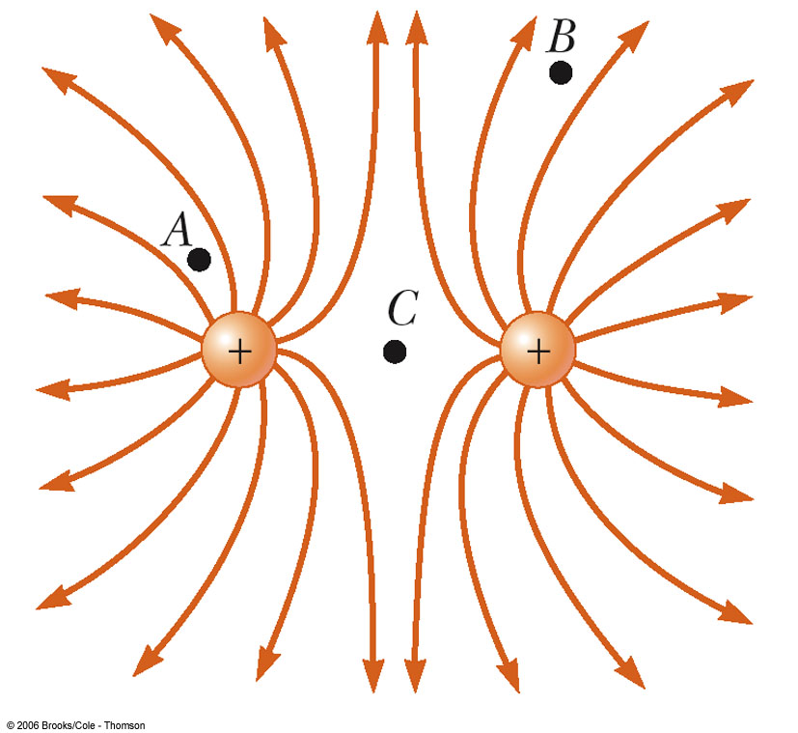
Electric Field Line Patterns
Two equal but like point charges
At a great distance from the charges, the field would be approximately that of a single charge of 2q
The bulging out of the field lines between the charges indicates the repulsion between the charges
The low field lines between the charges indicates a weak field in this region

Slide 40
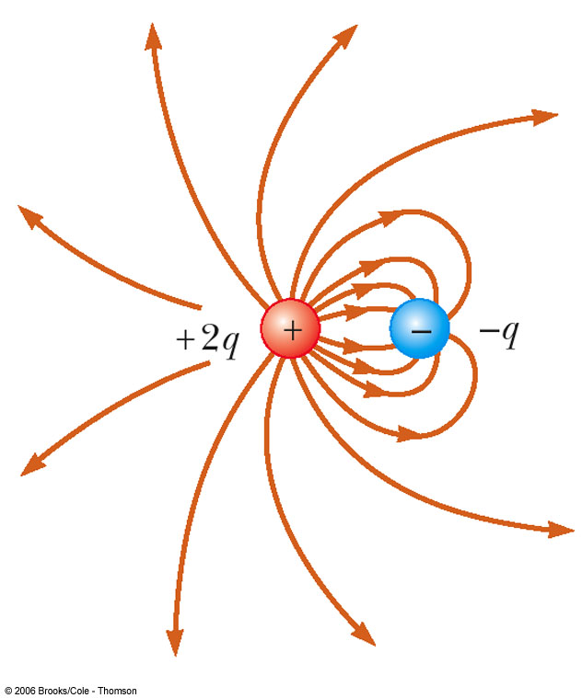
Electric Field Patterns
Unequal and unlike charges
Note that two lines leave the +2q charge for each line that terminates on -q

Slide 41
Rules for Drawing Electric Field Lines
The lines for a group of charges must begin on positive charges and end on negative charges
In the case of an excess of charge, some lines will begin or end infinitely far away
The number of lines drawn leaving a positive charge or ending on a negative charge is proportional to the magnitude of the charge
No two field lines can cross each other

Slide 42
Conductors in Electrostatic Equilibrium
When no net motion of charge occurs within a conductor, the conductor is said to be in electrostatic equilibrium
An isolated conductor has the following properties:
The electric field is zero everywhere inside the conducting material
Any excess charge on an isolated conductor resides entirely on its surface
The electric field just outside a charged conductor is perpendicular to the conductor’s surface
On an irregularly shaped conductor, the charge accumulates at locations where the radius of curvature of the surface is smallest (that is, at sharp points)

Slide 43
Property 1
The electric field is zero everywhere inside the conducting material
Consider if this were not true
If there were an electric field inside the conductor, the free charge there would move and there would be a flow of charge
If there were a movement of charge, the conductor would not be in equilibrium

Slide 44
Property 2
Any excess charge on an isolated conductor resides entirely on its surface
A direct result of the 1/r² repulsion between like charges in Coulomb’s Law
If some excess of charge could be placed inside the conductor, the repulsive forces would push them as far apart as possible, causing them to migrate to the surface

Slide 45
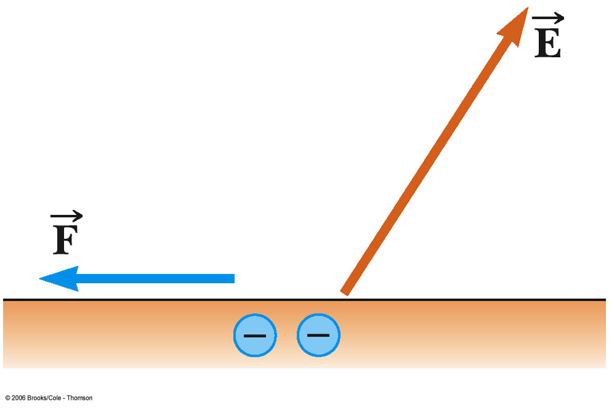
Property 3
The electric field just outside a charged conductor is perpendicular to the conductor’s surface
Consider what would happen it this was not true
The component along the surface would cause the charge to move
It would not be in equilibrium

Slide 46
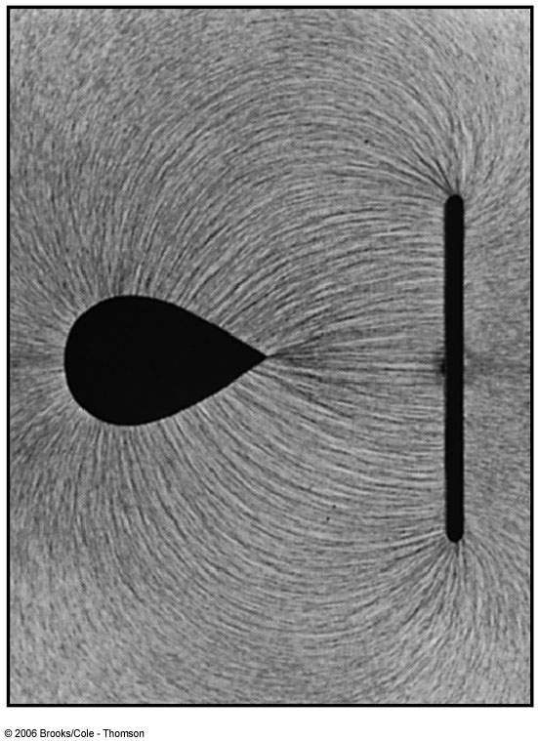
Property 4
On an irregularly shaped conductor, the charge accumulates at locations where the radius of curvature of the surface is smallest (that is, at sharp points)

Slide 47
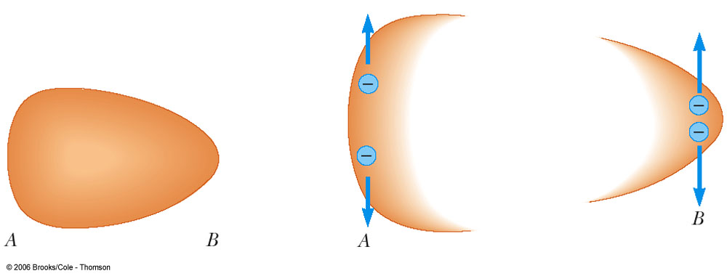
Property 4, cont.
Any excess charge moves to its surface
The charges move apart until an equilibrium is achieved
The amount of charge per unit area is greater at the flat end
The forces from the charges at the sharp end produce a larger resultant force away from the surface
Why a lightning rod works

Slide 48
Experiments to Verify Properties of Charges
Faraday’s Ice-Pail Experiment
Concluded a charged object suspended inside a metal container causes a rearrangement of charge on the container in such a manner that the sign of the charge on the inside surface of the container is opposite the sign of the charge on the suspended object
Millikan Oil-Drop Experiment
Measured the elementary charge, e
Found every charge had an integral multiple of e
q = n e

