Slide 1
Chapter 16
Electric Energy
and
Capacitance

Slide 2
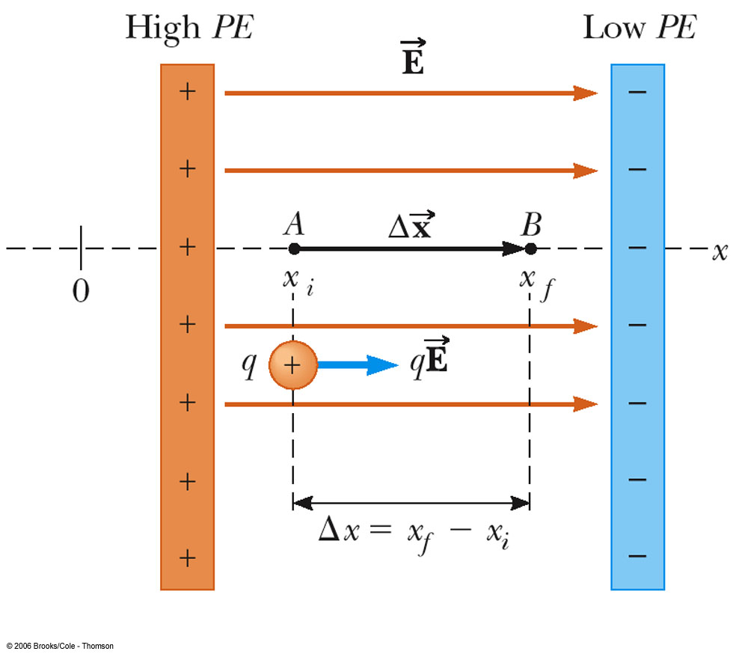
Work and Potential Energy
A uniform field exists between two plates as shown.
As the charge (q) moves from A to B, work is done on it (-w).
W = Fd=q E_{x}(x_{f} – x_{i})
ΔPE = - W
= - q E_{x} (x_{f} – x_{i})
  This only works for a uniform field

Slide 3
Potential Difference
The potential difference between points A and B is defined as the change in the potential energy (final value minus initial value) of a charge q moved from A to B divided by the size of the charge
  ΔV = V_{B} – V_{A} = ΔPE / q
Potential difference is not the same as potential energy.

Slide 4
Potential Difference, cont.
Another way to relate the energy and the potential difference: ΔPE = q ΔV
Both electric potential energy and potential difference are scalar quantities
Units of potential difference
  V = J/C
A special case occurs when there is a uniform electric field
  ΔV = V_{B} – V_{A}= -E_{x} Δx
    Gives more information about units: N/C = V/m

Slide 5
Energy and Charge Movements
A positive charge gains electrical potential energy when it is moved in a direction opposite the electric field
If a charge is released in the electric field, it experiences a force and accelerates, gaining kinetic energy
  As it gains kinetic energy, it loses an equal amount of electrical potential energy
A negative charge loses electrical potential energy when it moves in the direction opposite the electric field

Slide 6
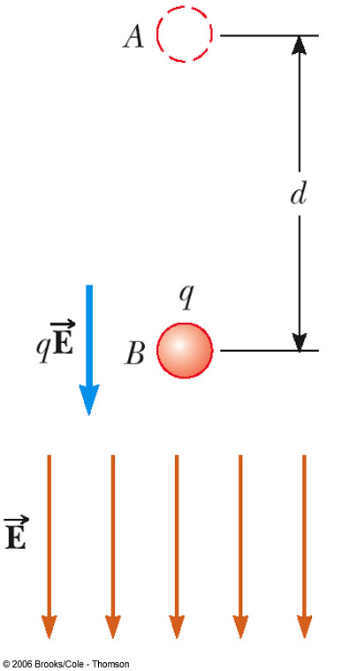
Energy and Charge Movements, cont
When the electric field is directed downward, point B is at a lower potential than point A
A positive test charge that moves from A to B loses electric potential energy
It will gain the same amount of kinetic energy as it loses in potential energy

Slide 7
Summary of Positive Charge Movements and Energy
When a positive charge is placed in an electric field
  It moves in the direction of the field
  It moves from a point of higher potential to a point of lower potential
  Its electrical potential energy decreases
  Its kinetic energy increases

Slide 8
Summary of Negative Charge Movements and Energy
When a negative charge is placed in an electric field
  It moves opposite to the direction of the field
  It moves from a point of lower potential to a point of higher potential
  Its electrical potential energy increases
  Its kinetic energy increases
  Work has to be done on the charge for it to move from point A to point B

Slide 9
Electric Potential of a Point Charge
The point of zero electric potential is taken to be at an infinite distance from the charge
The potential created by a point charge q at any distance r from the charge is
A potential exists at some point in space whether or not there is a test charge at that point

Slide 10
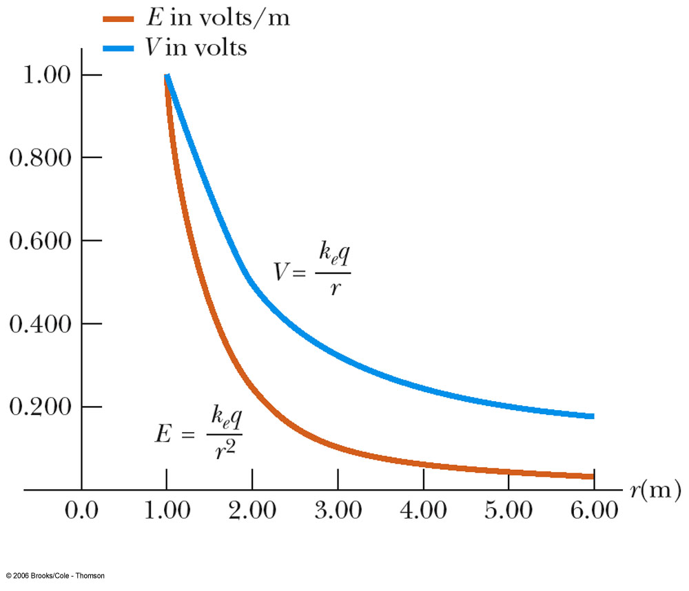
Electric Field and Electric Potential Depend on Distance
The electric field is proportional to 1/r²
The electric potential is proportional to 1/r

Slide 11
Electric Potential of Multiple Point Charges
Superposition principle applies
The total electric potential at some point P due to several point charges is the algebraic sum of the electric potentials due to the individual charges
  The algebraic sum is used because potentials are scalar quantities

Slide 12
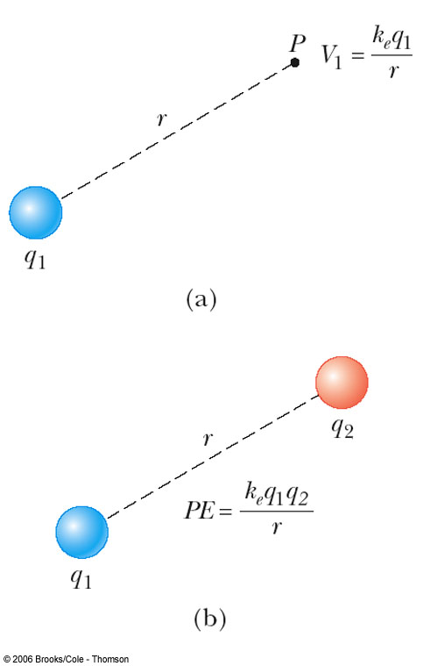
Electrical Potential Energy of Two Charges
V₁ is the electric potential due to q₁ at some point P
The work required to bring q₂ from infinity to P without acceleration is q₂V₁
This work is equal to the potential energy of the two particle system

Slide 13
Notes About Electric Potential Energy of Two Charges
If the charges have the same sign, PE is positive
  Positive work must be done to force the two charges near one another
  The like charges would repel
If the charges have opposite signs, PE is negative
  The force would be attractive
  Work must be done to hold back the unlike charges from accelerating as they are brought close together

Slide 14
Problem Solving with Electric Potential (Point Charges)
Draw a diagram of all charges
  Note the point of interest
Calculate the distance from each charge to the point of interest
Use the basic equation V = k_{e}q/r
  Include the sign
  The potential is positive if the charge is positive and negative if the charge is negative

Slide 15
Problem Solving with Electric Potential, cont
Use the superposition principle when you have multiple charges
  Take the algebraic sum
Remember that potential is a scalar quantity
  So no components to worry about

Slide 16
Potentials and Charged Conductors
Since W = -q(V_{B} – V_{A}), no work is required to move a charge between two points that are at the same electric potential
  W = 0 when V_{A} = V_{B}
All points on the surface of a charged conductor in electrostatic equilibrium are at the same potential
Therefore, the electric potential is a constant everywhere on the surface of a charged conductor in equilibrium

Slide 17
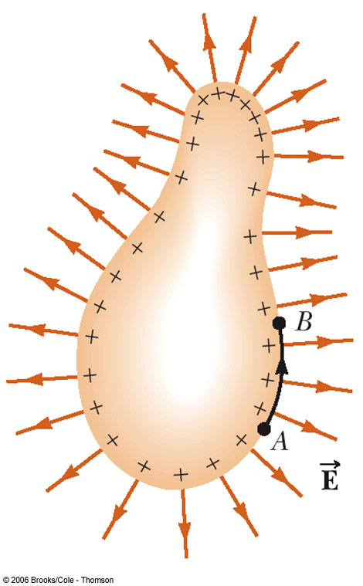
Conductors in Equilibrium
The conductor has an excess of positive charge
All of the charge resides at the surface
E = 0 inside the conductor
The electric field just outside the conductor is perpendicular to the surface
The potential is a constant everywhere on the surface of the conductor
The potential everywhere inside the conductor is constant and equal to its value at the surface

Slide 18
The Electron Volt
The electron volt (eV) is defined as the energy that an electron gains when accelerated through a potential difference of 1 V
  Electrons in normal atoms have energies of 10’s of eV
  Excited electrons have energies of 1000’s of eV
  High energy gamma rays have energies of millions of eV
1 eV = 1.6 x 10⁻¹⁹ J

Slide 19
Equipotential Surfaces
An equipotential surface is a surface on which all points are at the same potential
  No work is required to move a charge at a constant speed on an equipotential surface
  The electric field at every point on an equipotential surface is perpendicular to the surface

Slide 20
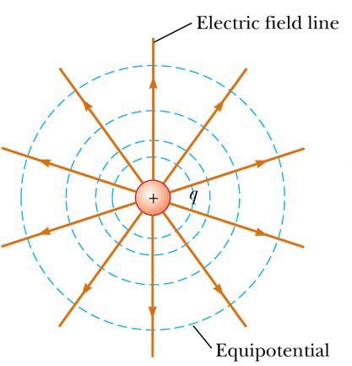
Equipotentials and Electric Fields Lines – Positive Charge
The equipotentials for a point charge are a family of spheres centered on the point charge
The field lines are perpendicular to the electric potential at all points

Slide 21
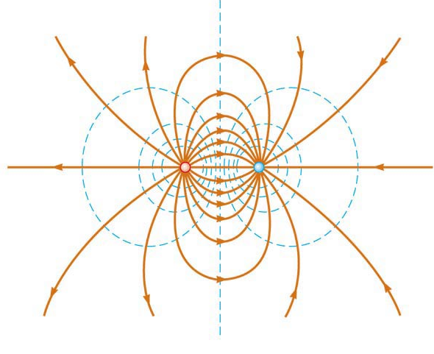
Equipotentials and Electric Fields Lines – Dipole
Equipotential lines are shown in blue
Electric field lines are shown in red
The field lines are perpendicular to the equipotential lines at all points

Slide 22
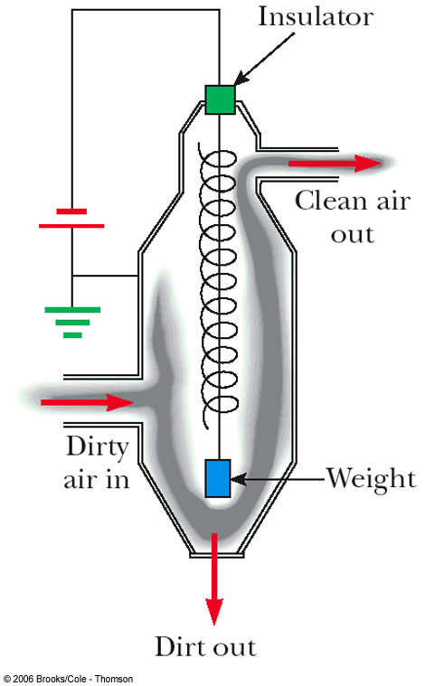
Application – Electrostatic Precipitator
It is used to remove particulate matter from combustion gases
Reduces air pollution
Can eliminate approximately 90% by mass of the ash and dust from smoke

Slide 23
Application – Electrostatic Air Cleaner
Used in homes to relieve the discomfort of allergy sufferers
It uses many of the same principles as the electrostatic precipitator

Slide 24
Application – Xerographic Copiers
The process of xerography is used for making photocopies
Uses photoconductive materials
  A photoconductive material is a poor conductor of electricity in the dark but becomes a good electric conductor when exposed to light

Slide 25
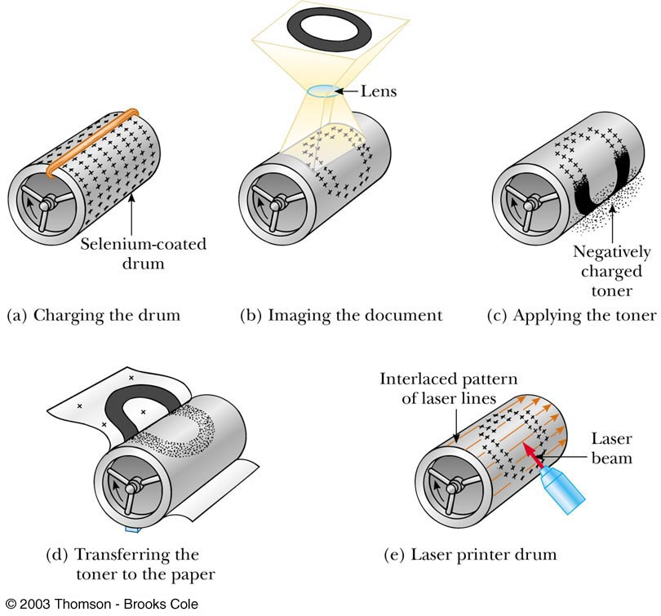
The Xerographic Process

Slide 26
Application – Laser Printer
The steps for producing a document on a laser printer is similar to the steps in the xerographic process
  Steps a, c, and d are the same
  The major difference is the way the image forms on the selenium-coated drum
    A rotating mirror inside the printer causes the beam of the laser to sweep across the selenium-coated drum
    The electrical signals form the desired letter in positive charges on the selenium-coated drum
    Toner is applied and the process continues as in the xerographic process

Slide 27
Capacitance
A capacitor is a device used in a variety of electric circuits
The capacitance, C, of a capacitor is defined as the ratio of the magnitude of the charge on either conductor (plate) to the magnitude of the potential difference between the conductors (plates)

Slide 28
Capacitance, cont
Units: Farad (F)
  1 F = 1 C / V
  A Farad is very large
    Often will see µF or pF

Slide 29
Parallel-Plate Capacitor
The capacitance of a device depends on the geometric arrangement of the conductors
For a parallel-plate capacitor whose plates are separated by air:

Slide 30
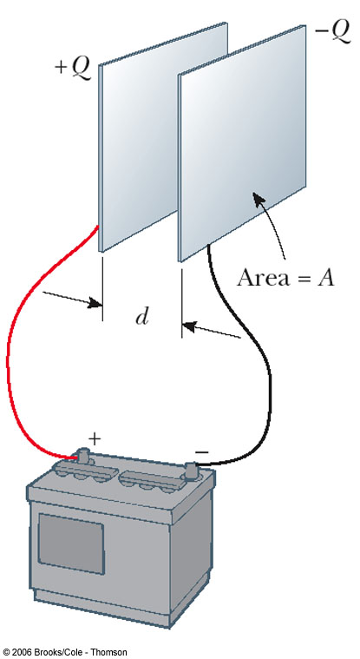
Parallel-Plate Capacitor, Example
The capacitor consists of two parallel plates
Each have area A
They are separated by a distance d
The plates carry equal and opposite charges
When connected to the battery, charge is pulled off one plate and transferred to the other plate
The transfer stops when ΔV_{cap} = ΔV_{battery}

Slide 31
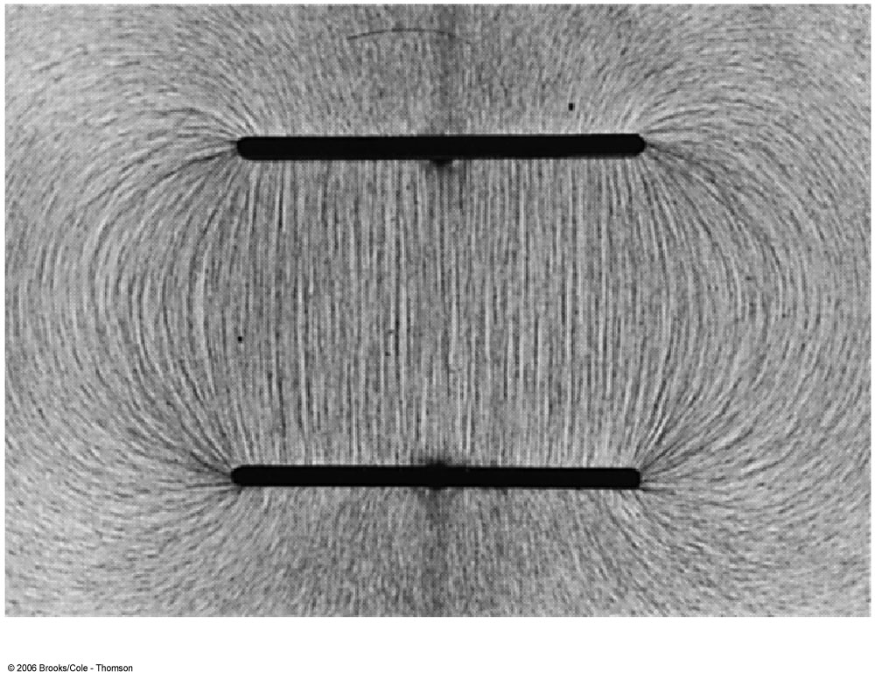
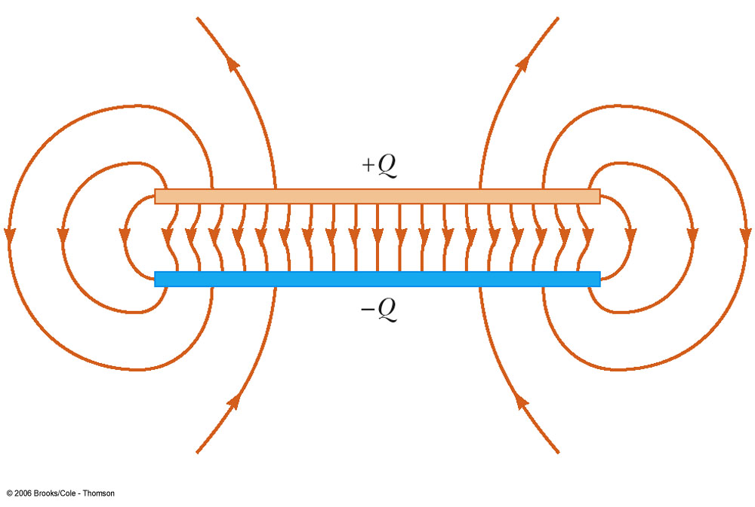
Electric Field in a Parallel-Plate Capacitor
The electric field between the plates is uniform
  Near the center
  Nonuniform near the edges
The field may be taken as constant throughout the region between the plates

Slide 32
Applications of Capacitors – Camera Flash
The flash attachment on a camera uses a capacitor
  A battery is used to charge the capacitor
  The energy stored in the capacitor is released when the button is pushed to take a picture
  The charge is delivered very quickly, illuminating the subject when more light is needed

Slide 33
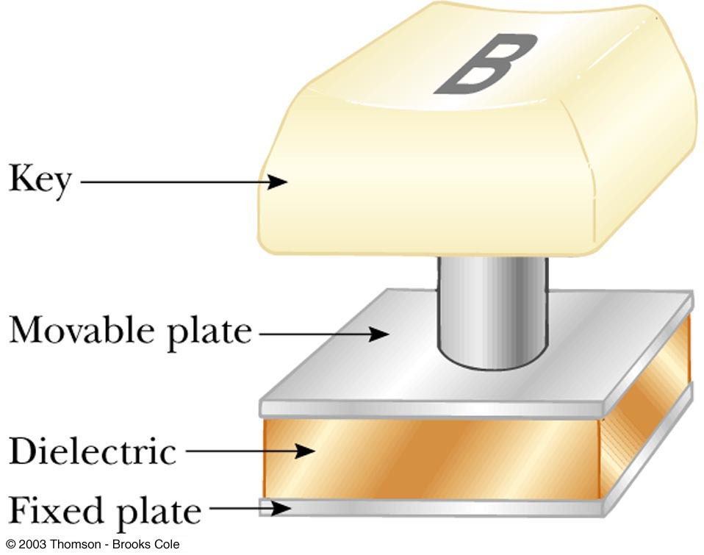
Applications of Capacitors – Computers
Computers use capacitors in many ways
  Some keyboards use capacitors at the bases of the keys
  When the key is pressed, the capacitor spacing decreases and the capacitance increases
  The key is recognized by the change in capacitance

Slide 34
Capacitors in Circuits
A circuit is a collection of objects usually containing a source of electrical energy (such as a battery) connected to elements that convert electrical energy to other forms
A circuit diagram can be used to show the path of the real circuit

Slide 35
Capacitors in Parallel
When capacitors are first connected in the circuit, electrons are transferred from the left plates through the battery to the right plate, leaving the left plate positively charged and the right plate negatively charged
The flow of charges ceases when the voltage across the capacitors equals that of the battery
The capacitors reach their maximum charge when the flow of charge ceases

Slide 36
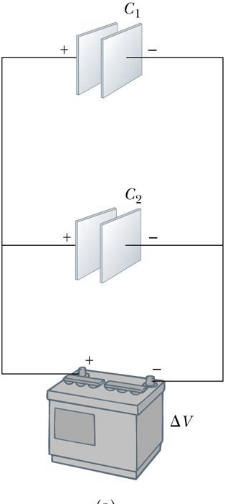
Capacitors in Parallel
The total charge is equal to the sum of the charges on the capacitors
  Q_{total} = Q₁ + Q₂
The potential difference across the capacitors is the same
  And each is equal to the voltage of the battery

Slide 37
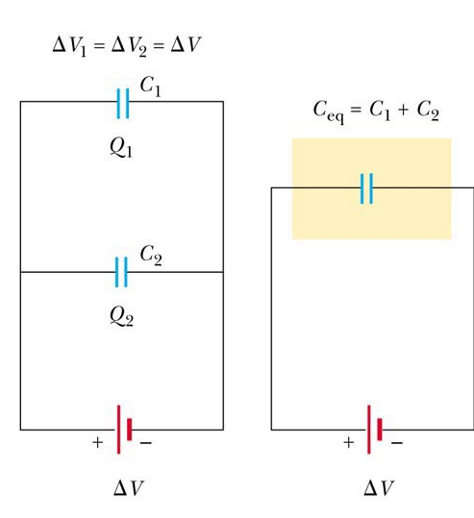
More About Capacitors in Parallel
The capacitors can be replaced with one capacitor with a capacitance of C_{eq}
  The equivalent capacitor must have exactly the same external effect on the circuit as the original capacitors

Slide 38
Capacitors in Parallel, final
C_{eq} = C₁ + C₂ + …
The equivalent capacitance of a parallel combination of capacitors is greater than any of the individual capacitors

Slide 39
Capacitors in Series
When a battery is connected to the circuit, electrons are transferred from the left plate of C₁ to the right plate of C₂ through the battery
As this negative charge accumulates on the right plate of C₂, an equivalent amount of negative charge is removed from the left plate of C₂, leaving it with an excess positive charge
All of the right plates gain charges of –Q and all the left plates have charges of +Q

Slide 40
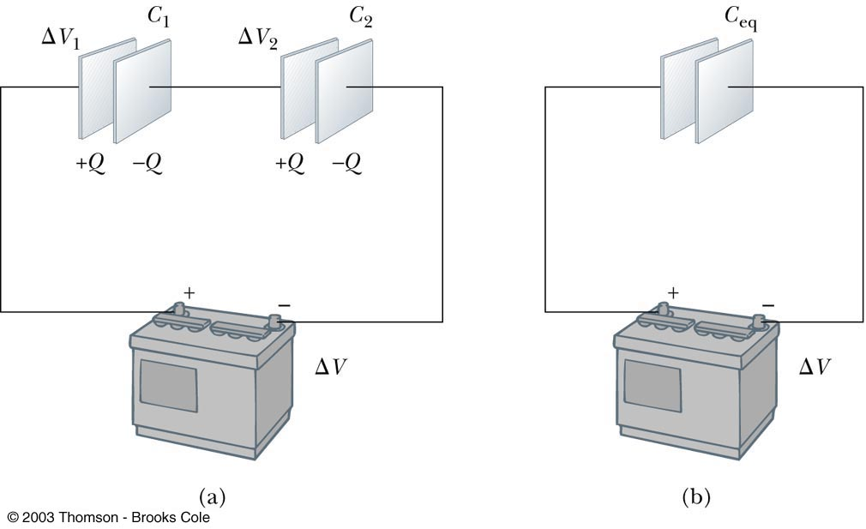
More About Capacitors in Series
An equivalent capacitor can be found that performs the same function as the series combination
The potential differences add up to the battery voltage

Slide 41
Capacitors in Series, cont
The equivalent capacitance of a series combination is always less than any individual capacitor in the combination

Slide 42
Problem-Solving Strategy
Be careful with the choice of units
Combine capacitors following the formulas
  When two or more unequal capacitors are connected in series, they carry the same charge, but the potential differences across them are not the same
    The capacitances add as reciprocals and the equivalent capacitance is always less than the smallest individual capacitor

Slide 43
Problem-Solving Strategy, cont
Combining capacitors
  When two or more capacitors are connected in parallel, the potential differences across them are the same
    The charge on each capacitor is proportional to its capacitance
    The capacitors add directly to give the equivalent capacitance

Slide 44
Problem-Solving Strategy, final
Repeat the process until there is only one single equivalent capacitor
  A complicated circuit can often be reduced to one equivalent capacitor
    Replace capacitors in series or parallel with their equivalent
    Redraw the circuit and continue
To find the charge on, or the potential difference across, one of the capacitors, start with your final equivalent capacitor and work back through the circuit reductions

Slide 45
Problem-Solving Strategy, Equation Summary
Use the following equations when working through the circuit diagrams:
  Capacitance equation: C = Q / ΔV
  Capacitors in parallel: C_{eq} = C₁ + C₂ + …
  Capacitors in parallel all have the same voltage differences as does the equivalent capacitance
  Capacitors in series: 1/C_{eq} = 1/C₁ + 1/C₂ + …
  Capacitors in series all have the same charge, Q, as does their equivalent capacitance

Slide 46
Energy Stored in a Capacitor
Energy stored = ½ Q ΔV
From the definition of capacitance, this can be rewritten in different forms

Slide 47
Applications
Defibrillators
  When fibrillation occurs, the heart produces a rapid, irregular pattern of beats
  A fast discharge of electrical energy through the heart can return the organ to its normal beat pattern
In general, capacitors act as energy reservoirs that can slowly charged and then discharged quickly to provide large amounts of energy in a short pulse

Slide 48
Capacitors with Dielectrics
A dielectric is an insulating material that, when placed between the plates of a capacitor, increases the capacitance
  Dielectrics include rubber, plastic, or waxed paper
C = κC_{o} = κε_{o}(A/d)
  The capacitance is multiplied by the factor κ when the dielectric completely fills the region between the plates

Slide 49
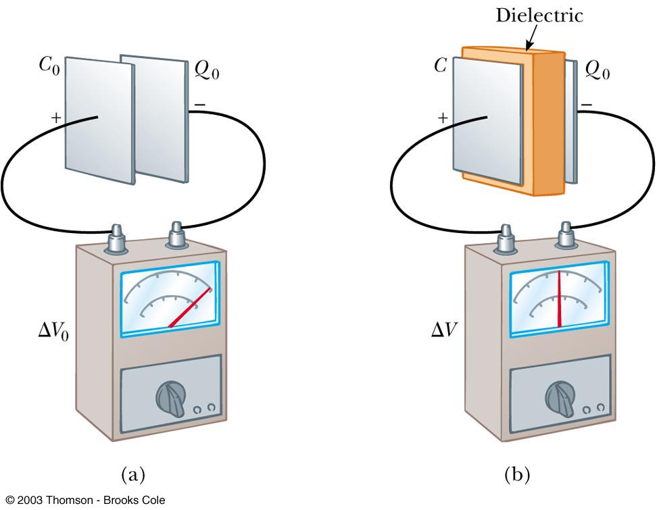
Capacitors with Dielectrics

Slide 50
Dielectric Strength
For any given plate separation, there is a maximum electric field that can be produced in the dielectric before it breaks down and begins to conduct
This maximum electric field is called the dielectric strength

Slide 51
An Atomic Description of Dielectrics
Polarization occurs when there is a separation between the “centers of gravity” of its negative charge and its positive charge
In a capacitor, the dielectric becomes polarized because it is in an electric field that exists between the plates

Slide 52
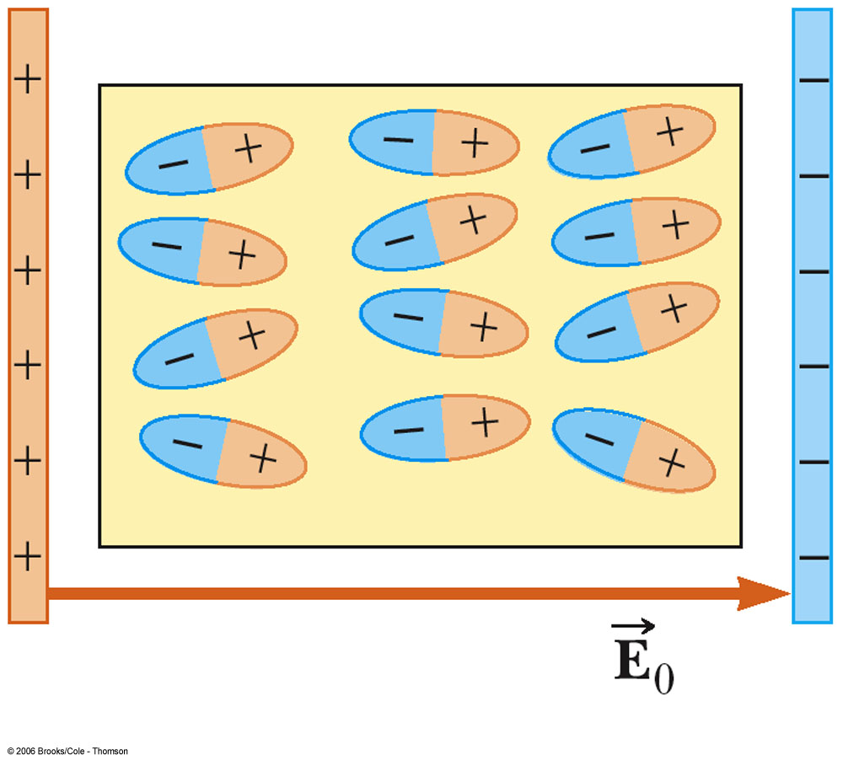
More Atomic Description
The presence of the positive charge on the dielectric effectively reduces some of the negative charge on the metal
This allows more negative charge on the plates for a given applied voltage
The capacitance increases

