Slide 1
Chapter 17
Current and Resistance

Slide 2
Electric Current
Whenever electric charges of like signs move, an electric current is said to exist
The current is the rate at which the charge flows through this surface
Look at the charges flowing perpendicularly to a surface of area A
The SI unit of current is Ampere (A)
1 A = 1 C/s

Slide 3
Electric Current, cont
The direction of the current is the direction positive charge would flow
This is known as conventional current direction
In a common conductor, such as copper, the current is due to the motion of the negatively charged electrons
It is common to refer to a moving charge as a mobile charge carrier
A charge carrier can be positive or negative

Slide 4
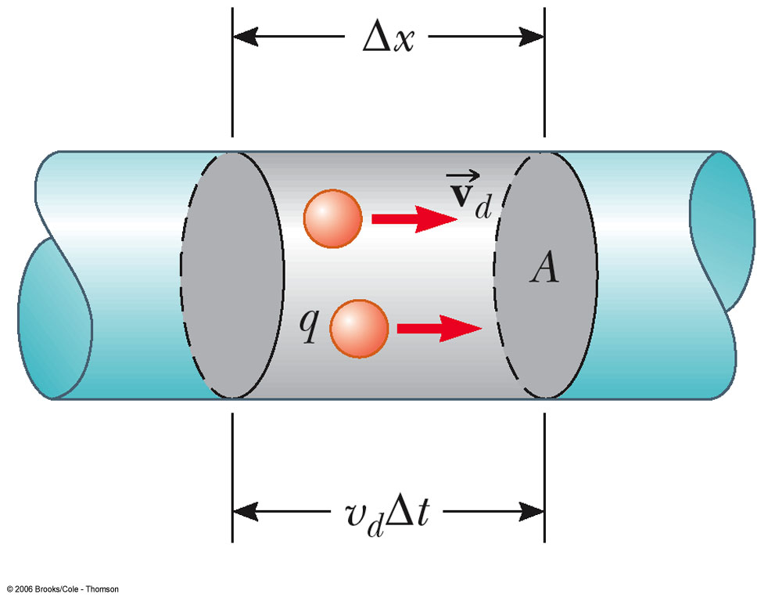
Current and Drift Speed
Charged particles move through a conductor of cross-sectional area A
n is the number of charge carriers per unit volume
n A Δx is the total number of charge carriers

Slide 5
Current and Drift Speed, cont
The total charge is the number of carriers times the charge per carrier, q
ΔQ = (n A Δx) q
The drift speed, v_{d}, is the speed at which the carriers move
v_{d} = Δx/ Δt
Rewritten: ΔQ = (n A v_{d} Δt) q
Finally, current, I = ΔQ/Δt = nqv_{d}A

Slide 6
Current and Drift Speed, final
If the conductor is isolated, the electrons undergo random motion
When an electric field is set up in the conductor, it creates an electric force on the electrons and hence a current

Slide 7
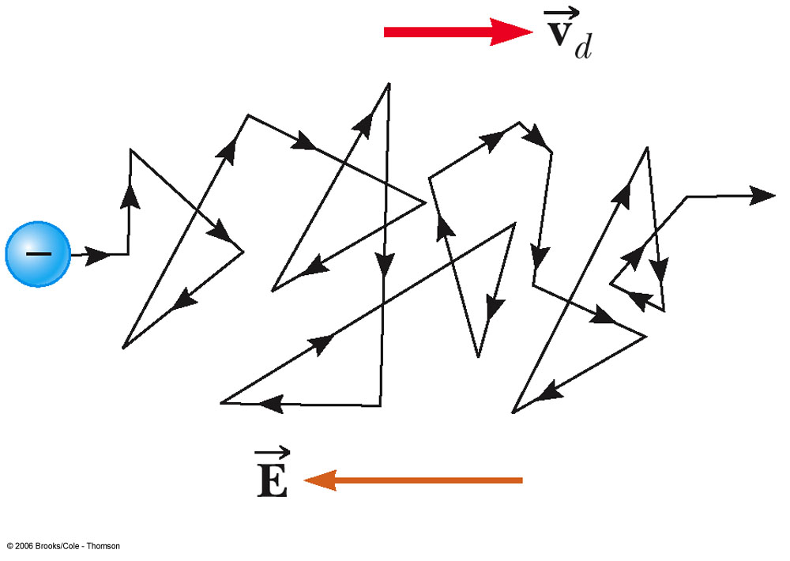
Charge Carrier Motion in a Conductor
The zig-zag black line represents the motion of charge carrier in a conductor
The net drift speed is small
The sharp changes in direction are due to collisions
The net motion of electrons is opposite the direction of the electric field

Slide 8
Electrons in a Circuit
The drift speed is much smaller than the average speed between collisions
When a circuit is completed, the electric field travels with a speed close to the speed of light
Although the drift speed is on the order of 10⁻⁴ m/s the effect of the electric field is felt on the order of 10⁸ m/s

Slide 9
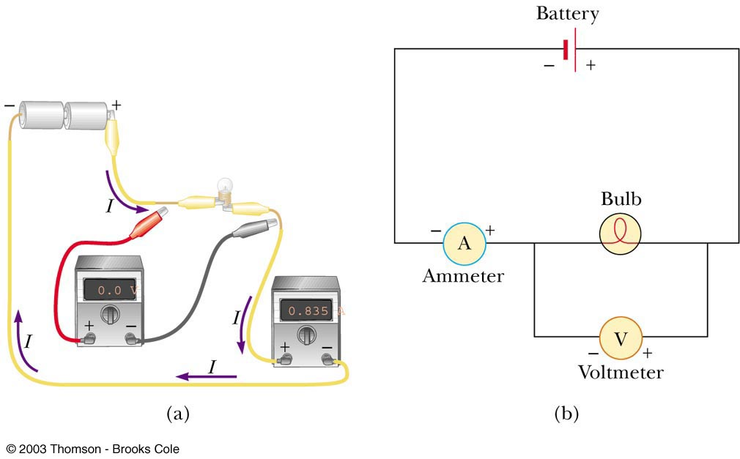
Meters in a Circuit – Ammeter
An ammeter is used to measure current
In line with the bulb, all the charge passing through the bulb also must pass through the meter

Slide 10
Meters in a Circuit – Voltmeter
A voltmeter is used to measure voltage (potential difference)
Connects to the two ends of the bulb

Slide 11
Resistance
In a conductor, the voltage applied across the ends of the conductor is proportional to the current through the conductor
The constant of proportionality is the resistance of the conductor

Slide 12
Resistance, cont
Units of resistance are ohms (Ω)
1 Ω = 1 V / A
Resistance in a circuit arises due to collisions between the electrons carrying the current with the fixed atoms inside the conductor

Slide 13
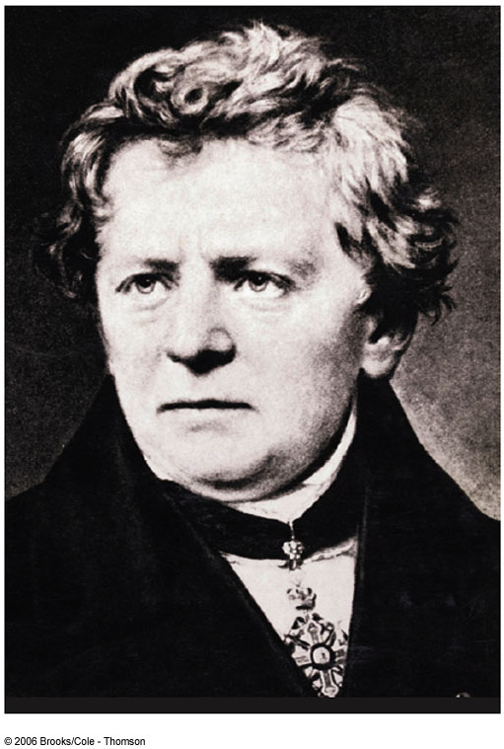
Georg Simon Ohm
1787 – 1854
Formulated the concept of resistance
Discovered the proportionality between current and voltages

Slide 14
Ohm’s Law
Experiments show that for many materials, including most metals, the resistance remains constant over a wide range of applied voltages or currents
This statement has become known as Ohm’s Law
ΔV = I R
Ohm’s Law is an empirical relationship that is valid only for certain materials
Materials that obey Ohm’s Law are said to be ohmic

Slide 15
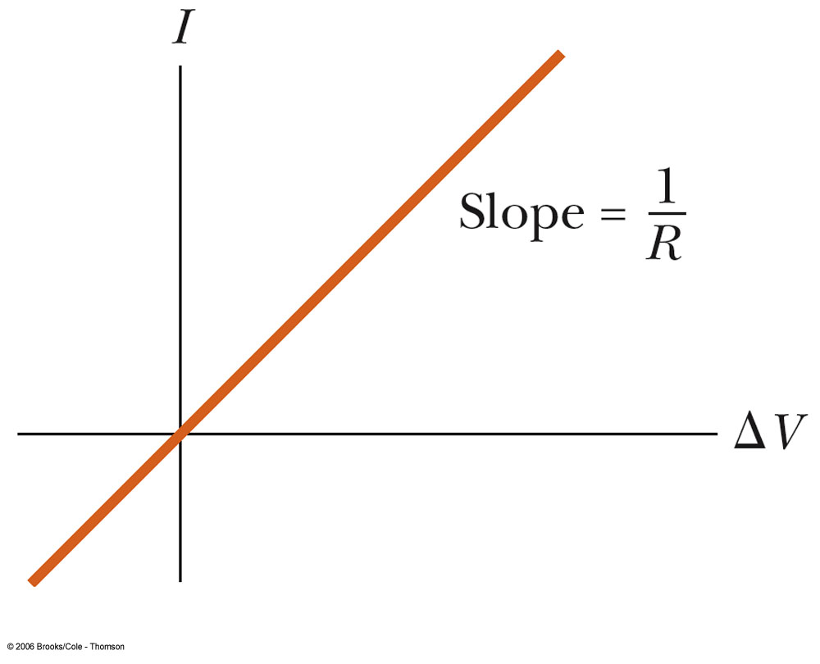
Ohm’s Law, cont
An ohmic device
The resistance is constant over a wide range of voltages
The relationship between current and voltage is linear
The slope is related to the resistance

Slide 16
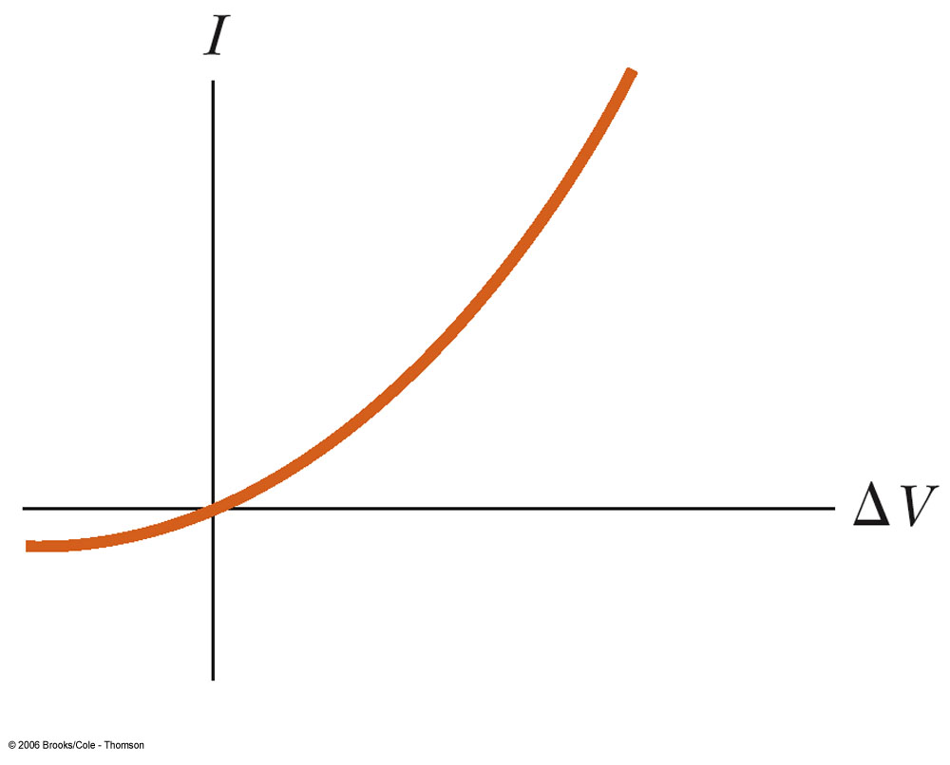
Ohm’s Law, final
Non-ohmic materials are those whose resistance changes with voltage or current
The current-voltage relationship is nonlinear
A diode is a common example of a non-ohmic device

Slide 17
Resistivity
The resistance of an ohmic conductor is proportional to its length, L, and inversely proportional to its cross-sectional area, A
ρ is the constant of proportionality and is called the resistivity of the material
See table 17.1

Slide 18
Temperature Variation of Resistivity
For most metals, resistivity increases with increasing temperature
With a higher temperature, the metal’s constituent atoms vibrate with increasing amplitude
The electrons find it more difficult to pass through the atoms

Slide 19
Temperature Variation of Resistivity, cont
For most metals, resistivity increases approximately linearly with temperature over a limited temperature range
ρ is the resistivity at some temperature T
ρ_{o} is the resistivity at some reference temperature T_{o}
T_{o} is usually taken to be 20° C
α is the temperature coefficient of resistivity

Slide 20
Temperature Variation of Resistance
Since the resistance of a conductor with uniform cross sectional area is proportional to the resistivity, you can find the effect of temperature on resistance

Slide 21
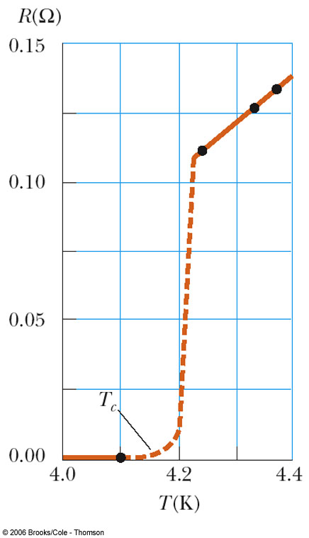
Superconductors
A class of materials and compounds whose resistances fall to virtually zero below a certain temperature, T_{C}
T_{C} is called the critical temperature
The graph is the same as a normal metal above T_{C}, but suddenly drops to zero at T_{C}

Slide 22
Superconductors, cont
The value of T_{C} is sensitive to
Chemical composition
Pressure
Crystalline structure
Once a current is set up in a superconductor, it persists without any applied voltage
Since R = 0

Slide 23
Superconductor Timeline
1911
Superconductivity discovered by H. Kamerlingh Onnes
1986
High temperature superconductivity discovered by Bednorz and Müller
Superconductivity near 30 K
1987
Superconductivity at 96 K and 105 K
Current
More materials and more applications

Slide 24
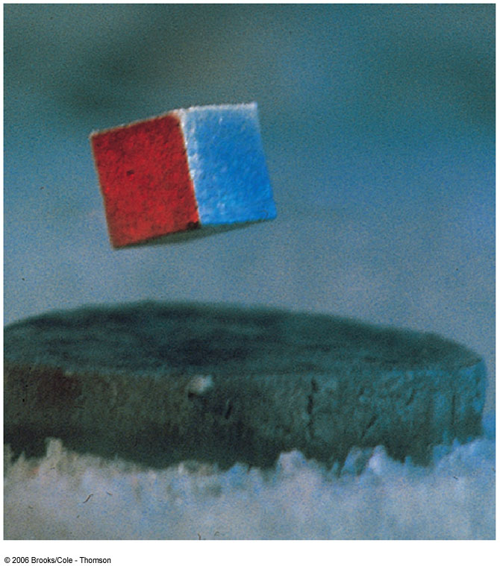
Superconductor, final
Good conductors do not necessarily exhibit superconductivity
One application is superconducting magnets

Slide 25
Electrical Energy and Power
In a circuit, as a charge moves through the battery, the electrical potential energy of the system is increased by ΔQΔV
The chemical potential energy of the battery decreases by the same amount
As the charge moves through a resistor, it loses this potential energy during collisions with atoms in the resistor
The temperature of the resistor will increase

Slide 26
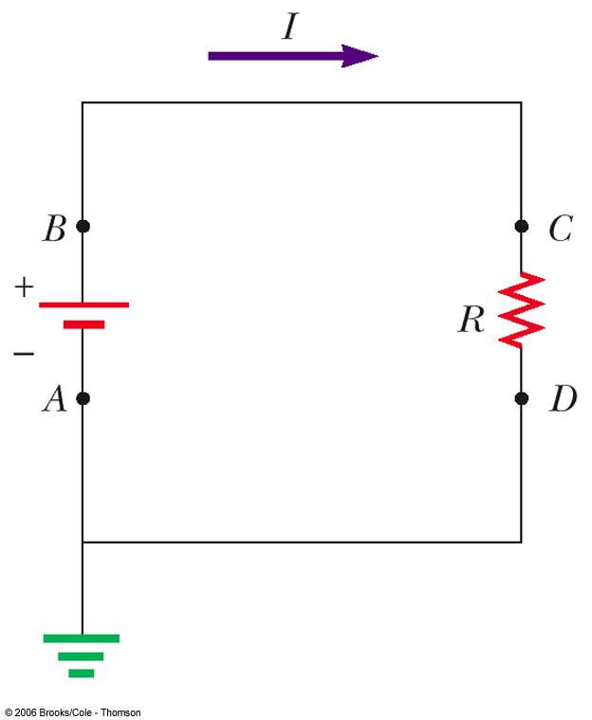
Energy Transfer in the Circuit
Consider the circuit shown
Imagine a quantity of positive charge, ΔQ, moving around the circuit from point A back to point A

Slide 27
Energy Transfer in the Circuit, cont
Point A is the reference point
It is grounded and its potential is taken to be zero
As the charge moves through the battery from A to B, the potential energy of the system increases by ΔQΔV
The chemical energy of the battery decreases by the same amount

Slide 28
Energy Transfer in the Circuit, final
As the charge moves through the resistor, from C to D, it loses energy in collisions with the atoms of the resistor
The energy is transferred to internal energy
When the charge returns to A, the net result is that some chemical energy of the battery has been delivered to the resistor and caused its temperature to rise

Slide 29
Electrical Energy and Power, cont
The rate at which the energy is lost is the power
From Ohm’s Law, alternate forms of power are

Slide 30
Electrical Energy and Power, final
The SI unit of power is Watt (W)
I must be in Amperes, R in ohms and ΔV in Volts
The unit of energy used by electric companies is the kilowatt-hour
This is defined in terms of the unit of power and the amount of time it is supplied
1 kWh = 3.60 x 10⁶ J

Slide 31
Electrical Activity in the Heart
Every action involving the body’s muscles is initiated by electrical activity
Voltage pulses cause the heart to beat
These voltage pulses are large enough to be detected by equipment attached to the skin

Slide 32
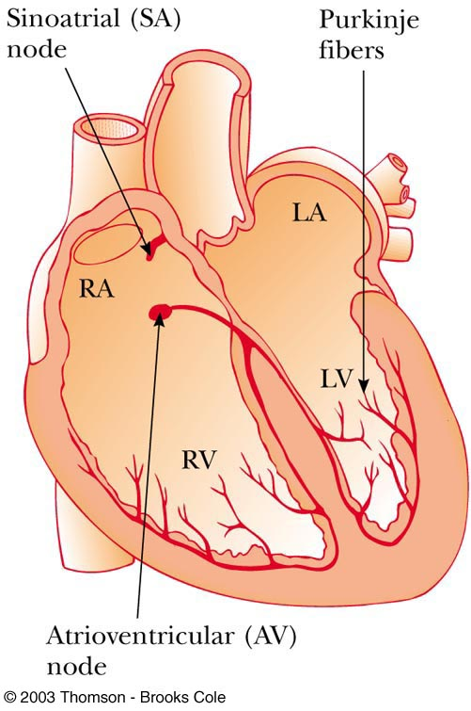
Operation of the Heart
The sinoatrial (SA) node initiates the heartbeat
The electrical impulses cause the right and left artial muscles to contract
When the impulse reaches the atrioventricular (AV) node, the muscles of the atria begin to relax
The ventricles relax and the cycle repeats

Slide 33
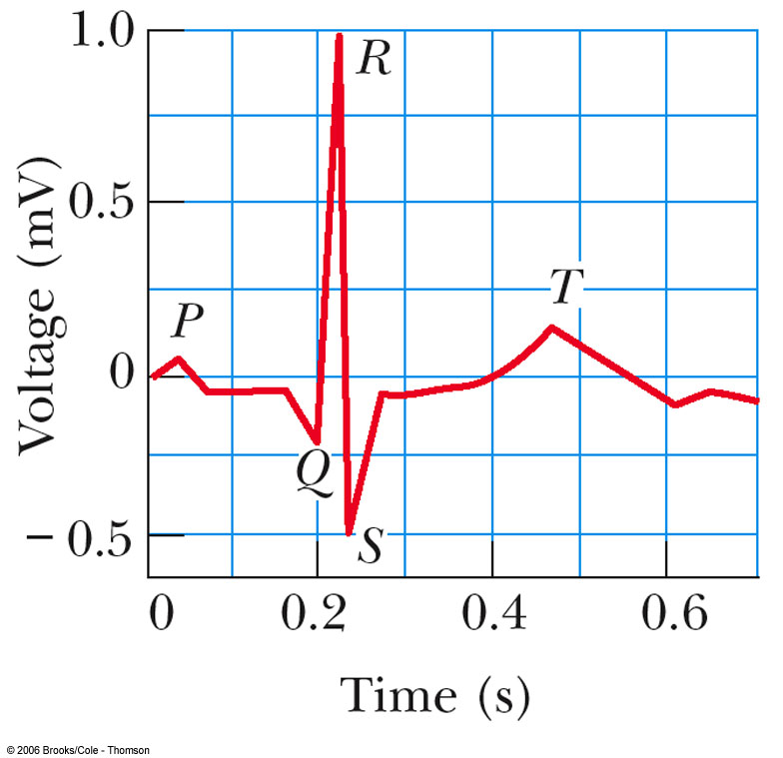
Electrocardiogram (EKG)
A normal EKG
P occurs just before the atria begin to contract
The QRS pulse occurs in the ventricles just before they contract
The T pulse occurs when the cells in the ventricles begin to recover

Slide 34
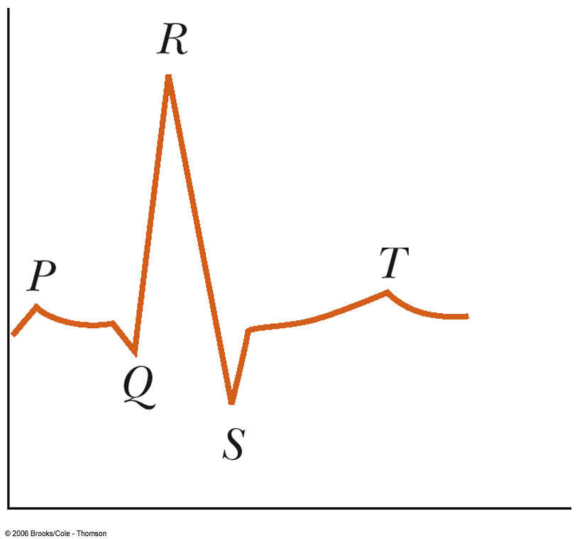
Abnormal EKG, 1
The QRS portion is wider than normal
This indicates the possibility of an enlarged heart

Slide 35
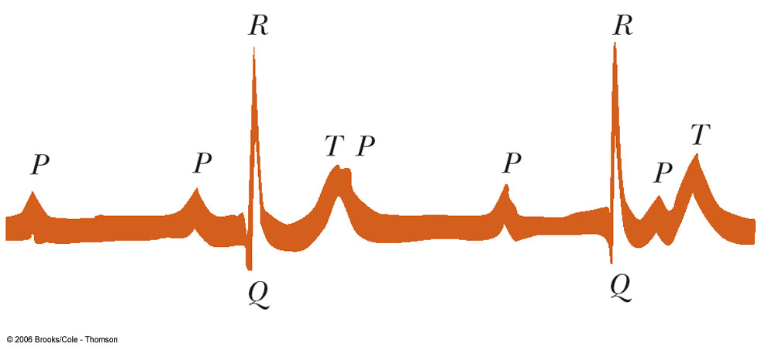
Abnormal EKG, 2
There is no constant relationship between P and QRS pulse
This suggests a blockage in the electrical conduction path between the SA and the AV nodes
This leads to inefficient heart pumping

Slide 36
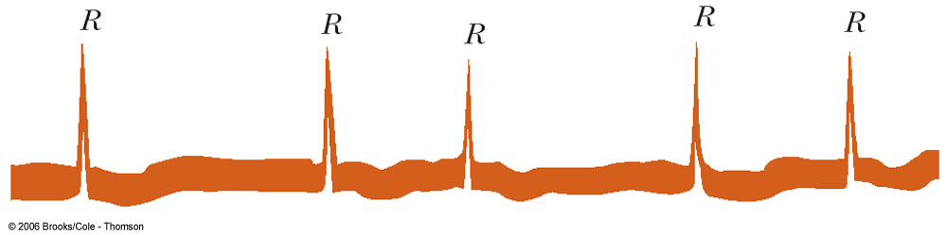
Abnormal EKG, 3
No P pulse and an irregular spacing between the QRS pulses
Symptomatic of irregular atrial contraction, called fibrillation
The atrial and ventricular contraction are irregular

Slide 37
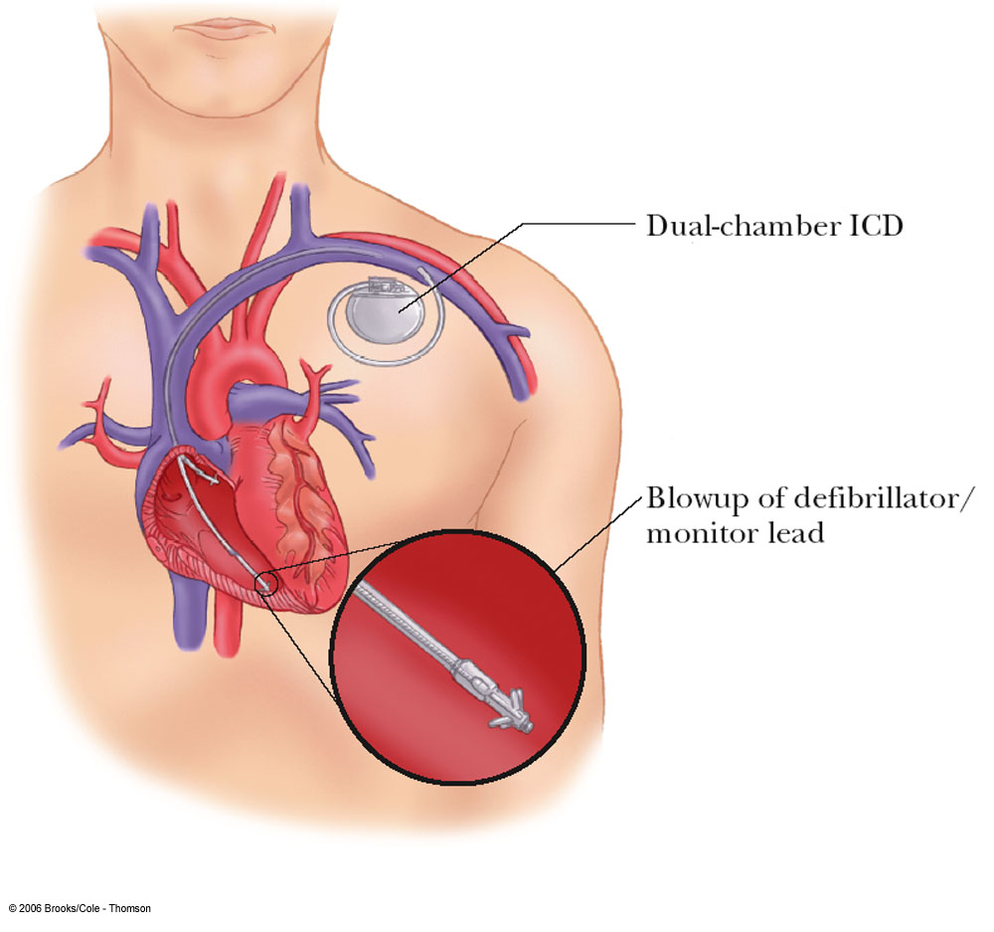
Implanted Cardioverter Defibrillator (ICD)
Devices that can monitor, record and logically process heart signals
Then supply different corrective signals to hearts that are not beating correctly

Slide 38
Functions of an ICD
Monitor artrial and ventricular chambers
Differentiate between arrhythmias
Store heart signals for read out by a physician
Easily reprogrammed by an external magnet

Slide 39
More Functions of an ICD
Perform signal analysis and comparison
Supply repetitive pacing signals to speed up or show down a malfunctioning heart
Adjust the number of pacing pulses per minute to match patient’s activity

