Slide 1
Chapter 18
Direct Current Circuits

Slide 2
Sources of emf
The source that maintains the current in a closed circuit is called a source of emf.
  Any devices that increase the potential energy of charges circulating in circuits are sources of emf. (Ex.batteries and generators)
SI units are Volts
  The emf is the work done per unit charge

Slide 3
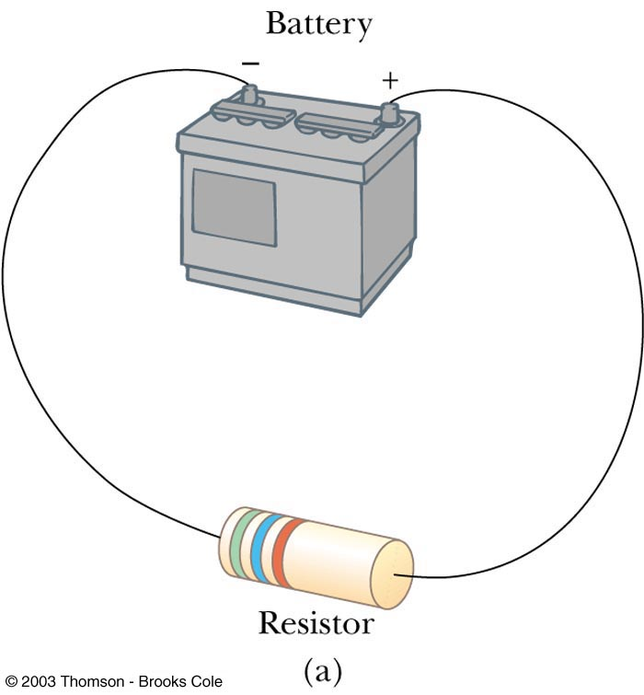
emf and Internal Resistance
A real battery has some internal resistance
Therefore, the terminal voltage is not equal to the emf

Slide 4
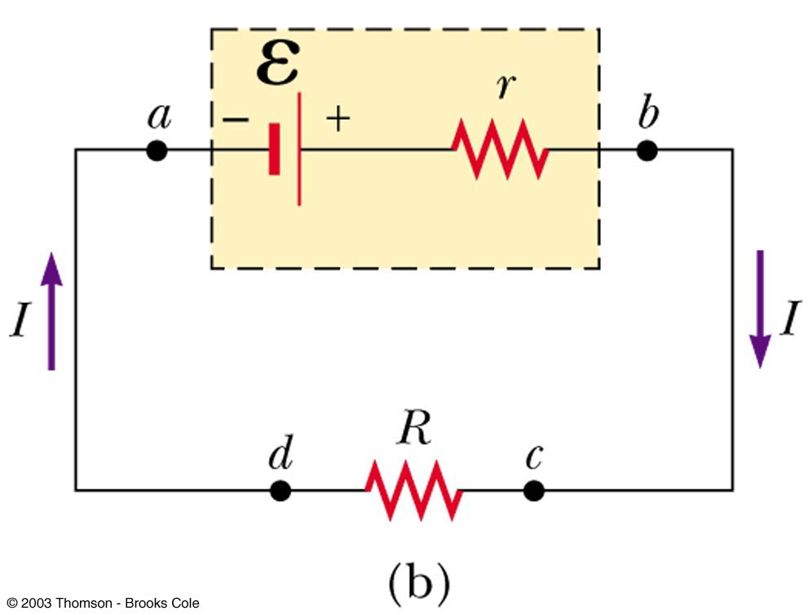
More About Internal Resistance
The schematic shows the internal resistance, r
The terminal voltage is ΔV = V_{b}-V_{a}
ΔV = ε – Ir
For the entire circuit, ε = IR + Ir

Slide 5
Internal Resistance and emf, cont
ε is equal to the terminal voltage when the current is zero
  Also called the open-circuit voltage
R is called the load resistance
The current depends on both the resistance external to the battery and the internal resistance.

Slide 6
Internal Resistance and emf, final
When R >> r, r can be ignored
  Generally assumed in problems

Slide 7
Resistors in Series
When two or more resistors are connected end-to-end, they are said to be in series.
The current is the same in all resistors.
The sum of the potential differences across the resistors is equal to the total potential difference across the combination.

Slide 8
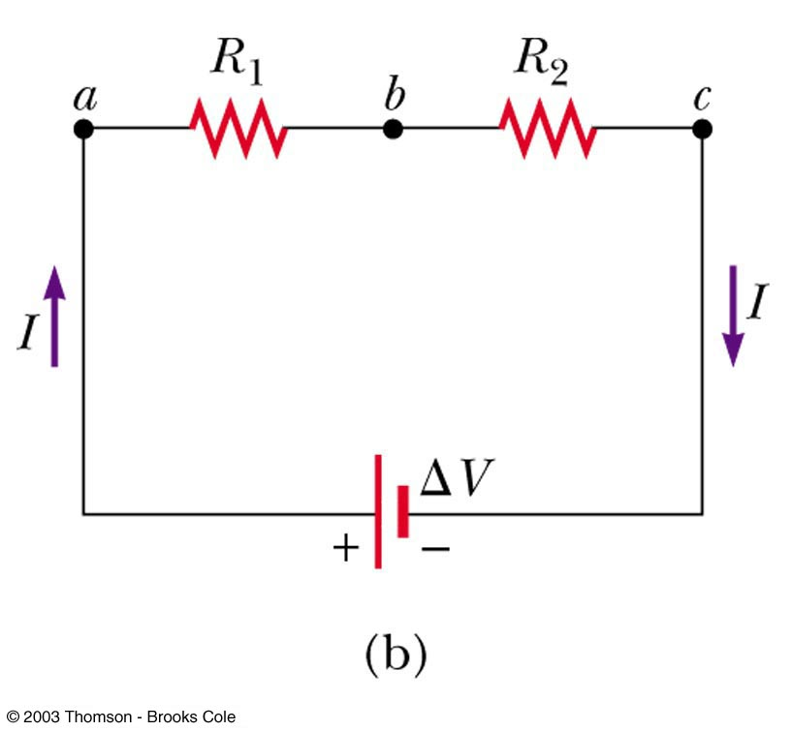
Resistors in Series, cont
Potentials add
  ΔV = IR₁ + IR₂ = I (R₁+R₂)
The equivalent resistance has the effect on the circuit as the original combination of resistors

Slide 9
Equivalent Resistance – Series
R_{eq} = R₁ + R₂ + R₃ + …

Slide 10
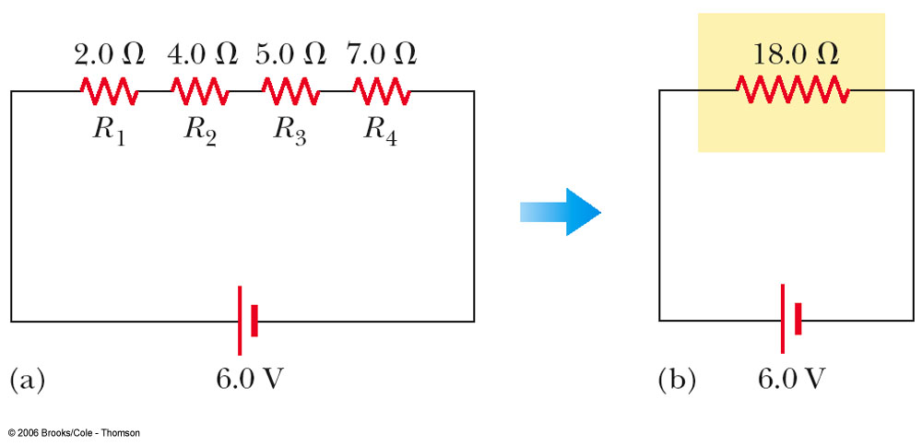
Equivalent Resistance – Series: An Example
Four resistors are replaced with their equivalent resistance

Slide 11
Resistors in Parallel
The potential difference across each resistor is the same because each is connected directly across the battery terminals
The current, I, that enters a point must be equal to the total current leaving that point
  I = I₁ + I₂
  The currents are generally not the same

Slide 12
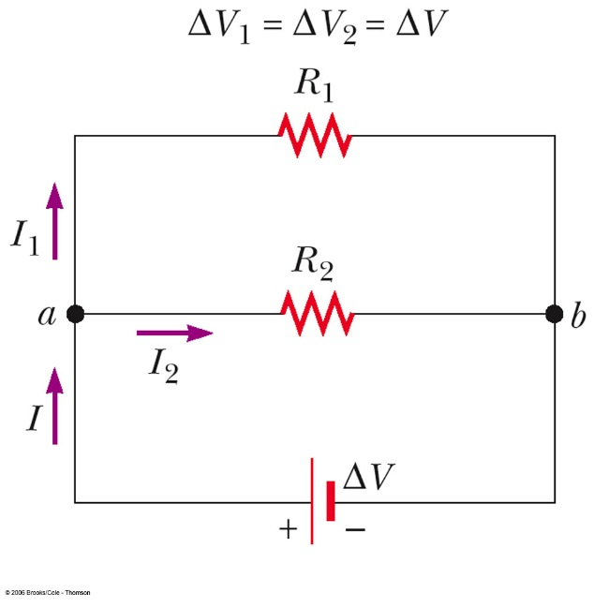
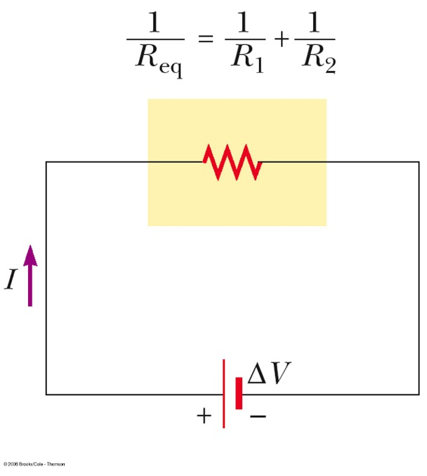
Equivalent Resistance – Parallel, Example
Equivalent resistance replaces the two original resistances
Household circuits are wired so the electrical devices are connected in parallel
  Circuit breakers may be used in series with other circuit elements for safety purposes

Slide 13
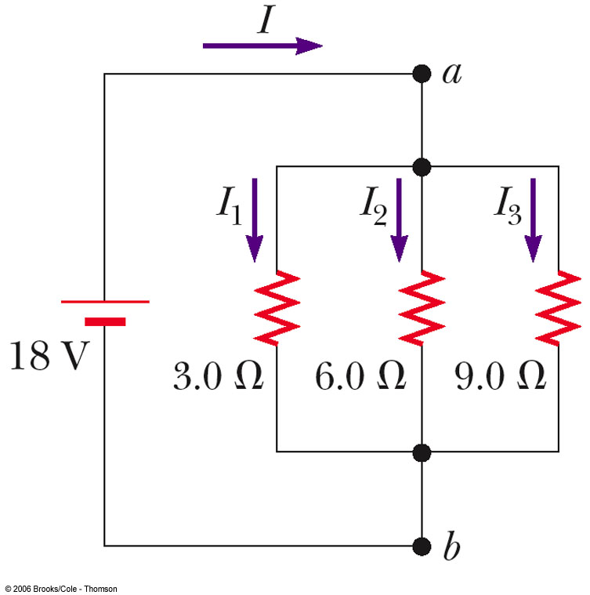
Equivalent Resistance – Parallel
Equivalent Resistance
The inverse of the equivalent resistance of two or more resistors connected in parallel is the algebraic sum of the inverses of the individual resistance
  The equivalent is always less than the smallest resistor in the group

Slide 14
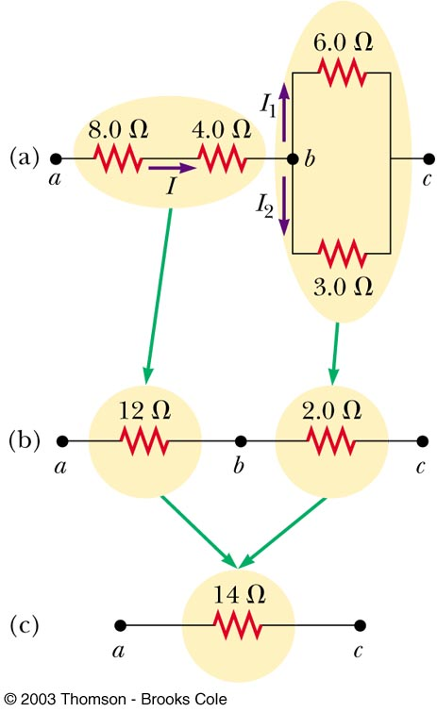
Equivalent
Resistance –
Complex Circuit

Slide 15
Kirchhoff’s Rules
There are ways in which resistors can be connected so that the circuits formed cannot be reduced to a single equivalent resistor
Two rules, called Kirchhoff’s Rules can be used instead

Slide 16
Statement of Kirchhoff’s Rules
Junction Rule
  The sum of the currents entering any junction must equal the sum of the currents leaving that junction
    A statement of Conservation of Charge
Loop Rule
  The sum of the potential differences across all the elements around any closed circuit loop must be zero
    A statement of Conservation of Energy

Slide 17
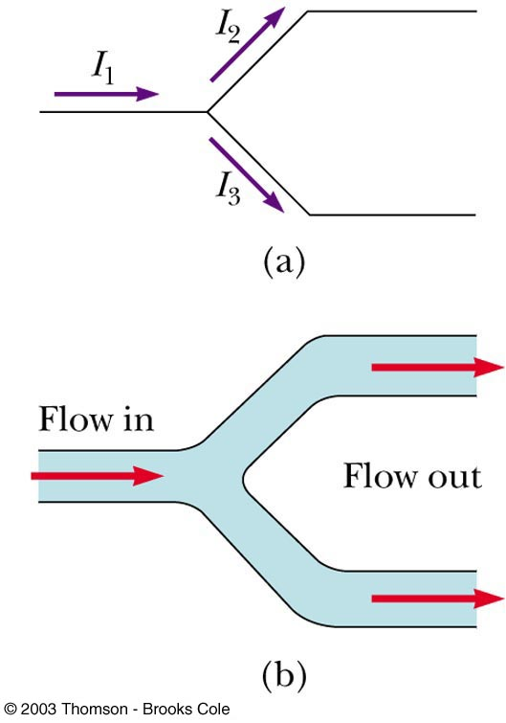
More About the Junction Rule
I₁ = I₂ + I₃
From Conservation of Charge
Diagram b shows a mechanical analog

Slide 18
Setting Up Kirchhoff’s Rules
Assign symbols and directions to the currents in all branches of the circuit
  If a direction is chosen incorrectly, the resulting answer will be negative, but the magnitude will be correct
When applying the loop rule, choose a direction for transversing the loop
  Record voltage drops and rises as they occur

Slide 19
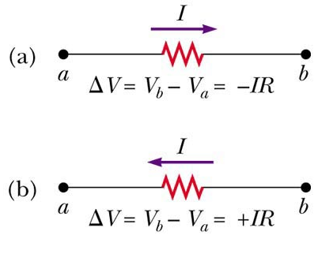
More About the Loop Rule
Traveling around the loop from a to b
In a, the resistor is transversed in the direction of the current, the potential across the resistor is –IR
In b, the resistor is transversed in the direction opposite of the current, the potential across the resistor is +IR

Slide 20
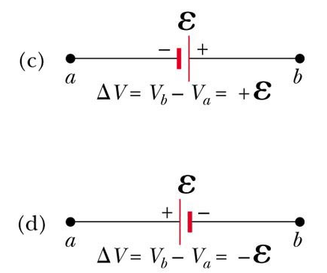
Loop Rule, final
In c, the source of emf is transversed in the direction of the emf (from – to +), the change in the electric potential is +ε
In d, the source of emf is transversed in the direction opposite of the emf (from + to -), the change in the electric potential is -ε

Slide 21
Junction Equations from Kirchhoff’s Rules
Use the junction rule as often as needed, so long as, each time you write an equation, you include in it a current that has not been used in a previous junction rule equation
  In general, the number of times the junction rule can be used is one fewer than the number of junction points in the circuit

Slide 22
Loop Equations from Kirchhoff’s Rules
The loop rule can be used as often as needed so long as a new circuit element (resistor or battery) or a new current appears in each new equation
You need as many independent equations as you have unknowns

Slide 23
Problem-Solving Strategy – Kirchhoff’s Rules
Draw the circuit diagram and assign labels and symbols to all known and unknown quantities
Assign directions to the currents.
Apply the junction rule to any junction in the circuit
Apply the loop rule to as many loops as are needed to solve for the unknowns
Solve the equations simultaneously for the unknown quantities
Check your answers

Slide 24
RC Circuits
A direct current circuit may contain capacitors and resistors, the current will vary with time
When the circuit is completed, the capacitor starts to charge
The capacitor continues to charge until it reaches its maximum charge (Q = Cε)
Once the capacitor is fully charged, the current in the circuit is zero

Slide 25
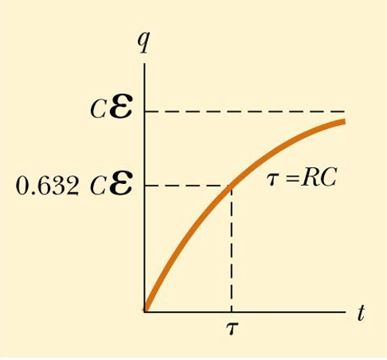
Charging Capacitor in an RC Circuit
The charge on the capacitor varies with time
  q = Q(1 – e^{-t/RC})
  The time constant, τ=RC
The time constant represents the time required for the charge to increase from zero to 63.2% of its maximum

Slide 26
Notes on Time Constant
In a circuit with a large time constant, the capacitor charges very slowly
The capacitor charges very quickly if there is a small time constant
After t = 10 τ, the capacitor is over 99.99% charged

Slide 27
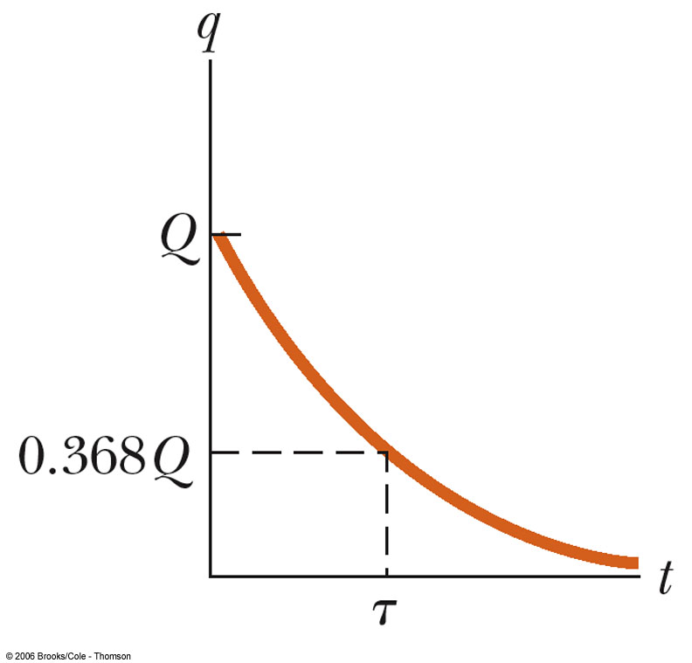
Discharging Capacitor in an RC Circuit
When a charged capacitor is placed in the circuit, it can be discharged
  q = Qe-t/RC
The charge decreases exponentially
At t = τ = RC, the charge decreases to 0.368 Qmax
  In other words, in one time constant, the capacitor loses 63.2% of its initial charge

