Slide 1
Chapter 3
Vectors and
Two-Dimensional Motion

Slide 2
Vector vs. Scalar Review
All physical quantities encountered in this text will be either a scalar or a vector
A vector quantity has both magnitude (size) and direction
A scalar is completely specified by only a magnitude (size)

Slide 3
Vector Notation
When handwritten, use an arrow:
When printed, will be in bold print with an arrow:
When dealing with just the magnitude of a vector in print, an italic letter will be used: A

Slide 4
Properties of Vectors
Equality of Two Vectors
Two vectors are equal if they have the same magnitude and the same direction
Movement of vectors in a diagram
Any vector can be moved parallel to itself without being affected

Slide 5
More Properties of Vectors
Negative Vectors
Two vectors are negative if they have the same magnitude but are 180° apart (opposite directions)
Resultant Vector
The resultant vector is the sum of a given set of vectors

Slide 6
Adding Vectors
When adding vectors, their directions must be taken into account
Units must be the same
Geometric Methods
Use scale drawings
Algebraic Methods
More convenient

Slide 7
Adding Vectors Geometrically (Triangle or Polygon Method)
Choose a scale
Draw the first vector with the appropriate length and in the direction specified, with respect to a coordinate system
Draw the next vector with the appropriate length and in the direction specified, with respect to a coordinate system whose origin is the end of vector and parallel to the coordinate system used for

Slide 8
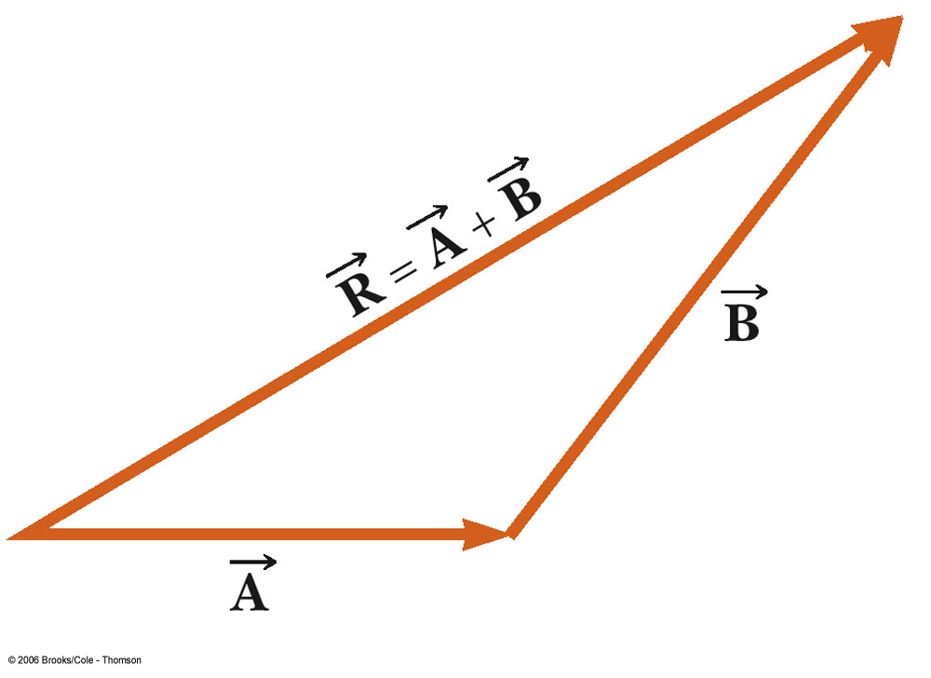
Graphically Adding Vectors, cont.
Continue drawing the vectors “tip-to-tail”
The resultant is drawn from the origin of to the end of the last vector
Measure the length of and its angle
Use the scale factor to convert length to actual magnitude

Slide 9
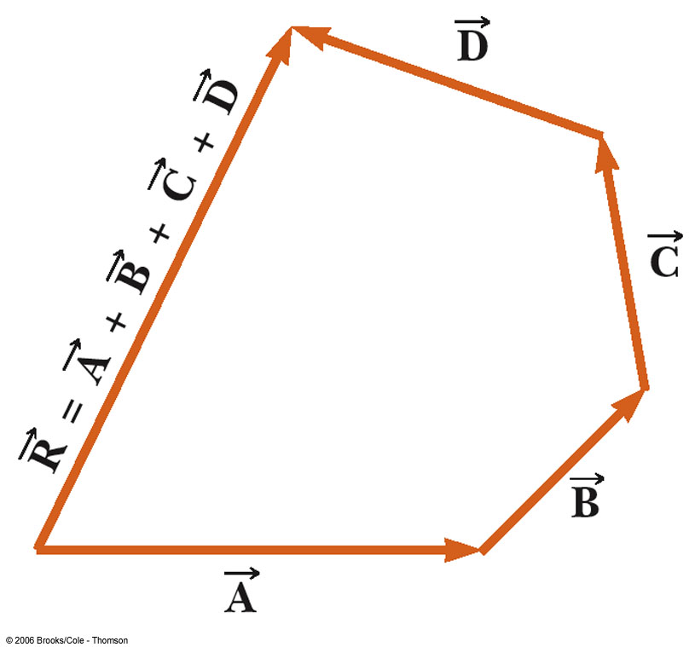
Graphically Adding Vectors, cont.
When you have many vectors, just keep repeating the process until all are included
The resultant is still drawn from the origin of the first vector to the end of the last vector

Slide 10
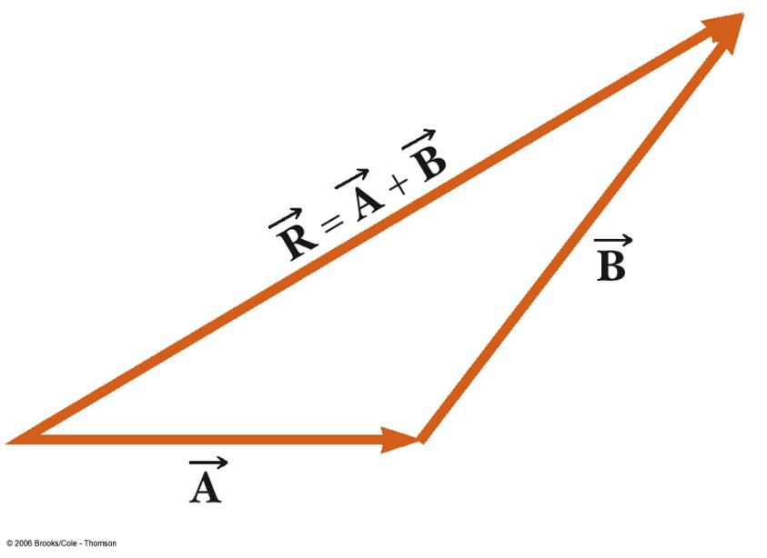
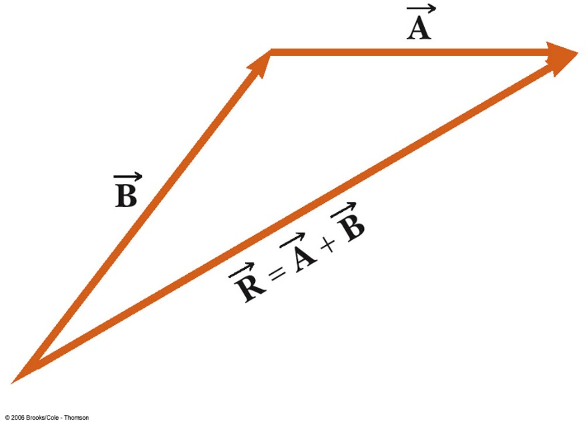
Notes about Vector Addition
Vectors obey the Commutative Law of Addition
The order in which the vectors are added doesn’t affect the result

Slide 11
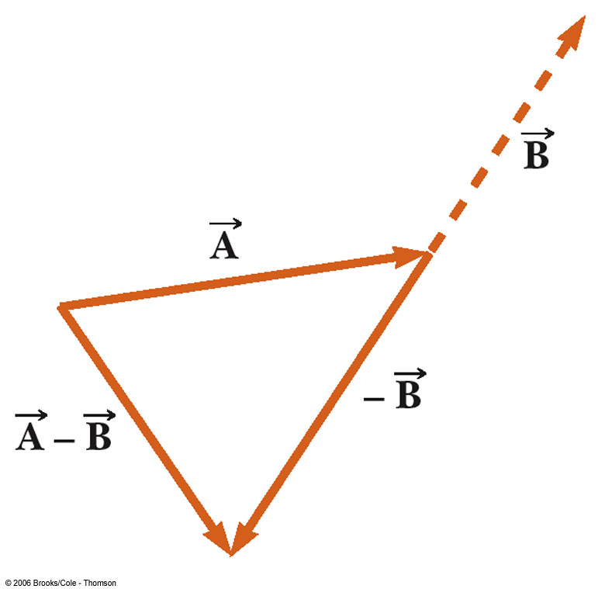
Vector Subtraction
Special case of vector addition
Add the negative of the subtracted vector
Continue with standard vector addition procedure

Slide 12
Multiplying or Dividing a Vector by a Scalar
The result of the multiplication or division is a vector
The magnitude of the vector is multiplied or divided by the scalar
If the scalar is positive, the direction of the result is the same as of the original vector
If the scalar is negative, the direction of the result is opposite that of the original vector

Slide 13
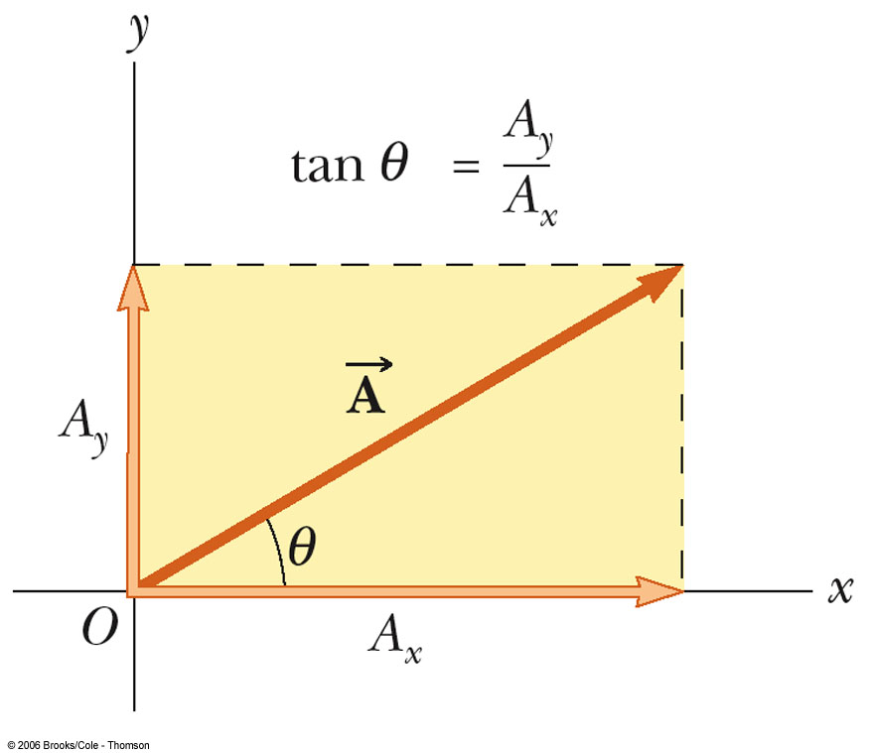
Components of a Vector
A component is a part
It is useful to use rectangular components
These are the projections of the vector along the x- and y-axes

Slide 14
Components of a Vector, cont.
The x-component of a vector is the projection along the x-axis
The y-component of a vector is the projection along the y-axis
Then,

Slide 15
More About Components of a Vector
The previous equations are valid only if θ is measured with respect to the x-axis
The components can be positive or negative and will have the same units as the original vector

Slide 16
More About Components, cont.
The components are the legs of the right triangle whose hypotenuse is
May still have to find θ with respect to the positive x-axis
The value will be correct only if the angle lies in the first or fourth quadrant
In the second or third quadrant, add 180°

Slide 17
Adding Vectors Algebraically
Choose a coordinate system and sketch the vectors
Find the x- and y-components of all the vectors
Add all the x-components
This gives R_{x}:

Slide 18
Adding Vectors Algebraically, cont.
Add all the y-components
This gives R_{y}:
Use the Pythagorean Theorem to find the magnitude of the resultant:
Use the inverse tangent function to find the direction of R:

Slide 19
Motion in Two Dimensions
Using + or – signs is not always sufficient to fully describe motion in more than one dimension
Vectors can be used to more fully describe motion
Still interested in displacement, velocity, and acceleration

Slide 20
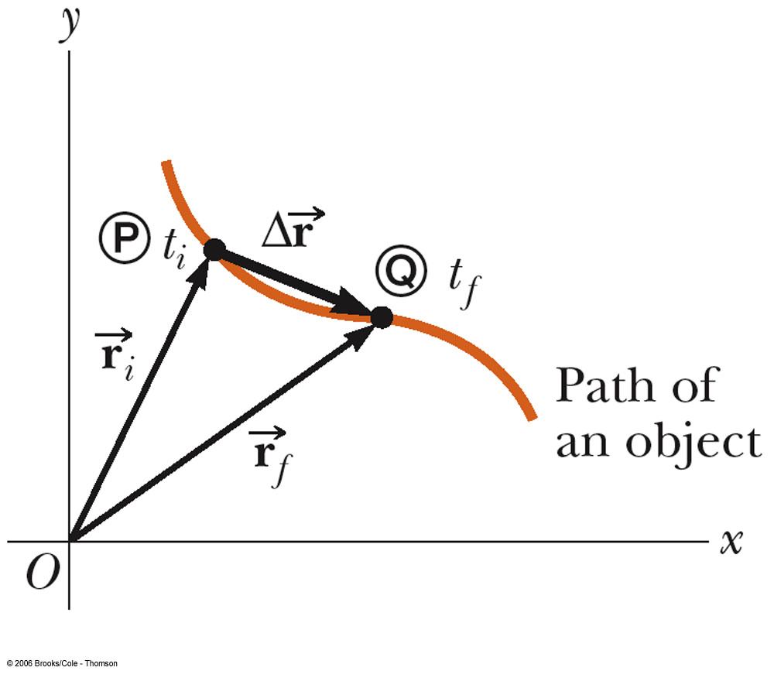
Displacement
The position of an object is described by its position vector,
The displacement of the object is defined as the change in its position

Slide 21
Velocity
The average velocity is the ratio of the displacement to the time interval for the displacement
The instantaneous velocity is the limit of the average velocity as Δt approaches zero
The direction of the instantaneous velocity is along a line that is tangent to the path of the particle and in the direction of motion

Slide 22
Acceleration
The average acceleration is defined as the rate at which the velocity changes
The instantaneous acceleration is the limit of the average acceleration as Δt approaches zero

Slide 23
Unit Summary (SI)
Displacement
m
Average velocity and instantaneous velocity
m/s
Average acceleration and instantaneous acceleration
m/s²

Slide 24
Ways an Object Might Accelerate
The magnitude of the velocity (the speed) can change
The direction of the velocity can change
Even though the magnitude is constant
Both the magnitude and the direction can change

Slide 25
Projectile Motion
An object may move in both the x and y directions simultaneously
It moves in two dimensions
The form of two dimensional motion we will deal with is called projectile motion

Slide 26
Assumptions of Projectile Motion
We may ignore air friction
We may ignore the rotation of the earth
With these assumptions, an object in projectile motion will follow a parabolic path

Slide 27
Rules of Projectile Motion
The x- and y-directions of motion are completely independent of each other
The x-direction is uniform motion
a_{x} = 0
The y-direction is free fall
a_{y} = -g
The initial velocity can be broken down into its x- and y-components

Slide 28
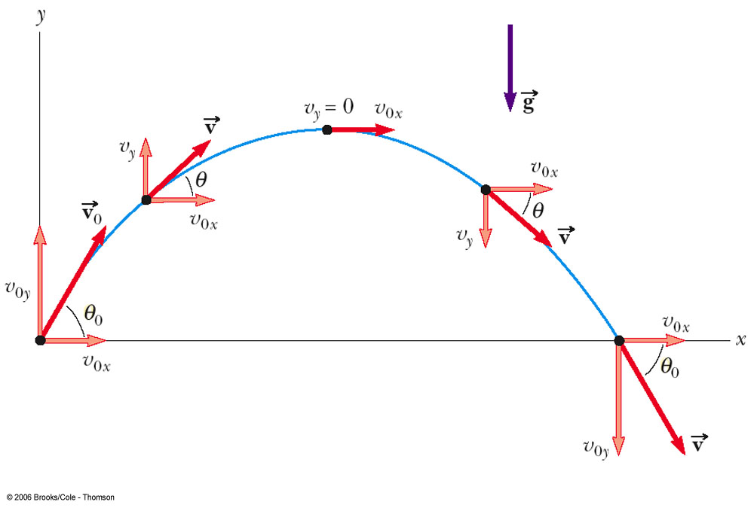
Projectile Motion

Slide 29
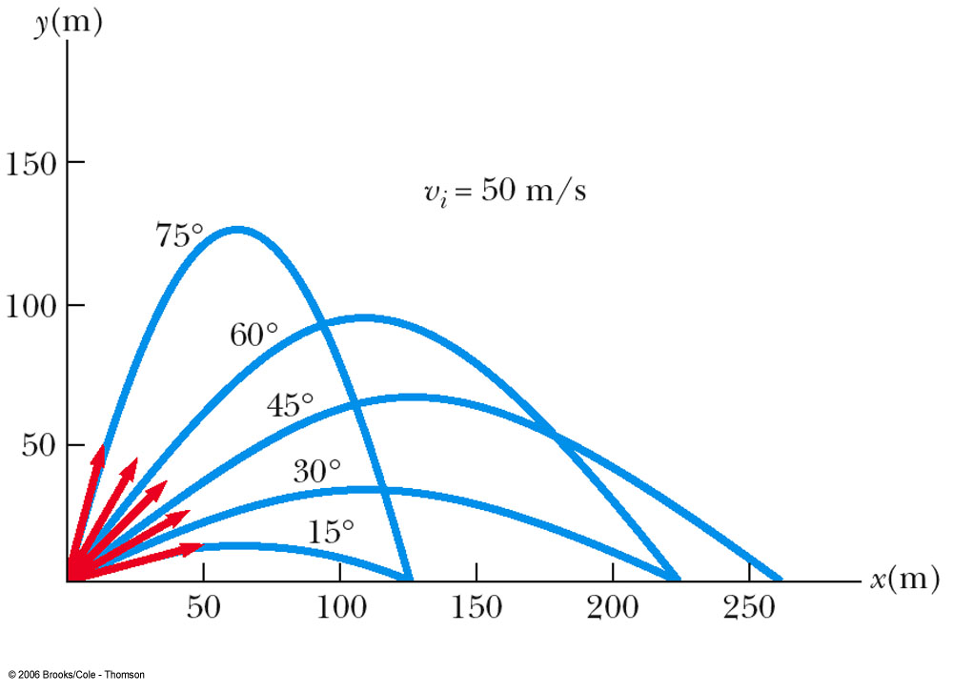
Projectile Motion at Various Initial Angles
Complementary values of the initial angle result in the same range
The heights will be different
The maximum range occurs at a projection angle of 45º

Slide 30
Some Details About the Rules
x-direction
a_{x} = 0
x = v_{xo}t
This is the only operative equation in the x-direction since there is uniform velocity in that direction

Slide 31
More Details About the Rules
y-direction
free fall problem
a = -g
take the positive direction as upward
uniformly accelerated motion, so the motion equations all hold

Slide 32
Velocity of the Projectile
The velocity of the projectile at any point of its motion is the vector sum of its x and y components at that point
Remember to be careful about the angle’s quadrant

Slide 33
Problem-Solving Strategy
Select a coordinate system and sketch the path of the projectile
Include initial and final positions, velocities, and accelerations
Resolve the initial velocity into x- and y-components
Treat the horizontal and vertical motions independently

Slide 34
Problem-Solving Strategy, cont
Follow the techniques for solving problems with constant velocity to analyze the horizontal motion of the projectile
Follow the techniques for solving problems with constant acceleration to analyze the vertical motion of the projectile

Slide 35
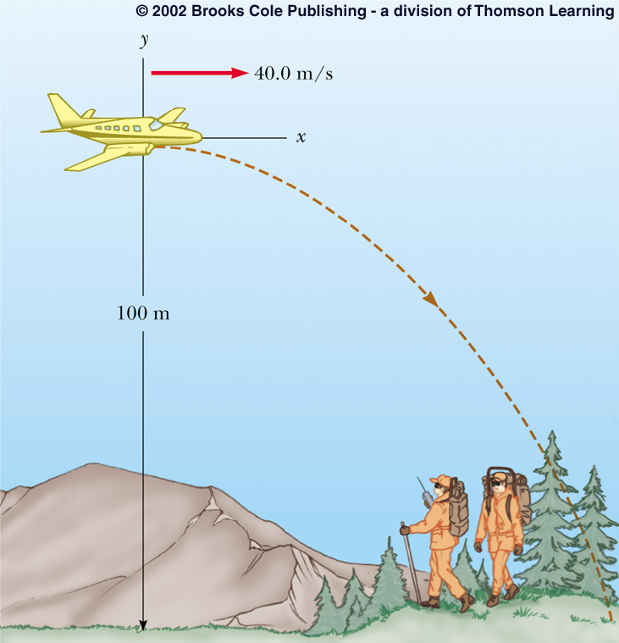
Some Variations of Projectile Motion
An object may be fired horizontally
The initial velocity is all in the x-direction
v_{o} = v_{x} and v_{y} = 0
All the general rules of projectile motion apply

Slide 36
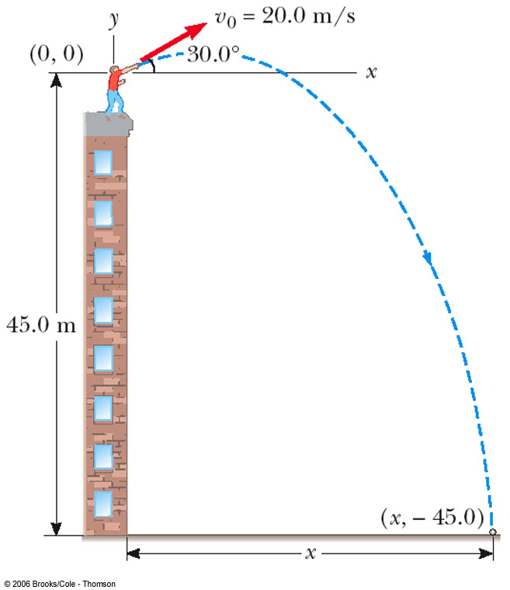
Non-Symmetrical Projectile Motion
Follow the general rules for projectile motion
Break the y-direction into parts
up and down
symmetrical back to initial height and then the rest of the height

Slide 37
Relative Velocity
Relative velocity is about relating the measurements of two different observers
It may be useful to use a moving frame of reference instead of a stationary one
It is important to specify the frame of reference, since the motion may be different in different frames of reference
There are no specific equations to learn to solve relative velocity problems

Slide 38
Relative Velocity Notation
The pattern of subscripts can be useful in solving relative velocity problems
Assume the following notation:
E is an observer, stationary with respect to the earth
A and B are two moving cars

Slide 39
Relative Position Equations
is the position of car A as measured by E
is the position of car B as measured by E
is the position of car A as measured by car B

Slide 40
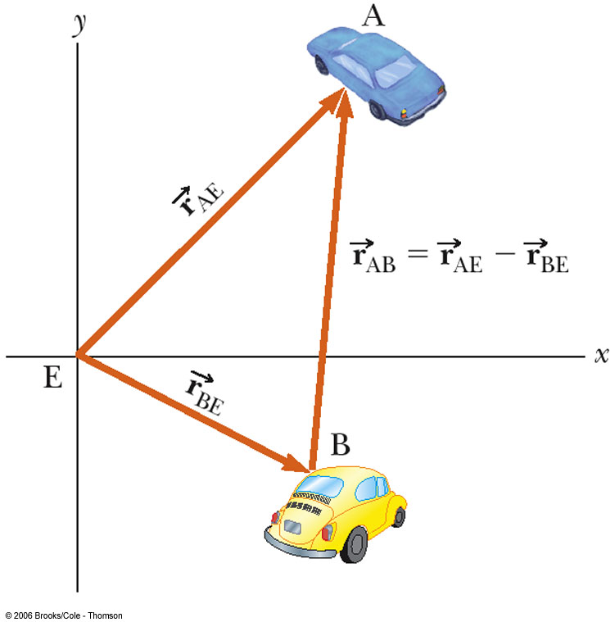
Relative Position
The position of car A relative to car B is given by the vector subtraction equation

Slide 41
Relative Velocity Equations
The rate of change of the displacements gives the relationship for the velocities

Slide 42
Problem-Solving Strategy: Relative Velocity
Label all the objects with a descriptive letter
Look for phrases such as “velocity of A relative to B”
Write the velocity variables with appropriate notation
If there is something not explicitly noted as being relative to something else, it is probably relative to the earth

Slide 43
Problem-Solving Strategy: Relative Velocity, cont
Take the velocities and put them into an equation
Keep the subscripts in an order analogous to the standard equation
Solve for the unknown(s)

