Slide 1
Chapter 4
The Laws of Motion

Slide 2
Classical Mechanics
Describes the relationship between the motion of objects in our everyday world and the forces acting on them
Conditions when Classical Mechanics does not apply
very tiny objects (< atomic sizes)
objects moving near the speed of light

Slide 3
Forces
Usually think of a force as a push or pull
Vector quantity
May be a contact force or a field force
Contact forces result from physical contact between two objects
Field forces act between disconnected objects
Also called “action at a distance”

Slide 4
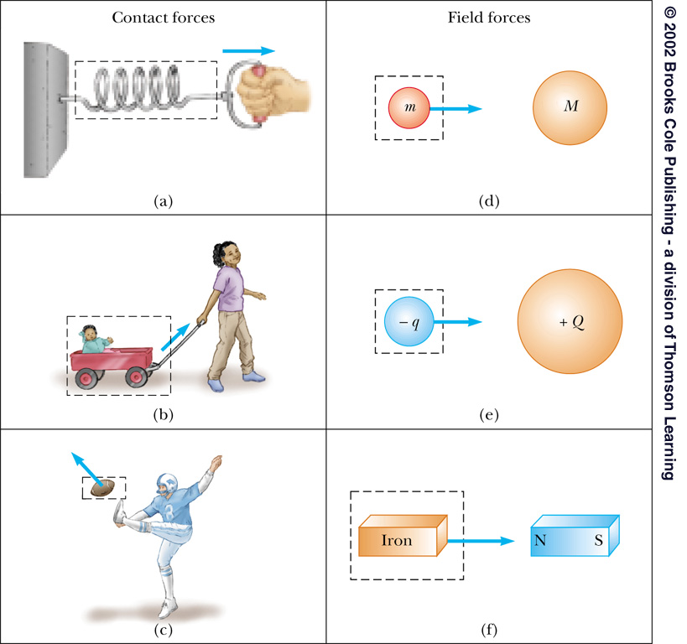
Contact and Field Forces

Slide 5
Fundamental Forces
Types
Strong nuclear force
Electromagnetic force
Weak nuclear force
Gravity
Characteristics
All field forces
Listed in order of decreasing strength
Only gravity and electromagnetic in mechanics

Slide 6
Newton’s First Law
An object moves with a velocity that is constant in magnitude and direction, unless acted on by a nonzero net force
The net force is defined as the vector sum of all the external forces exerted on the object

Slide 7
External and Internal Forces
External force
Any force that results from the interaction between the object and its environment
Internal forces
Forces that originate within the object itself
They cannot change the object’s velocity

Slide 8
Inertia
Is the tendency of an object to continue in its original motion

Slide 9
Mass
A measure of the resistance of an object to changes in its motion due to a force
Scalar quantity
SI units are kg

Slide 10
Newton’s Second Law
The acceleration of an object is directly proportional to the net force acting on it and inversely proportional to its mass.
F and a are both vectors
Can also be applied three-dimensionally

Slide 11
Units of Force
SI unit of force is a Newton (N)
US Customary unit of force is a pound (lb)
1 N = 0.225 lb
See table 4.1

Slide 12
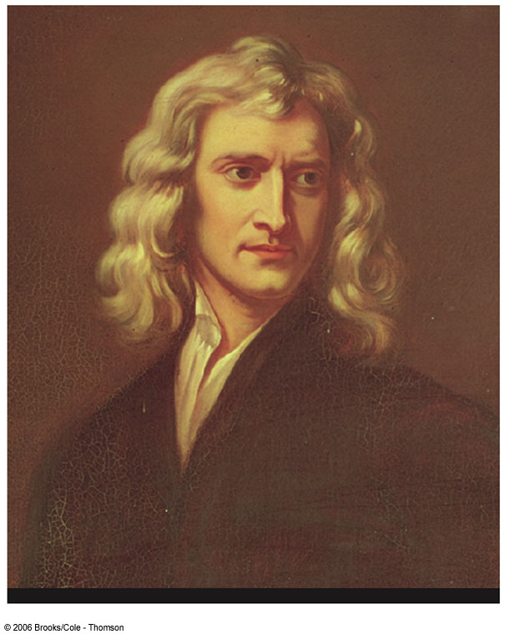
Sir Isaac Newton
1642 – 1727
Formulated basic concepts and laws of mechanics
Universal Gravitation
Calculus
Light and optics

Slide 13
Gravitational Force
Mutual force of attraction between any two objects
Expressed by Newton’s Law of Universal Gravitation:

Slide 14
Weight
The magnitude of the gravitational force acting on an object of mass m near the Earth’s surface is called the weight w of the object
w = m g is a special case of Newton’s Second Law
g is the acceleration due to gravity
g can also be found from the Law of Universal Gravitation

Slide 15
More about weight
Weight is not an inherent property of an object
mass is an inherent property
Weight depends upon location

Slide 16
Newton’s Third Law
If object 1 and object 2 interact, the force exerted by object 1 on object 2 is equal in magnitude but opposite in direction to the force exerted by object 2 on object 1.
Equivalent to saying a single isolated force cannot exist

Slide 17
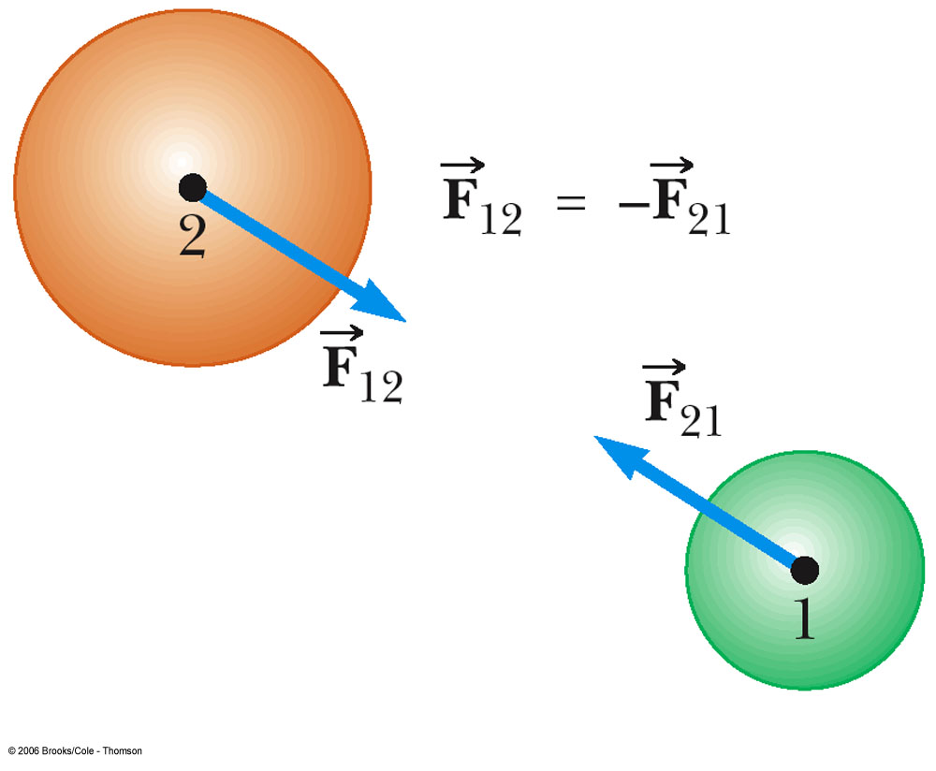
Newton’s Third Law cont.
F₁₂ may be called the action force and F₂₁ the reaction force
Actually, either force can be the action or the reaction force
The action and reaction forces act on different objects

Slide 18
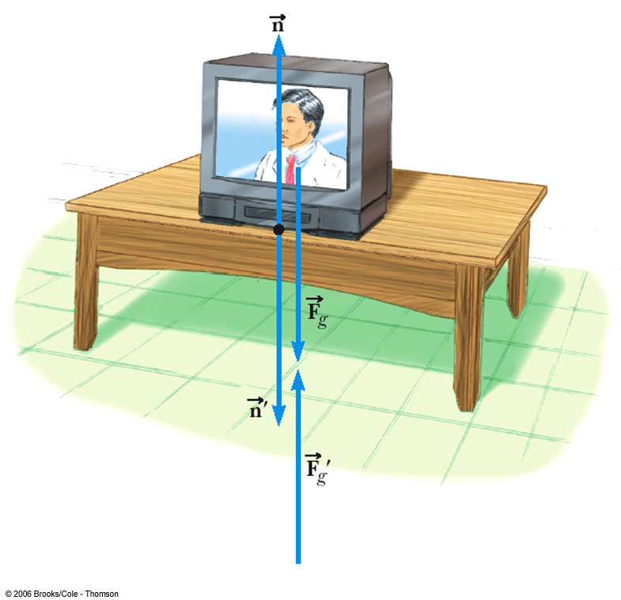
Some Action-Reaction Pairs
is the normal force, the force the table exerts on the TV
is always perpendicular to the surface
is the reaction – the TV on the table

Slide 19
More Action-Reaction pairs
is the force the Earth exerts on the object
is the force the object exerts on the earth

Slide 20
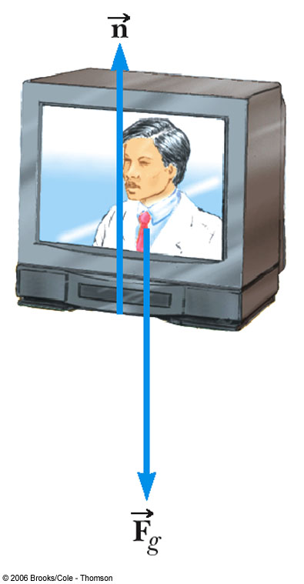
Forces Acting on an Object
Newton’s Law uses the forces acting on an object
are acting on the object
are acting on other objects

Slide 21
Applications of Newton’s Laws
Assumptions
Objects behave as particles
can ignore rotational motion (for now)
Masses of strings or ropes are negligible
Interested only in the forces acting on the object
can neglect reaction forces

Slide 22
Free Body Diagram
Must identify all the forces acting on the object of interest
Choose an appropriate coordinate system
If the free body diagram is incorrect, the solution will likely be incorrect

Slide 23

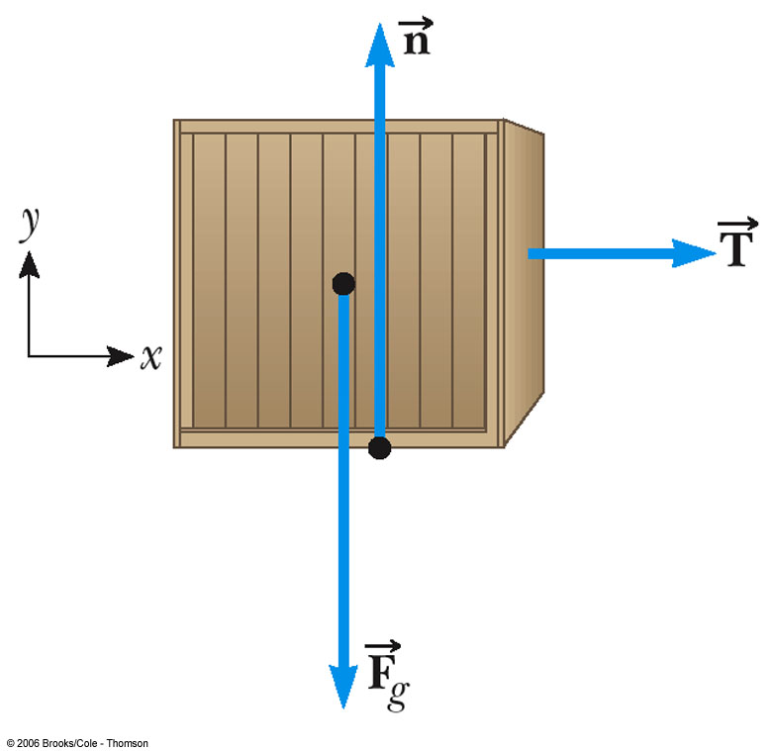
Free Body Diagram, Example
The force is the tension acting on the box
The tension is the same at all points along the rope
are the forces exerted by the earth and the ground

Slide 24
Free Body Diagram, final
Only forces acting directly on the object are included in the free body diagram
Reaction forces act on other objects and so are not included
The reaction forces do not directly influence the object’s motion

Slide 25
Solving Newton’s Second Law Problems
Read the problem at least once
Draw a picture of the system
Identify the object of primary interest
Indicate forces with arrows
Label each force
Use labels that bring to mind the physical quantity involved

Slide 26
Solving Newton’s Second Law Problems
Draw a free body diagram
If additional objects are involved, draw separate free body diagrams for each object
Choose a convenient coordinate system for each object
Apply Newton’s Second Law
The x- and y-components should be taken from the vector equation and written separately
Solve for the unknown(s)

Slide 27
Equilibrium
An object either at rest or moving with a constant velocity is said to be in equilibrium
The net force acting on the object is zero (since the acceleration is zero)

Slide 28
Equilibrium cont.
Easier to work with the equation in terms of its components:
This could be extended to three dimensions

Slide 29
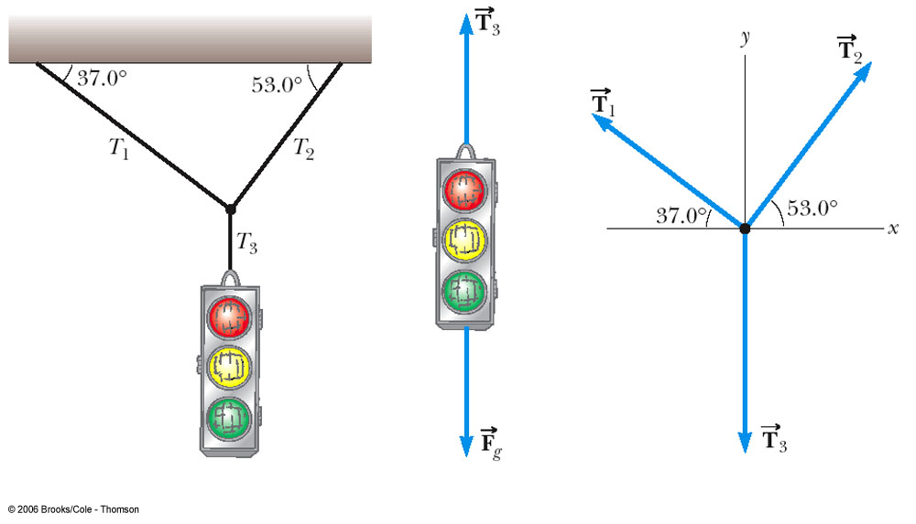
Equilibrium Example – Free Body Diagrams

Slide 30
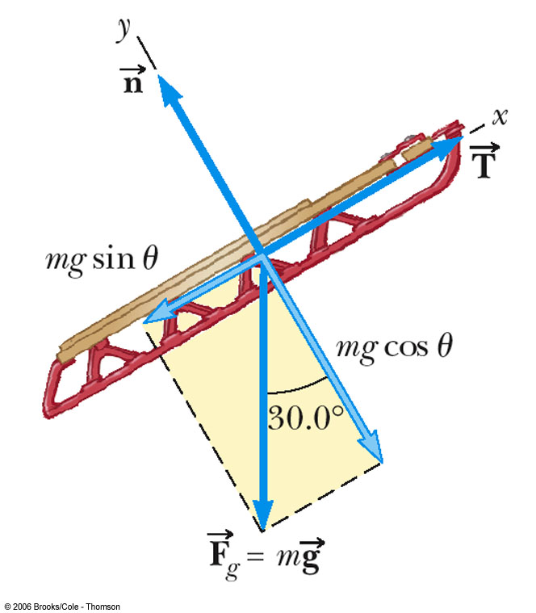
Inclined Planes
Choose the coordinate system with x along the incline and y perpendicular to the incline
Replace the force of gravity with its components

Slide 31
Multiple Objects – Example
When you have more than one object, the problem-solving strategy is applied to each object
Draw free body diagrams for each object
Apply Newton’s Laws to each object
Solve the equations

Slide 32
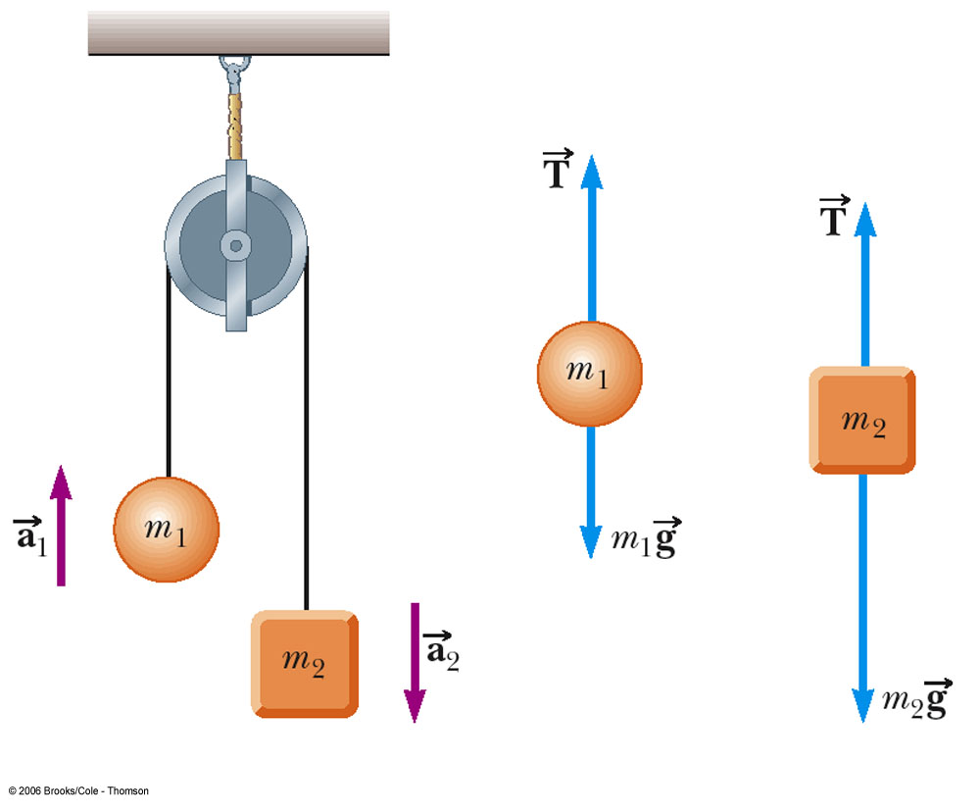
Multiple Objects – Example, cont.

Slide 33
Forces of Friction
When an object is in motion on a surface or through a viscous medium, there will be a resistance to the motion
This is due to the interactions between the object and its environment
This is resistance is called friction

Slide 34
More About Friction
Friction is proportional to the normal force
The force of static friction is generally greater than the force of kinetic friction
The coefficient of friction (µ) depends on the surfaces in contact
The direction of the frictional force is opposite the direction of motion
The coefficients of friction are nearly independent of the area of contact

Slide 35
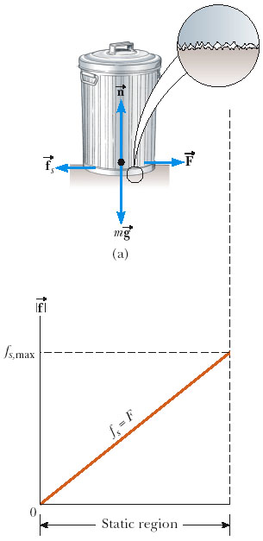
Static Friction, ƒ_{s}
Static friction acts to keep the object from moving
If F increases, so does ƒ_{s}
If F decreases, so does ƒ_{s}
ƒ_{s} ≤ µ n

Slide 36
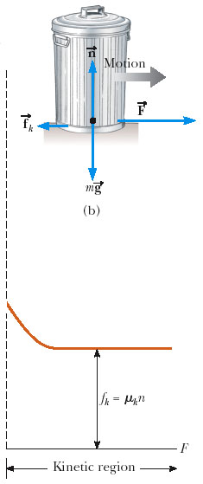
Kinetic Friction, ƒ_{k}
The force of kinetic friction acts when the object is in motion
ƒ_{k} = µ n
Variations of the coefficient with speed will be ignored

Slide 37
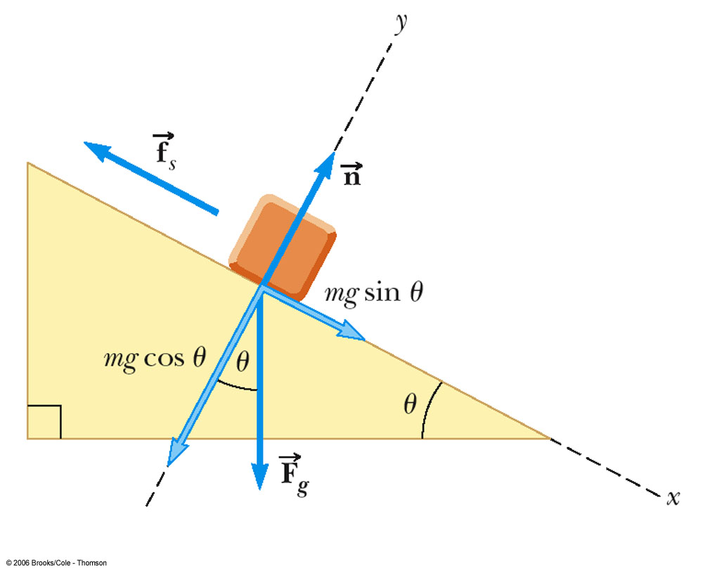
Block on a Ramp, Example
Axes are rotated as usual on an incline
The direction of impending motion would be down the plane
Friction acts up the plane
Opposes the motion
Apply Newton’s Laws and solve equations

Slide 38
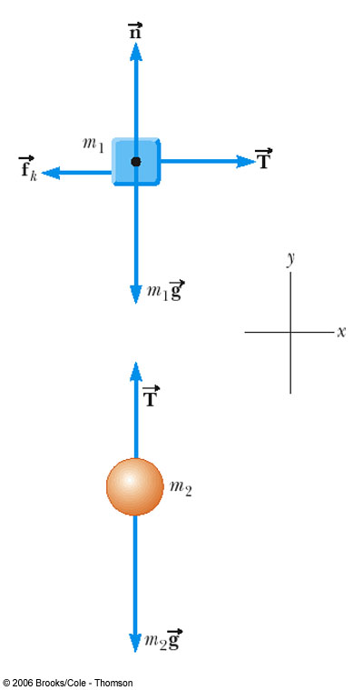
Connected Objects
Apply Newton’s Laws separately to each object
The magnitude of the acceleration of both objects will be the same
The tension is the same in each diagram
Solve the simultaneous equations

Slide 39
More About Connected Objects
Treating the system as one object allows an alternative method or a check
Use only external forces
Not the tension – it’s internal
The mass is the mass of the system
Doesn’t tell you anything about any internal forces

