Slide 1
Chapter 5
Energy

Slide 2
Forms of Energy
Mechanical
  Focus for now
  May be kinetic (associated with motion) or potential (associated with position)
Chemical
Electromagnetic
Nuclear

Slide 3
Some Energy Considerations
Energy can be transformed from one form to another
  Essential to the study of physics, chemistry, biology, geology, astronomy
Can be used in place of Newton’s laws to solve certain problems more simply

Slide 4
Work
Provides a link between force and energy
The work, W, done by a constant force on an object is defined as the product of the component of the force along the direction of displacement and the magnitude of the displacement

Slide 5
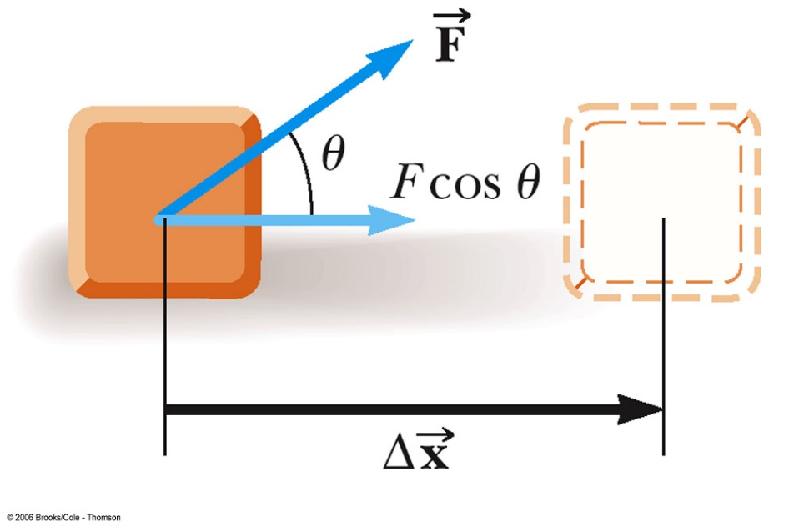
Work, cont.
  F is the magnitude of the force
  Δ x is the magnitude of the object’s displacement
  θ is the angle between

Slide 6
Work, cont.
This gives no information about
  the time it took for the displacement to occur
  the velocity or acceleration of the object
Work is a scalar quantity

Slide 7
Units of Work
SI
  Newton • meter = Joule
    N • m = J
    J = kg • m² / s²
US Customary
  foot • pound
    ft • lb
      no special name

Slide 8
More About Work
The work done by a force is zero when the force is perpendicular to the displacement
  cos 90° = 0
If there are multiple forces acting on an object, the total work done is the algebraic sum of the amount of work done by each force

Slide 9
More About Work, cont.
Work can be positive or negative
  Positive if the force and the displacement are in the same direction
  Negative if the force and the displacement are in the opposite direction

Slide 10
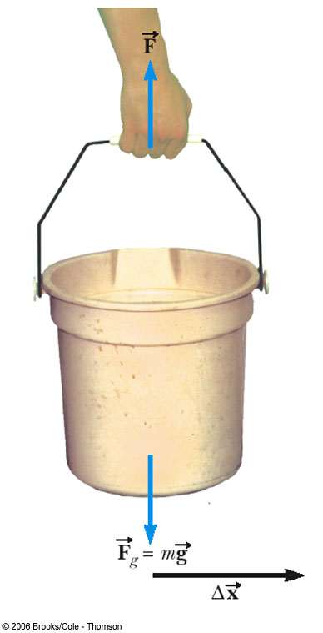
When Work is Zero
Displacement is horizontal
Force is vertical
cos 90° = 0

Slide 11
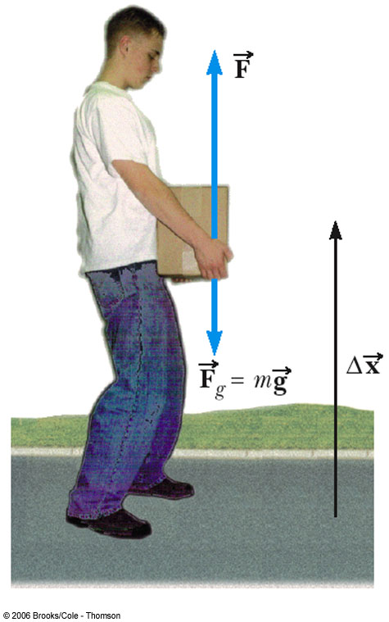
Work Can Be Positive or Negative
Work is positive when lifting the box
Work would be negative if lowering the box
  The force would still be upward, but the displacement would be downward

Slide 12
Work and Dissipative Forces
Work can be done by friction
The energy lost to friction by an object goes into heating both the object and its environment
  Some energy may be converted into sound
For now, the phrase “Work done by friction” will denote the effect of the friction processes on mechanical energy alone

Slide 13
Kinetic Energy
Energy associated with the motion of an object
Scalar quantity with the same units as work
Work is related to kinetic energy

Slide 14
Work-Kinetic Energy Theorem
When work is done by a net force on an object and the only change in the object is its speed, the work done is equal to the change in the object’s kinetic energy
  Speed will increase if work is positive
  Speed will decrease if work is negative

Slide 15
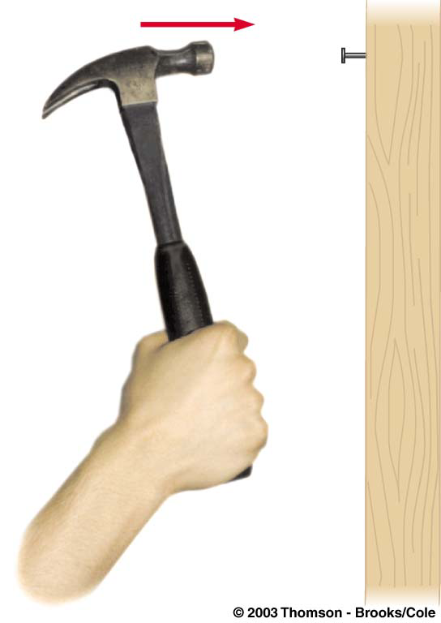
Work and Kinetic Energy
An object’s kinetic energy can also be thought of as the amount of work the moving object could do in coming to rest
  The moving hammer has kinetic energy and can do work on the nail

Slide 16
Types of Forces
There are two general kinds of forces
  Conservative
    Work and energy associated with the force can be recovered
  Nonconservative
    The forces are generally dissipative and work done against it cannot easily be recovered

Slide 17
Conservative Forces
A force is conservative if the work it does on an object moving between two points is independent of the path the objects take between the points
  The work depends only upon the initial and final positions of the object
  Any conservative force can have a potential energy function associated with it

Slide 18
More About Conservative Forces
Examples of conservative forces include:
  Gravity
  Spring force
  Electromagnetic forces
Potential energy is another way of looking at the work done by conservative forces

Slide 19
Nonconservative Forces
A force is nonconservative if the work it does on an object depends on the path taken by the object between its final and starting points.
Examples of nonconservative forces
  kinetic friction, air drag, propulsive forces

Slide 20
Friction as a Nonconservative Force
The friction force is transformed from the kinetic energy of the object into a type of energy associated with temperature
  The objects are warmer than they were before the movement
  Internal Energy is the term used for the energy associated with an object’s temperature

Slide 21
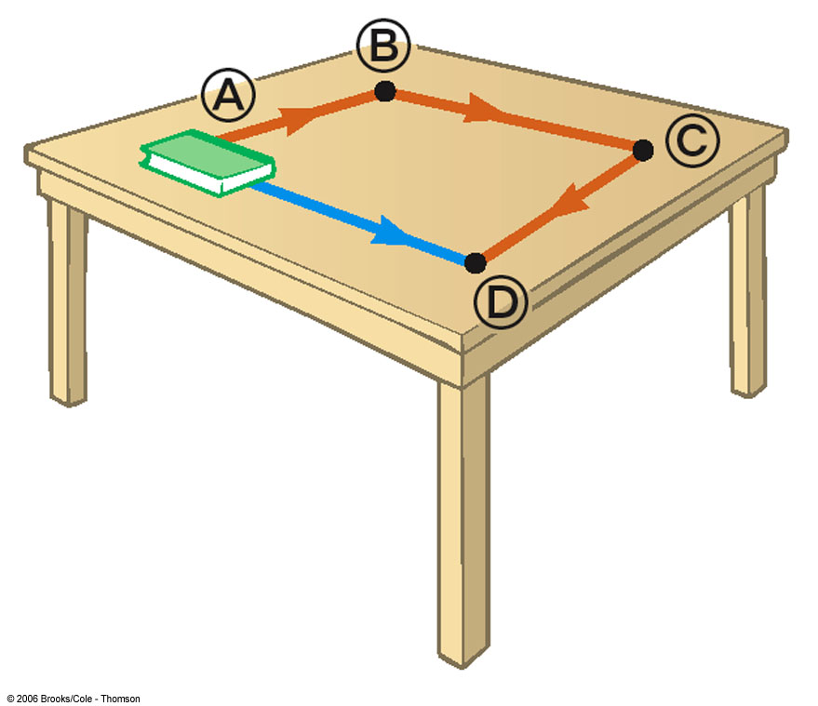
Friction Depends on the Path
The blue path is shorter than the red path
The work required is less on the blue path than on the red path
Friction depends on the path and so is a non-conservative force

Slide 22
Potential Energy
Potential energy is associated with the position of the object within some system
  Potential energy is a property of the system, not the object
  A system is a collection of objects interacting via forces or processes that are internal to the system

Slide 23
Work and Potential Energy
For every conservative force a potential energy function can be found
Evaluating the difference of the function at any two points in an object’s path gives the negative of the work done by the force between those two points

Slide 24
Gravitational Potential Energy
Gravitational Potential Energy is the energy associated with the relative position of an object in space near the Earth’s surface
  Objects interact with the earth through the gravitational force
  Actually the potential energy is for the earth-object system

Slide 25
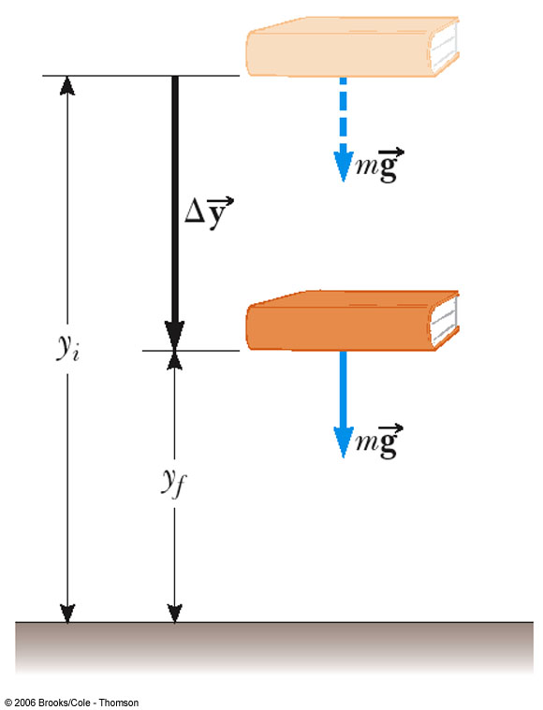
Work and Gravitational Potential Energy
PE = mgy
Units of Potential Energy are the same as those of Work and Kinetic Energy

Slide 26
Work-Energy Theorem, Extended
The work-energy theorem can be extended to include potential energy:
If other conservative forces are present, potential energy functions can be developed for them and their change in that potential energy added to the right side of the equation

Slide 27
Reference Levels for Gravitational Potential Energy
A location where the gravitational potential energy is zero must be chosen for each problem
  The choice is arbitrary since the change in the potential energy is the important quantity
  Choose a convenient location for the zero reference height
    often the Earth’s surface
    may be some other point suggested by the problem
  Once the position is chosen, it must remain fixed for the entire problem

Slide 28
Conservation of Mechanical Energy
Conservation in general
  To say a physical quantity is conserved is to say that the numerical value of the quantity remains constant throughout any physical process
In Conservation of Energy, the total mechanical energy remains constant
  In any isolated system of objects interacting only through conservative forces, the total mechanical energy of the system remains constant.

Slide 29
Conservation of Energy, cont.
Total mechanical energy is the sum of the kinetic and potential energies in the system
  Other types of potential energy functions can be added to modify this equation

Slide 30
Problem Solving with Conservation of Energy
Define the system
Select the location of zero gravitational potential energy
  Do not change this location while solving the problem
Identify two points the object of interest moves between
  One point should be where information is given
  The other point should be where you want to find out something

Slide 31
Problem Solving, cont
Verify that only conservative forces are present
Apply the conservation of energy equation to the system
  Immediately substitute zero values, then do the algebra before substituting the other values
Solve for the unknown(s)

Slide 32
Work-Energy With Nonconservative Forces
If nonconservative forces are present, then the full Work-Energy Theorem must be used instead of the equation for Conservation of Energy
Often techniques from previous chapters will need to be employed

Slide 33
Potential Energy Stored in a Spring
Involves the spring constant, k
Hooke’s Law gives the force
  F = - k x
    F is the restoring force
    F is in the opposite direction of x
    k depends on how the spring was formed, the material it is made from, thickness of the wire, etc.

Slide 34
Potential Energy in a Spring
Elastic Potential Energy
  related to the work required to compress a spring from its equilibrium position to some final, arbitrary, position x

Slide 35
Work-Energy Theorem Including a Spring
W_{nc} = (KE_{f} – KE_{i}) + (PE_{gf} – PE_{gi}) + (PE_{sf} – PE_{si})
  PE_{g} is the gravitational potential energy
  PE_{s} is the elastic potential energy associated with a spring
  PE will now be used to denote the total potential energy of the system

Slide 36
Conservation of Energy Including a Spring
The PE of the spring is added to both sides of the conservation of energy equation
The same problem-solving strategies apply

Slide 37
Nonconservative Forces with Energy Considerations
When nonconservative forces are present, the total mechanical energy of the system is not constant
The work done by all nonconservative forces acting on parts of a system equals the change in the mechanical energy of the system

Slide 38
Nonconservative Forces and Energy
In equation form:
The energy can either cross a boundary or the energy is transformed into a form of non-mechanical energy such as thermal energy

Slide 39

Transferring Energy
By Work
  By applying a force
  Produces a displacement of the system

Slide 40

Transferring Energy
Heat
  The process of transferring heat by collisions between molecules
  For example, the spoon becomes hot because some of the KE of the molecules in the coffee is transferred to the molecules of the spoon as internal energy

Slide 41
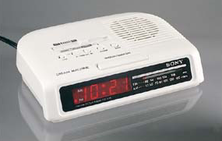
Transferring Energy
Mechanical Waves
  A disturbance propagates through a medium
  Examples include sound, water, seismic

Slide 42
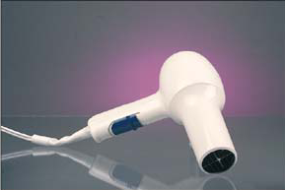
Transferring Energy
Electrical transmission
  Transfer by means of electrical current
  This is how energy enters any electrical device

Slide 43

Transferring Energy
Electromagnetic radiation
  Any form of electromagnetic waves
    Light, microwaves, radio waves

Slide 44
Notes About Conservation of Energy
We can neither create nor destroy energy
  Another way of saying energy is conserved
  If the total energy of the system does not remain constant, the energy must have crossed the boundary by some mechanism
  Applies to areas other than physics

Slide 45
Power
Often also interested in the rate at which the energy transfer takes place
Power is defined as this rate of energy transfer
SI units are Watts (W)

Slide 46
Power, cont.
US Customary units are generally hp
  Need a conversion factor
  Can define units of work or energy in terms of units of power:
    kilowatt hours (kWh) are often used in electric bills
    This is a unit of energy, not power

Slide 47
Center of Mass
The point in the body at which all the mass may be considered to be concentrated
  When using mechanical energy, the change in potential energy is related to the change in height of the center of mass

Slide 48
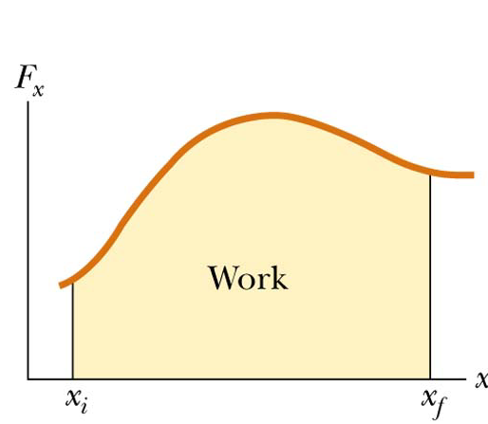
Work Done by Varying Forces
The work done by a variable force acting on an object that undergoes a displacement is equal to the area under the graph of F versus x

Slide 49
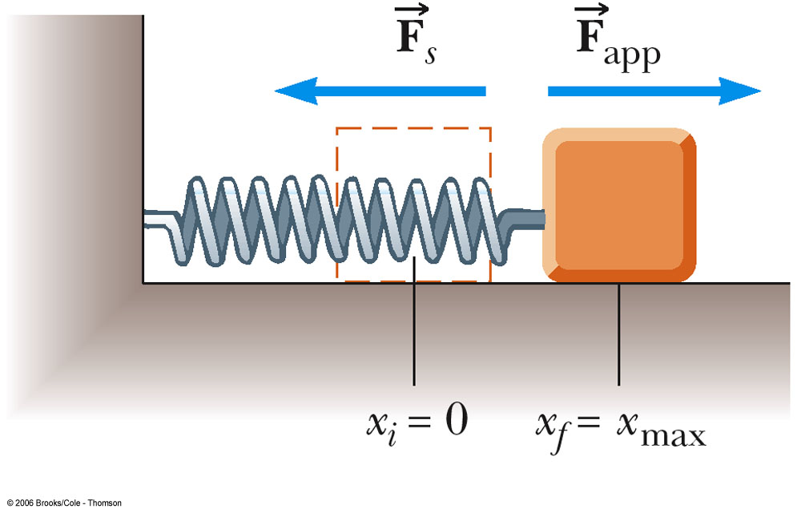
Spring Example
Spring is slowly stretched from 0 to xmax
W = ½kx²

Slide 50
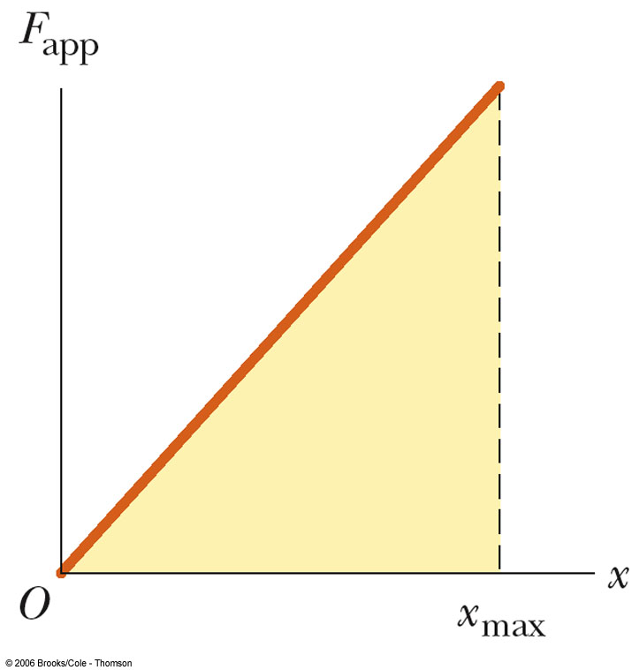
Spring Example, cont.
The work is also equal to the area under the curve
In this case, the “curve” is a triangle
A = ½ B h gives W = ½ k x²

