Slide 1
Chapter 6
Momentum and Collisions

Slide 2
Momentum
The linear momentum of an object of mass m moving with a velocity is defined as the product of the mass and the velocity
  SI Units are kg m / s
  Vector quantity, the direction of the momentum is the same as the velocity’s

Slide 3
Momentum components
Applies to two-dimensional motion

Slide 4
Impulse
In order to change the momentum of an object, a force must be applied
The time rate of change of momentum of an object is equal to the net force acting on it
  Gives an alternative statement of Newton’s second law

Slide 5
Impulse cont.
When a single, constant force acts on the object, there is an impulse delivered to the object
  is defined as the impulse
  Vector quantity, the direction is the same as the direction of the force

Slide 6
Impulse-Momentum Theorem
The theorem states that the impulse acting on the object is equal to the change in momentum of the object
  If the force is not constant, use the average force applied

Slide 7
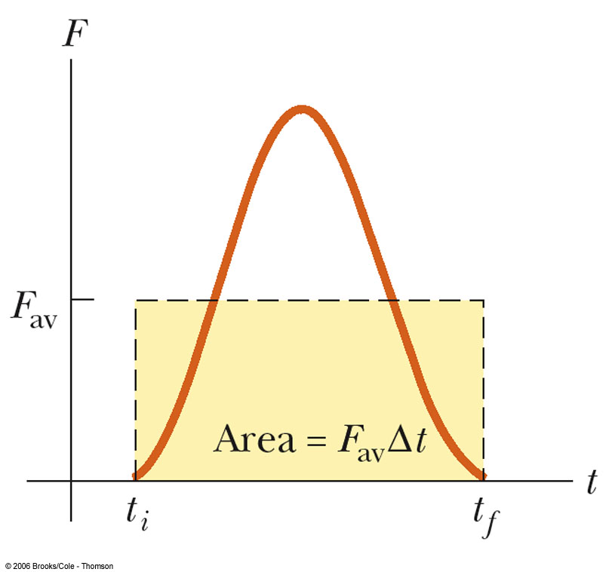
Average Force in Impulse
The average force can be thought of as the constant force that would give the same impulse to the object in the time interval as the actual time-varying force gives in the interval

Slide 8
Average Force cont.
The impulse imparted by a force during the time interval Δt is equal to the area under the force-time graph from the beginning to the end of the time interval
Or, the impulse is equal to the average force multiplied by the time interval,

Slide 9
Impulse Applied to Auto Collisions
The most important factor is the collision time or the time it takes the person to come to a rest
  This will reduce the chance of dying in a car crash
Ways to increase the time
  Seat belts
  Air bags

Slide 10
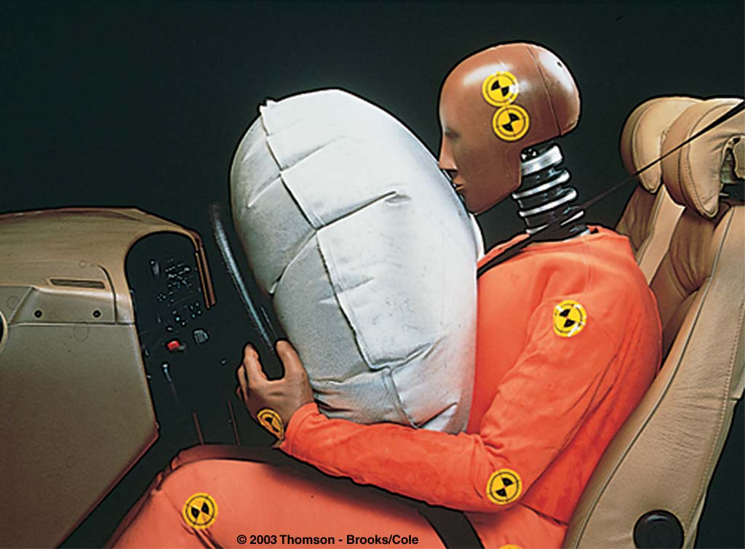
Air Bags
The air bag increases the time of the collision
It will also absorb some of the energy from the body
It will spread out the area of contact
  decreases the pressure
  helps prevent penetration wounds

Slide 11
Conservation of Momentum
Momentum in an isolated system in which a collision occurs is conserved
  A collision may be the result of physical contact between two objects
  “Contact” may also arise from the electrostatic interactions of the electrons in the surface atoms of the bodies
  An isolated system will have not external forces

Slide 12
Conservation of Momentum, cont
The principle of conservation of momentum states when no external forces act on a system consisting of two objects that collide with each other, the total momentum of the system remains constant in time
  Specifically, the total momentum before the collision will equal the total momentum after the collision

Slide 13
Conservation of Momentum, cont.
Mathematically:
  Momentum is conserved for the system of objects
  The system includes all the objects interacting with each other
  Assumes only internal forces are acting during the collision
  Can be generalized to any number of objects

Slide 14
Notes About A System
Remember conservation of momentum applies to the system
You must define the isolated system

Slide 15
Types of Collisions
Momentum is conserved in any collision
Inelastic collisions
  Kinetic energy is not conserved
    Some of the kinetic energy is converted into other types of energy such as heat, sound, work to permanently deform an object
  Perfectly inelastic collisions occur when the objects stick together
    Not all of the KE is necessarily lost

Slide 16
More Types of Collisions
Elastic collision
  both momentum and kinetic energy are conserved
Actual collisions
  Most collisions fall between elastic and perfectly inelastic collisions

Slide 17
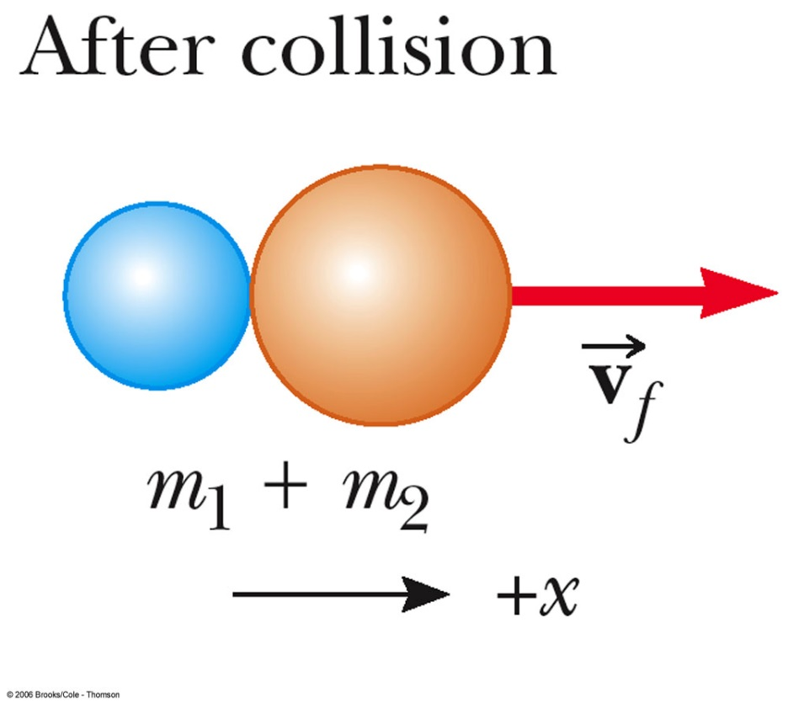
More About Perfectly Inelastic Collisions
When two objects stick together after the collision, they have undergone a perfectly inelastic collision
Conservation of momentum becomes

Slide 18
Some General Notes About Collisions
Momentum is a vector quantity
  Direction is important
  Be sure to have the correct signs

Slide 19
More About Elastic Collisions
Both momentum and kinetic energy are conserved
Typically have two unknowns
Solve the equations simultaneously

Slide 20
Elastic Collisions, cont.
A simpler equation can be used in place of the KE equation

Slide 21
Summary of Types of Collisions
In an elastic collision, both momentum and kinetic energy are conserved
In an inelastic collision, momentum is conserved but kinetic energy is not
In a perfectly inelastic collision, momentum is conserved, kinetic energy is not, and the two objects stick together after the collision, so their final velocities are the same

Slide 22
Problem Solving for One -Dimensional Collisions
Coordinates: Set up a coordinate axis and define the velocities with respect to this axis
  It is convenient to make your axis coincide with one of the initial velocities
Diagram: In your sketch, draw all the velocity vectors and label the velocities and the masses

Slide 23
Problem Solving for One -Dimensional Collisions, 2
Conservation of Momentum: Write a general expression for the total momentum of the system before and after the collision
  Equate the two total momentum expressions
  Fill in the known values

Slide 24
Problem Solving for One -Dimensional Collisions, 3
Conservation of Energy: If the collision is elastic, write a second equation for conservation of KE, or the alternative equation
  This only applies to perfectly elastic collisions
Solve: the resulting equations simultaneously

Slide 25
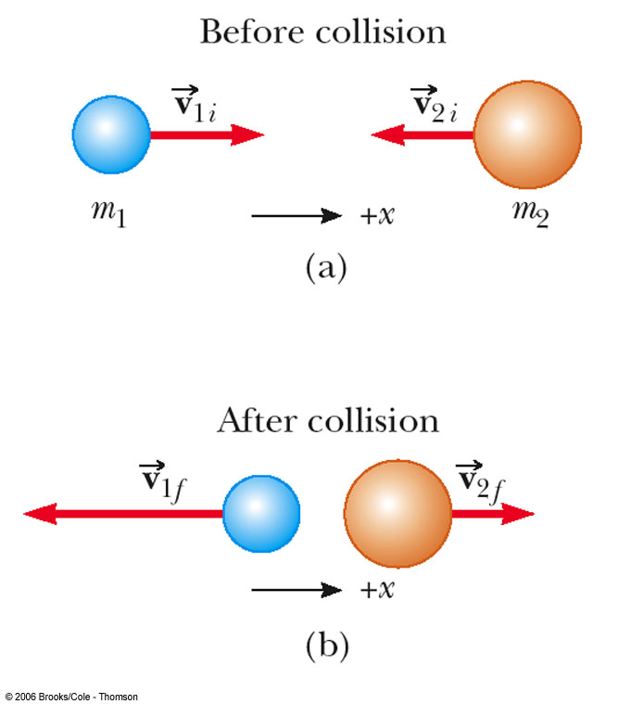
Sketches for Collision Problems
Draw “before” and “after” sketches
Label each object
  include the direction of velocity
  keep track of subscripts

Slide 26
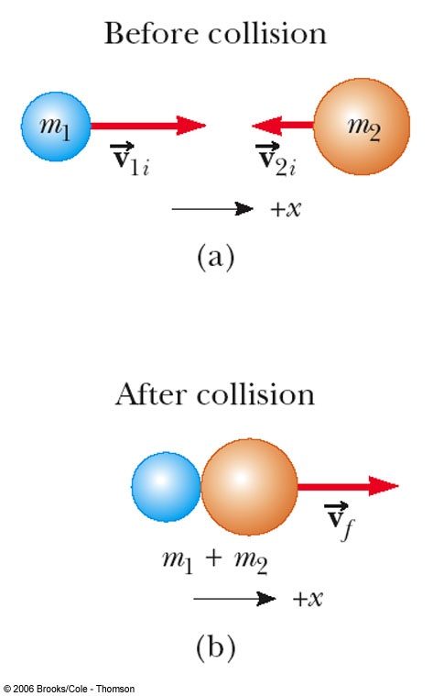
Sketches for Perfectly Inelastic Collisions
The objects stick together
Include all the velocity directions
The “after” collision combines the masses

Slide 27
Glancing Collisions
For a general collision of two objects in three-dimensional space, the conservation of momentum principle implies that the total momentum of the system in each direction is conserved
  Use subscripts for identifying the object, initial and final velocities, and components

Slide 28
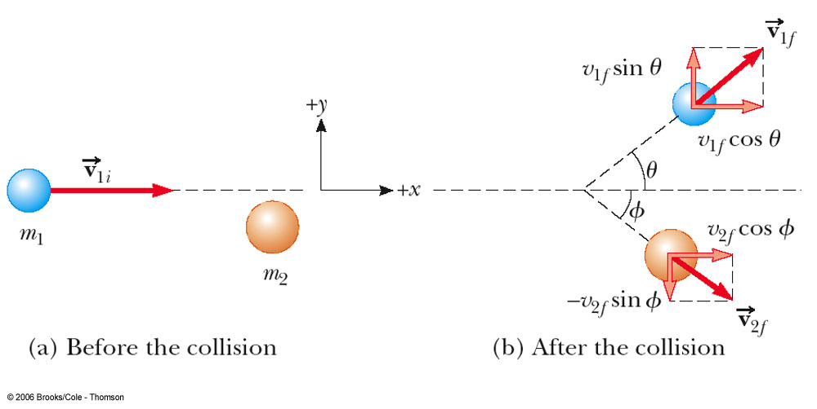
Glancing Collisions
The “after” velocities have x and y components
Momentum is conserved in the x direction and in the y direction
Apply conservation of momentum separately to each direction

Slide 29
Problem Solving for Two-Dimensional Collisions
Coordinates: Set up coordinate axes and define your velocities with respect to these axes
  It is convenient to choose the x- or y- axis to coincide with one of the initial velocities
Draw: In your sketch, draw and label all the velocities and masses

Slide 30
Problem Solving for Two-Dimensional Collisions, 2
Conservation of Momentum: Write expressions for the x and y components of the momentum of each object before and after the collision
Write expressions for the total momentum before and after the collision in the x-direction and in the y-direction

Slide 31
Problem Solving for Two-Dimensional Collisions, 3
Conservation of Energy: If the collision is elastic, write an expression for the total energy before and after the collision
  Equate the two expressions
  Fill in the known values
  Solve the quadratic equations
    Can’t be simplified

Slide 32
Problem Solving for Two-Dimensional Collisions, 4
Solve for the unknown quantities
  Solve the equations simultaneously
  There will be two equations for inelastic collisions
  There will be three equations for elastic collisions

Slide 33
Rocket Propulsion
The operation of a rocket depends on the law of conservation of momentum as applied to a system, where the system is the rocket plus its ejected fuel
  This is different than propulsion on the earth where two objects exert forces on each other
    road on car
    train on track

Slide 34
Rocket Propulsion, 2
The rocket is accelerated as a result of the thrust of the exhaust gases
This represents the inverse of an inelastic collision
  Momentum is conserved
  Kinetic Energy is increased (at the expense of the stored energy of the rocket fuel)

Slide 35
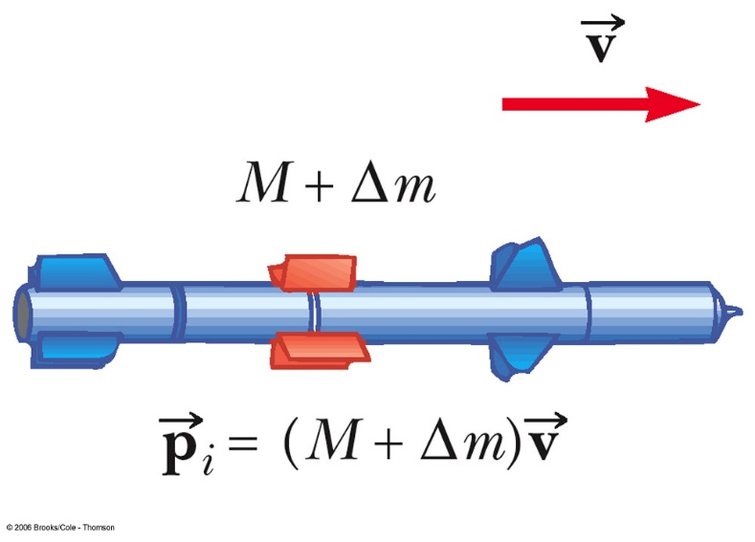
Rocket Propulsion, 3
The initial mass of the rocket is M + Δm
  M is the mass of the rocket
  m is the mass of the fuel
The initial velocity of the rocket is

Slide 36
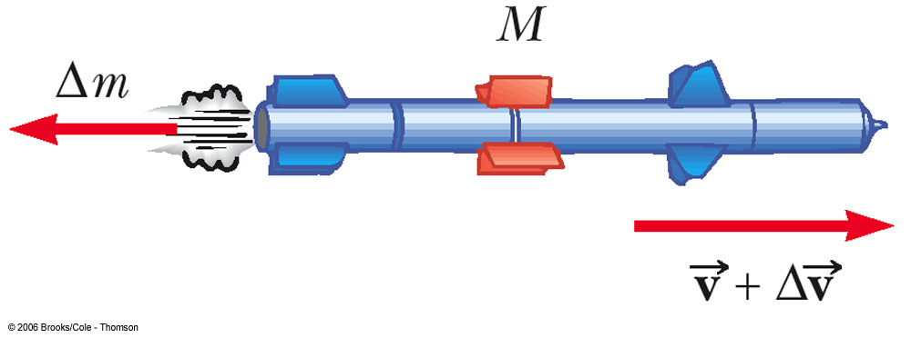
Rocket Propulsion
The rocket’s mass is M
The mass of the fuel, Δm, has been ejected
The rocket’s speed has increased to

Slide 37
Rocket Propulsion, final
The basic equation for rocket propulsion is:
  M_{i} is the initial mass of the rocket plus fuel
  M_{f} is the final mass of the rocket plus any remaining fuel
  The speed of the rocket is proportional to the exhaust speed

Slide 38
Thrust of a Rocket
The thrust is the force exerted on the rocket by the ejected exhaust gases
The instantaneous thrust is given by
  The thrust increases as the exhaust speed increases and as the burn rate (ΔM/Δt) increases

