Slide 1
Chapter 7
Rotational Motion
and
The Law of Gravity

Slide 2
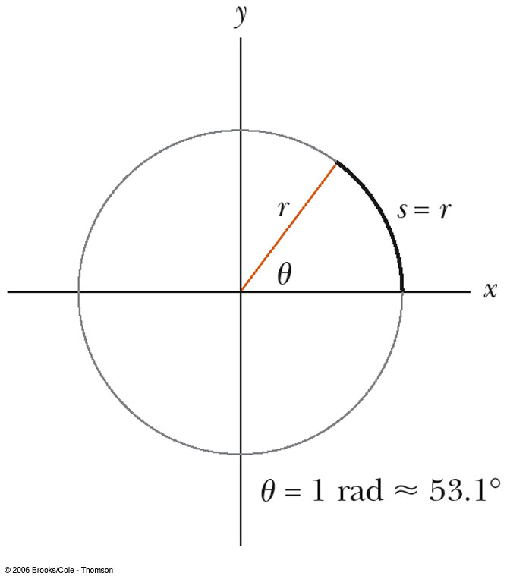
The Radian
The radian is a unit of angular measure
The radian can be defined as the arc length s along a circle divided by the radius r

Slide 3
More About Radians
Comparing degrees and radians
Converting from degrees to radians

Slide 4
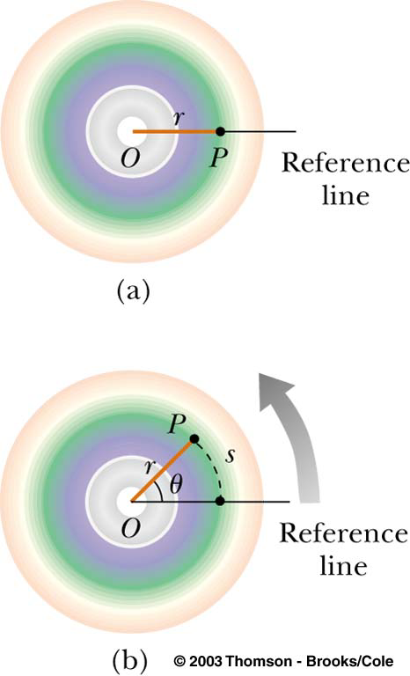
Angular Displacement
Axis of rotation is the center of the disk
Need a fixed reference line
During time t, the reference line moves through angle θ

Slide 5
Rigid Body
Every point on the object undergoes circular motion about the point O
All parts of the object of the body rotate through the same angle during the same time
The object is considered to be a rigid body
  This means that each part of the body is fixed in position relative to all other parts of the body

Slide 6
Angular Displacement, cont.
The angular displacement is defined as the angle the object rotates through during some time interval
The unit of angular displacement is the radian
Each point on the object undergoes the same angular displacement

Slide 7
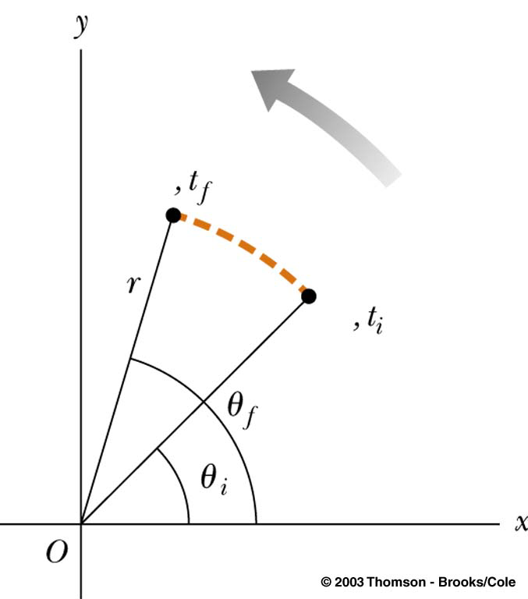
Average Angular Speed
The average angular speed, ω, of a rotating rigid object is the ratio of the angular displacement to the time interval

Slide 8
Angular Speed, cont.
The instantaneous angular speed is defined as the limit of the average speed as the time interval approaches zero
Units of angular speed are radians/sec
  rad/s
Speed will be positive if θ is increasing (counterclockwise)
Speed will be negative if θ is decreasing (clockwise)

Slide 9
Average Angular Acceleration
The average angular acceleration of an object is defined as the ratio of the change in the angular speed to the time it takes for the object to undergo the change:

Slide 10
Angular Acceleration, cont
Units of angular acceleration are rad/s²
Positive angular accelerations are in the counterclockwise direction and negative accelerations are in the clockwise direction
When a rigid object rotates about a fixed axis, every portion of the object has the same angular speed and the same angular acceleration

Slide 11
Angular Acceleration, final
The sign of the acceleration does not have to be the same as the sign of the angular speed
The instantaneous angular acceleration is defined as the limit of the average acceleration as the time interval approaches zero

Slide 12
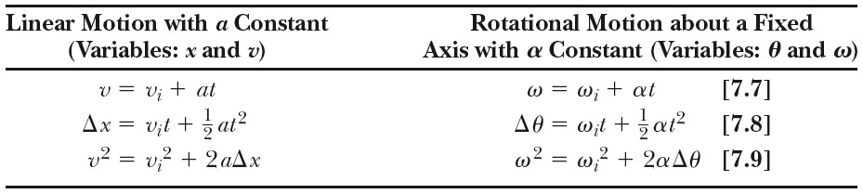
Analogies Between Linear and Rotational Motion

Slide 13
Relationship Between Angular and Linear Quantities
Displacements
Speeds
Accelerations
Every point on the rotating object has the same angular motion
Every point on the rotating object does not have the same linear motion

Slide 14
Centripetal Acceleration
An object traveling in a circle, even though it moves with a constant speed, will have an acceleration
The centripetal acceleration is due to the change in the direction of the velocity

Slide 15
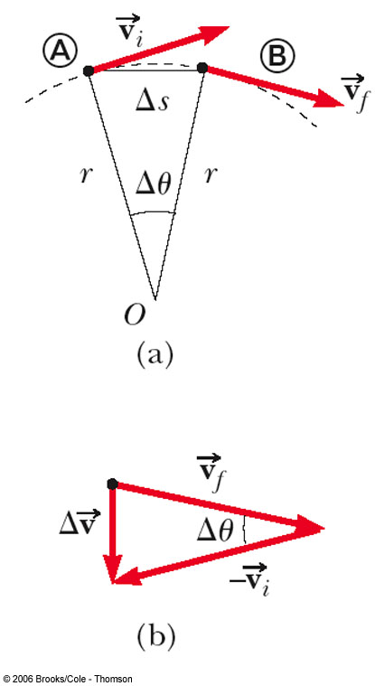
Centripetal Acceleration, cont.
Centripetal refers to “center-seeking”
The direction of the velocity changes
The acceleration is directed toward the center of the circle of motion

Slide 16
Centripetal Acceleration, final
The magnitude of the centripetal acceleration is given by
  This direction is toward the center of the circle

Slide 17
Centripetal Acceleration and Angular Velocity
The angular velocity and the linear velocity are related (v = ωr)
The centripetal acceleration can also be related to the angular velocity

Slide 18
Total Acceleration
The tangential component of the acceleration is due to changing speed
The centripetal component of the acceleration is due to changing direction
Total acceleration can be found from these components

Slide 19
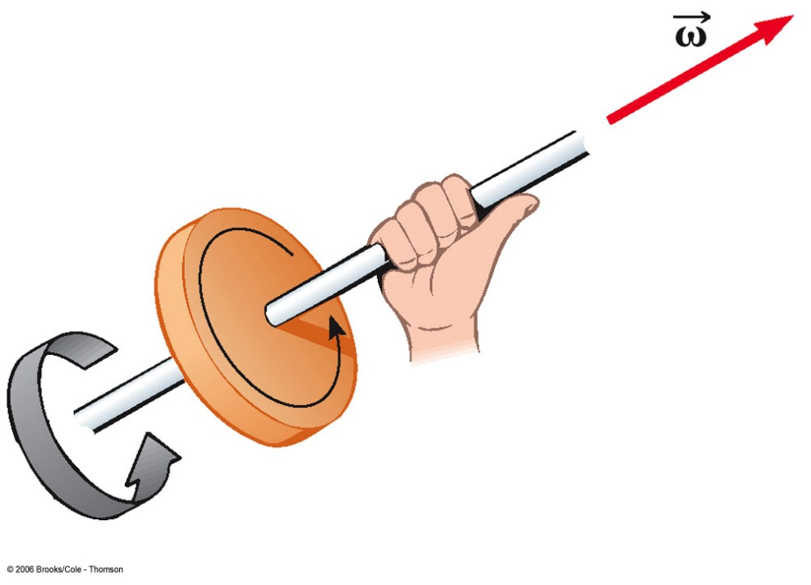
Vector Nature of Angular Quantities
Angular displacement, velocity and acceleration are all vector quantities
Direction can be more completely defined by using the right hand rule
  Grasp the axis of rotation with your right hand
  Wrap your fingers in the direction of rotation
  Your thumb points in the direction of ω

Slide 20
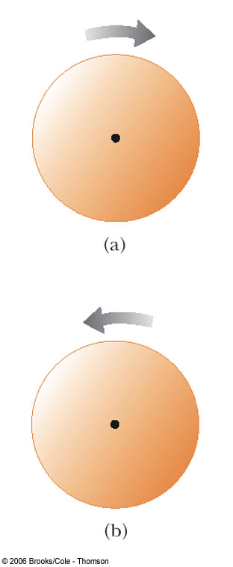
Velocity Directions, Example
In a, the disk rotates clockwise, the velocity is into the page
In b, the disk rotates counterclockwise, the velocity is out of the page

Slide 21
Acceleration Directions
If the angular acceleration and the angular velocity are in the same direction, the angular speed will increase with time
If the angular acceleration and the angular velocity are in opposite directions, the angular speed will decrease with time

Slide 22
Forces Causing Centripetal Acceleration
Newton’s Second Law says that the centripetal acceleration is accompanied by a force
  F_{C} = ma_{C}
  F_{C} stands for any force that keeps an object following a circular path
    Tension in a string
    Gravity
    Force of friction

Slide 23
Problem Solving Strategy
Draw a free body diagram, showing and labeling all the forces acting on the object(s)
Choose a coordinate system that has one axis perpendicular to the circular path and the other axis tangent to the circular path
  The normal to the plane of motion is also often needed

Slide 24
Problem Solving Strategy, cont.
Find the net force toward the center of the circular path (this is the force that causes the centripetal acceleration, F_{C})
Use Newton’s second law
  The directions will be radial, normal, and tangential
  The acceleration in the radial direction will be the centripetal acceleration
Solve for the unknown(s)

Slide 25
Applications of Forces Causing Centripetal Acceleration
Many specific situations will use forces that cause centripetal acceleration
  Level curves
  Banked curves
  Horizontal circles
  Vertical circles

Slide 26
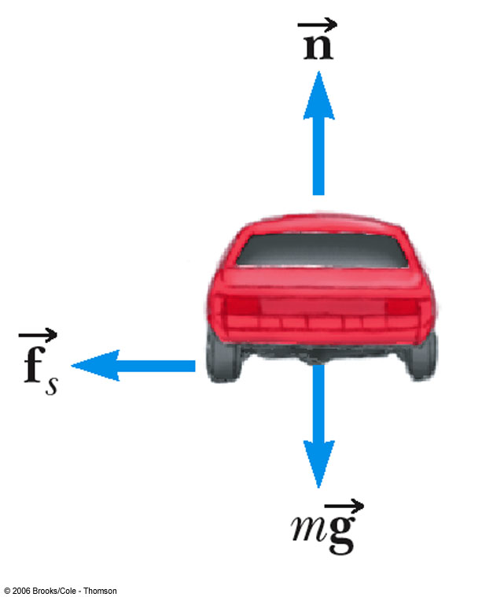
Level Curves
Friction is the force that produces the centripetal acceleration
Can find the frictional force, µ, or v

Slide 27
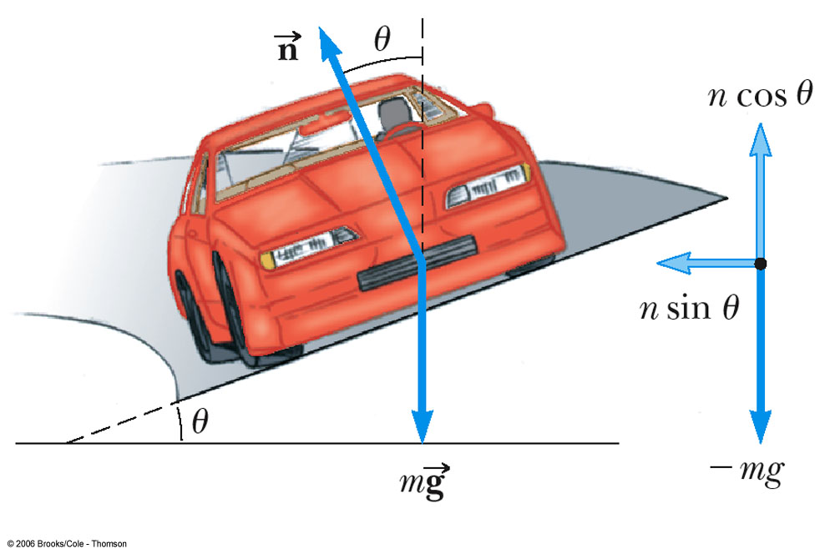
Banked Curves
A component of the normal force adds to the frictional force to allow higher speeds

Slide 28
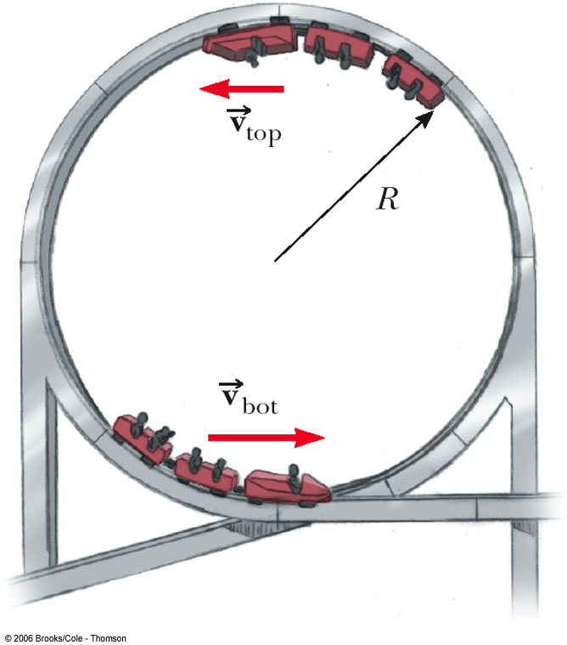
Vertical Circle
Look at the forces at the top of the circle
The minimum speed at the top of the circle can be found

Slide 29
Forces in Accelerating Reference Frames
Distinguish real forces from fictitious forces
“Centrifugal” force is a fictitious force
Real forces always represent interactions between objects

Slide 30
Newton’s Law of Universal Gravitation
Every particle in the Universe attracts every other particle with a force that is directly proportional to the product of the masses and inversely proportional to the square of the distance between them.

Slide 31
G is the constant of universal gravitational
G = 6.673 x 10⁻¹¹ N m² /kg²
This is an example of an inverse square law
The centripetal force that holds the planets in orbit is the gravitational force.

Slide 32
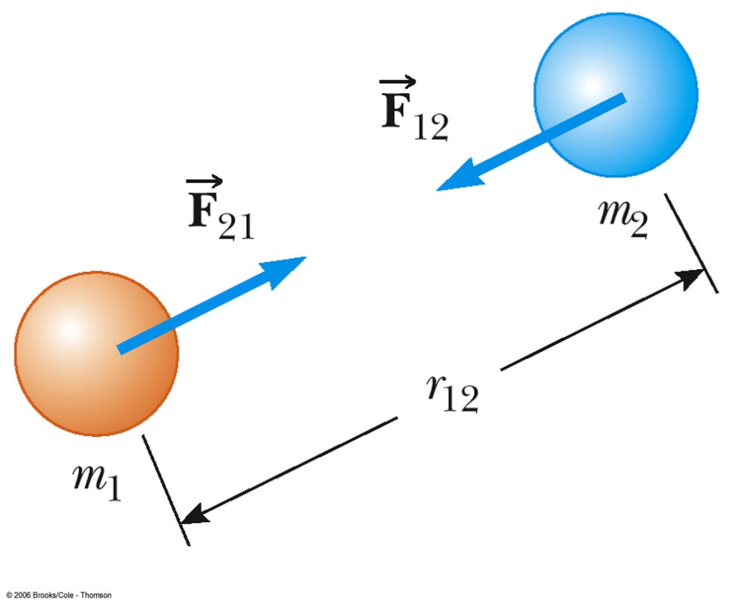
The force that mass 1 exerts on mass 2 is equal and opposite to the force mass 2 exerts on mass 1
Newton’s third law action-reaction

Slide 33
The gravitational force exerted by a uniform sphere on a particle outside the sphere is the same as the force exerted if the entire mass of the sphere were concentrated on its center
  This is called Gauss’ Law

Slide 34

weight = mass × gravitational field strength.
  So, weight (w) = Fg
Because it depends on gravitational field strength, weight changes with location:
On the surface of any planet, the value of g, as well as your weight, will depend on the planet’s mass and radius.

Slide 35
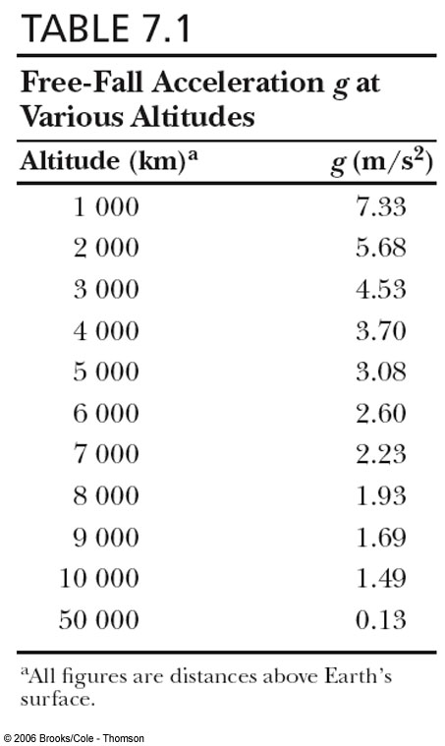
Acceleration due to gravity (g) will vary with altitude.

Slide 36
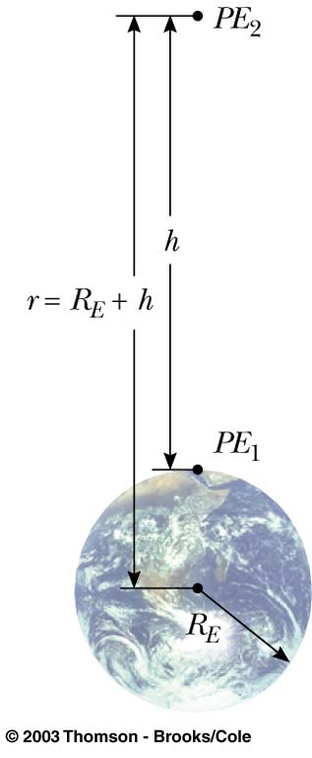
Gravitational Potential
Energy
PE = mgy is valid only near the earth’s surface
For objects high above the earth’s surface, an alternate expression is needed

Slide 37
Escape Speed
The escape speed is the speed needed for an object to soar off into space and not return
For the earth, v_{esc} is about 11.2 km/s

Slide 38
Kepler’s Laws
Law 1: All planets move in elliptical orbits with the Sun at one of the focal points.
Law 2: A line drawn from the Sun to any planet sweeps out equal areas in equal time intervals.

Slide 39
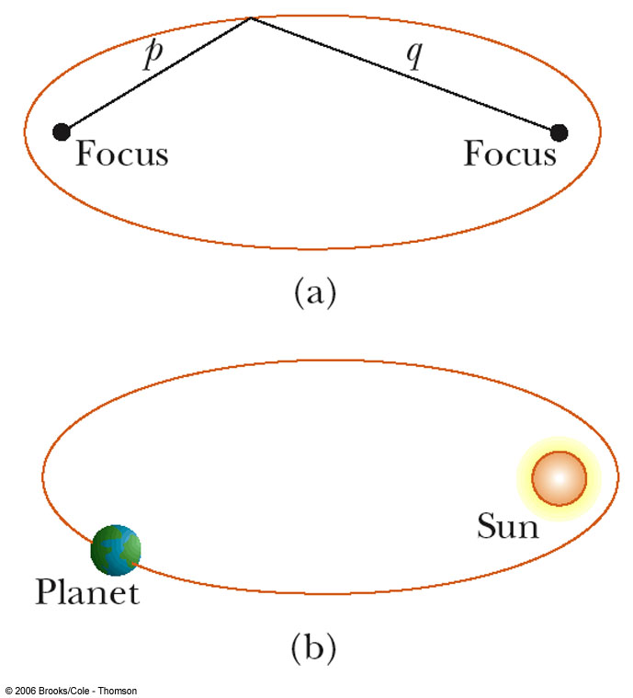
Kepler’s First Law
All planets move in elliptical orbits with the Sun at one focus.
  Any object bound to another by an inverse square law will move in an elliptical path
  Second focus is empty

Slide 40
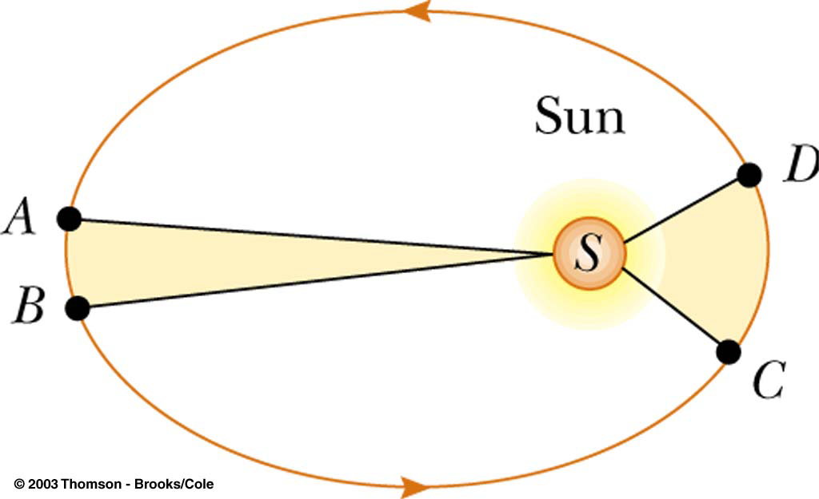
Kepler’s Second Law
A line drawn from the Sun to any planet will sweep out equal areas in equal times
  Area from A to B and C to D are the same

Slide 41
Kepler’s Third Law
Third Law: The square of the orbital period of any planet is proportional to cube of the average distance from the Star to the planet.
  For orbit around the Sun, K = K_{S} = 2.97x10⁻¹⁹ s²/m³
  K is independent of the mass of the planet

Slide 42
Communications Satellite
A geosynchronous orbit
  Remains above the same place on the earth
  The period of the satellite will be 24 hr
r = h + R_{E}
Still independent of the mass of the satellite

Slide 43
Kepler’s Laws, continued
Chapter 7
Section 3 Motion in Space
Kepler’s third law states that T² ∝ r³.
The constant of proportionality is 4π²/Gm, where m is the mass of the object being orbited.
So, Kepler’s third law can also be stated as follows:

Slide 44
Kepler’s Laws, continued
Chapter 7
Section 3 Motion in Space
Kepler’s third law leads to an equation for the period of an object in a circular orbit. The speed of an object in a circular orbit depends on the same factors:
Note that m is the mass of the central object that is being orbited. The mass of the planet or satellite that is in orbit does not affect its speed or period.
The mean radius (r) is the distance between the centers of the two bodies.

