Slide 1
Chapter 8
Rotational Equilibrium
and
Rotational Dynamics

Slide 2
Force vs. Torque
Forces cause accelerations (F=ma)
Torques cause angular accelerations
Force and torque are related

Slide 3
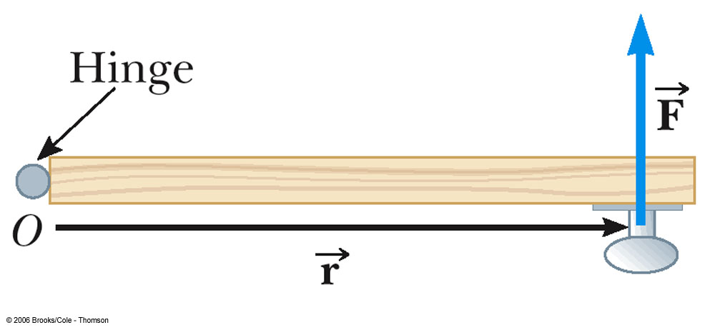
Torque:
The door is free to rotate about an axis through O
There are three factors that determine the effectiveness of the force in opening the door:
  The magnitude of the force
  The position of the application of the force
  The angle at which the force is applied

Slide 4
Torque, τ, is the tendency of a force to rotate an object about some axis.
  τ = r F
    τ is the torque
    F is the force
    r is the length of the position vector
SI unit is N.m = Newton meter

Slide 5
Direction of Torque:
Torque is a vector quantity
  The direction is perpendicular to the plane determined by the position vector and the force.
  If the turning tendency of the force is counterclockwise, the torque will be positive
  If the turning tendency is clockwise, the torque will be negative

Slide 6
Multiple Torques:
When two or more torques are acting on an object, the torques are added as vectors
If the net torque is zero, the object’s rate of rotation doesn’t change.

Slide 7
The applied force is not always perpendicular to the position vector
The component of the force perpendicular to the object will cause it to rotate

Slide 8
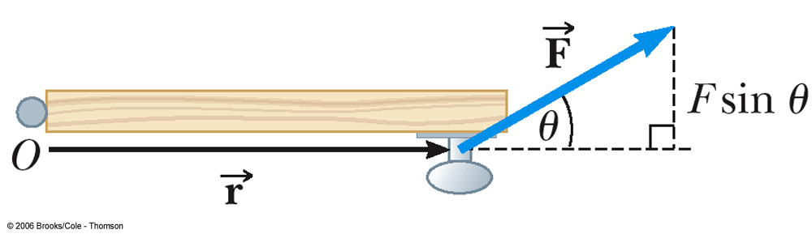
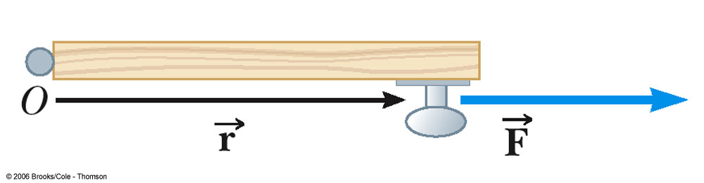
When the force (F) is parallel to the position vector (r), no rotation occurs
When the force (F) is at some angle (Ѳ) to the position vector (r),the perpendicular component (F_{y}) causes the rotation and is found by F_{y}=FsinѲ.

Slide 9
With an angle, use the following equation for torque:
  τ = r F sin θ
    F is the force (N)
    r is the position vector (m)
    θ is the angle between the force and the position vector (deg)

Slide 10
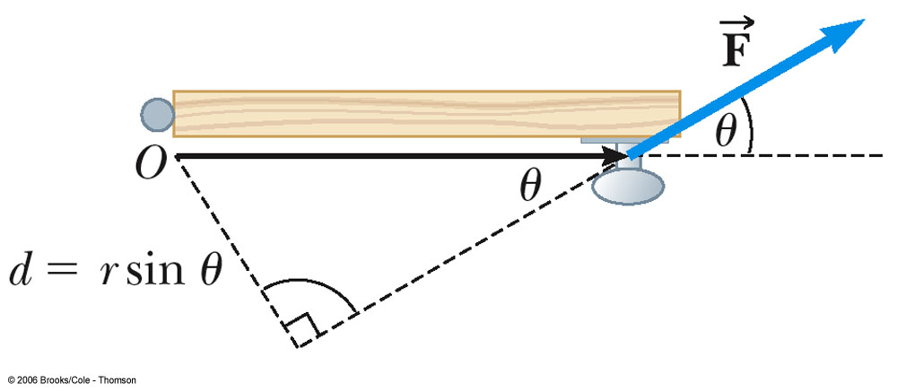
Lever Arm (d):
The lever arm, d, is the perpendicular distance from the axis of rotation to a line drawn along the direction of the force
d = r sin θ

Slide 11
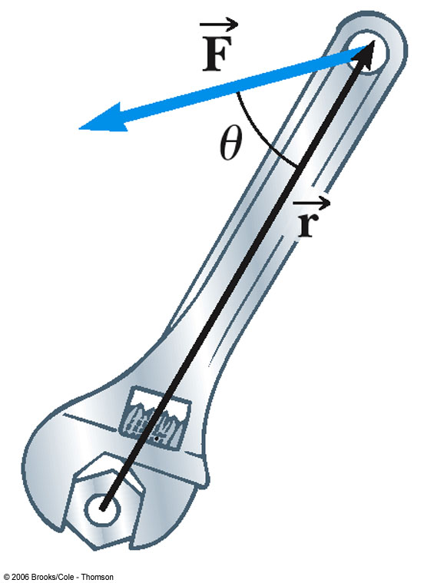
Right Hand Rule:
Using your right hand:
Point the fingers in the direction of the position vector
Curl the fingers toward the force vector
The thumb points in the direction of the torque. (Out, or into the page)

Slide 12
Net Torque:
The net torque is the sum of all the torques produced by all the forces.
  Remember to account for the direction(+ or -) of the tendency for rotation.
    Counterclockwise torques are positive
    Clockwise torques are negative

Slide 13
Mechanical Equilibrium and Torque: (2 conditions)
First Condition needed of Equilibrium
    The net external force must be zero
  This is a statement of translational equilibrium.

Slide 14
Second Condition of Equilibrium states:
  The net external torque must be zero
  This is a statement of rotational equilibrium
  **For Mechanical equilibrium you must have both translational and rotational equilibrium present. F_{net} and T_{net} must both equal 0.

Slide 15
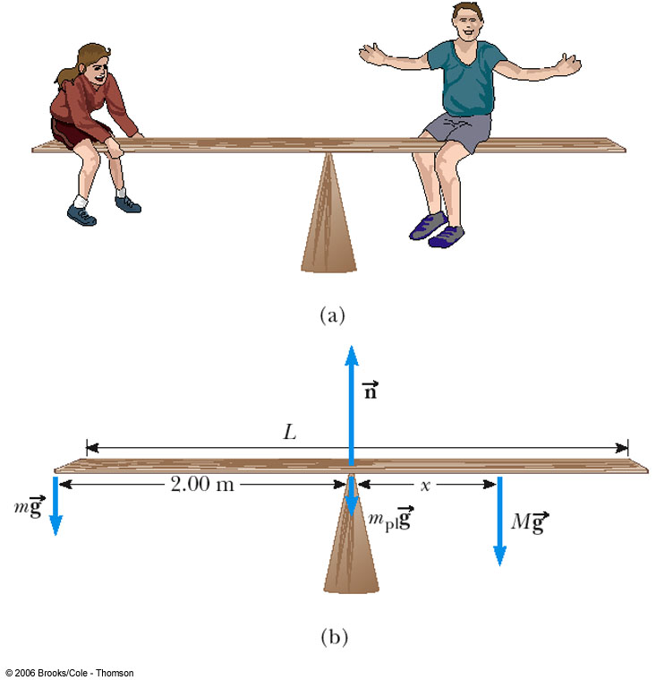
Solving for Equilibrium:
The woman, mass m, sits on the left end of the see-saw
The man, mass M, sits where the see-saw will be balanced
Apply the Second Condition of Equilibrium and solve for the unknown distance, x

Slide 16
Axis of Rotation:
If the object is in equilibrium, it does not matter where you put the axis of rotation for calculating the net torque
  The location of the axis of rotation is completely arbitrary
  When solving a problem, you must specify an axis of rotation
    Once you have chosen an axis, you must maintain that choice consistently throughout the problem

Slide 17
Center of Gravity:
The force of gravity acting on an object must be considered
In finding the torque produced by the force of gravity, all of the weight of the object can be considered to be concentrated at a single point

Slide 18
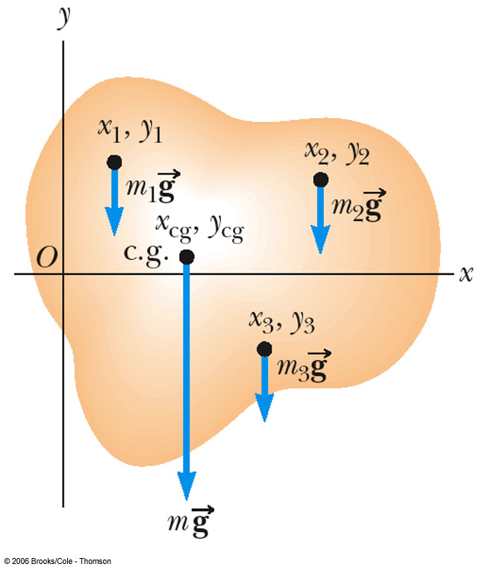
Calculating the Center of Gravity:
The object is divided up into a large number of very small particles of weight (mg)
Each particle will have a set of coordinates indicating its location (x,y)

Slide 19
We assume the object is free to rotate about its center.
The torque produced by each particle about the axis of rotation is equal to its weight (mg) times its lever arm (x)
  For example, τ₁ = m₁gx₁

Slide 20
Locate the point of application of the single force whose magnitude is equal to the weight of the object, and whose effect on the rotation is the same as all the individual particles.
This point is called the center of gravity of the object.

Slide 21
Coordinates of the Center of Gravity:
The coordinates of the center of gravity
  Found from the sum of the torques acting on the individual particles being set equal to the torque produced by the weight of the object

Slide 22
Center of Gravity of a Uniform Object:
The center of gravity of a homogenous, symmetric body must lie on the axis of symmetry.
Often, the center of gravity of such an object is the geometric center of the object.

Slide 23
Notes About Equilibrium
A zero net torque does not mean the absence of rotational motion
  An object that rotates at uniform angular velocity can be under the influence of a zero net torque
    Just like translational situation (linear motion), where a zero net force does not mean the object is not in motion

Slide 24
Steps for Solving Equilibrium Problems:
Draw a diagram of the system.
Include coordinates.
Choose a rotation axis.
Isolate the object being analyzed and draw a free body diagram showing all the external forces acting on the object.
For systems containing more than one object, draw a separate free body diagram for each object.

Slide 25
6. Apply the Second Condition of Equilibrium.
  This will yield a single equation, often with one unknown which can be solved immediately.
7. Apply the First Condition of Equilibrium.

Slide 26
  This will give you two more equations
8. Solve the resulting simultaneous equations for all of the unknowns
  Solving by substitution is generally easiest

Slide 27
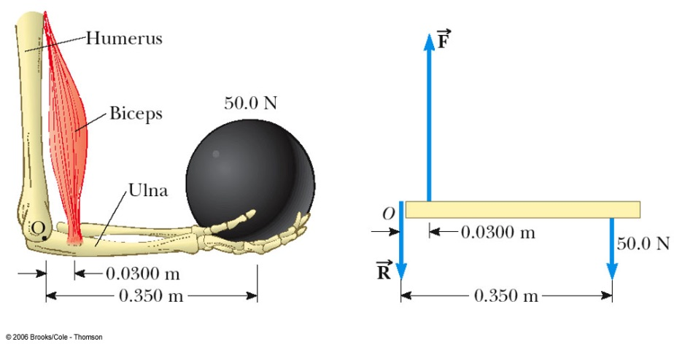
Example of a Free Body Diagram (Forearm)
Isolate the object to be analyzed
Show axis of rotation (0)
Draw the free body diagram for that object
  Include all the external forces acting on the object.

Slide 28
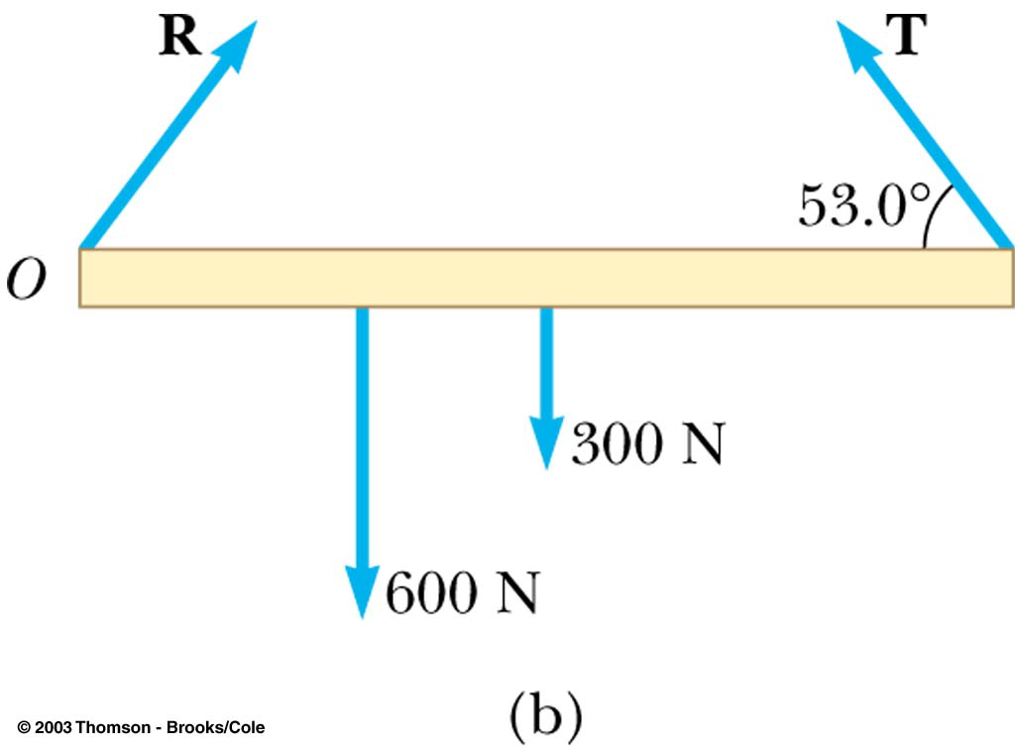
Example of a Free Body Diagram (Beam)
The free body diagram includes the directions of the forces.
The weights act through the centers of gravity of their objects

Slide 29
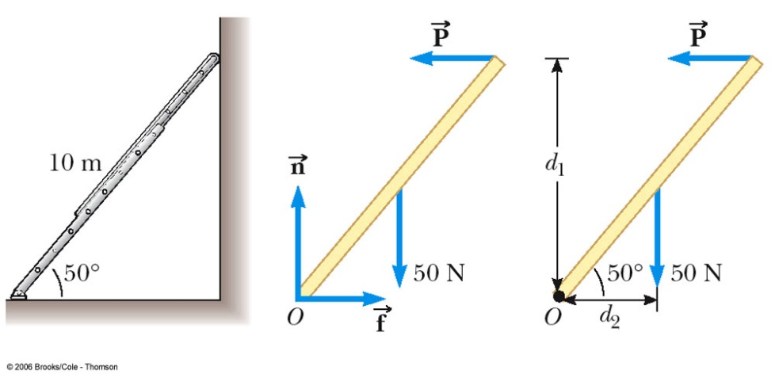
Example of a Free Body Diagram (Ladder)
The free body diagram shows the normal force and the force of static friction acting on the ladder at the ground
The last diagram shows the lever arms for the forces

Slide 30
Torque and Angular Acceleration
When a rigid object is subject to a net torque (≠0), it undergoes an angular acceleration
The angular acceleration is directly proportional to the net torque
  The relationship is analogous to ∑F = ma
    Newton’s Second Law

Slide 31
**Moment of Inertia
The angular acceleration is inversely proportional to the analogy of the mass in a rotating system
This mass analog is called the moment of inertia, I, of the object
  SI units are kg m²

Slide 32
Newton’s Second Law for a Rotating Object
The angular acceleration is directly proportional to the net torque
The angular acceleration is inversely proportional to the moment of inertia of the object.

Slide 33
Difference between moment of inertia and mass***
There is a major difference between moment of inertia and mass: the moment of inertia depends on the quantity of matter and its distribution in the rigid object.
The moment of inertia also depends upon the location of the axis of rotation

Slide 34
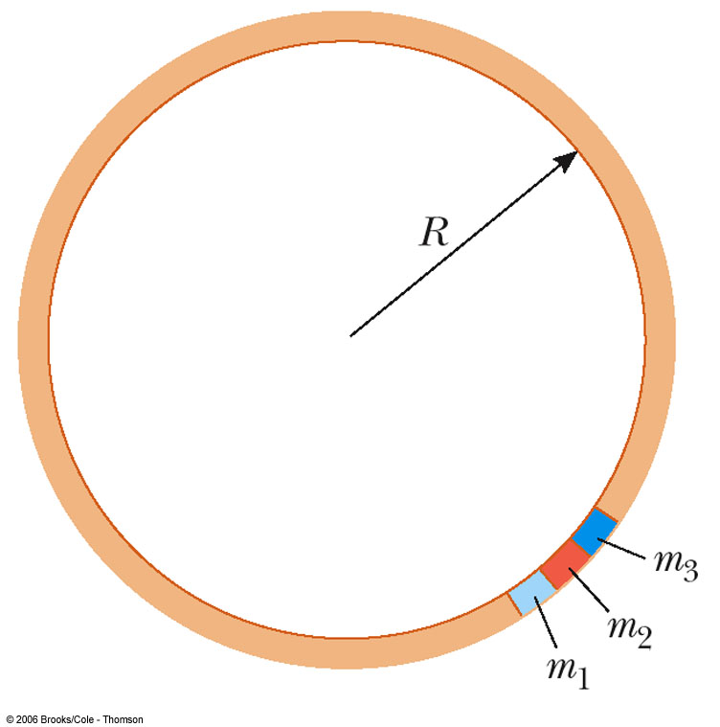
Moment of Inertia of a Uniform Ring:
Image the hoop is divided into a number of small segments, m₁ …
These segments are equidistant from the axis

Slide 35
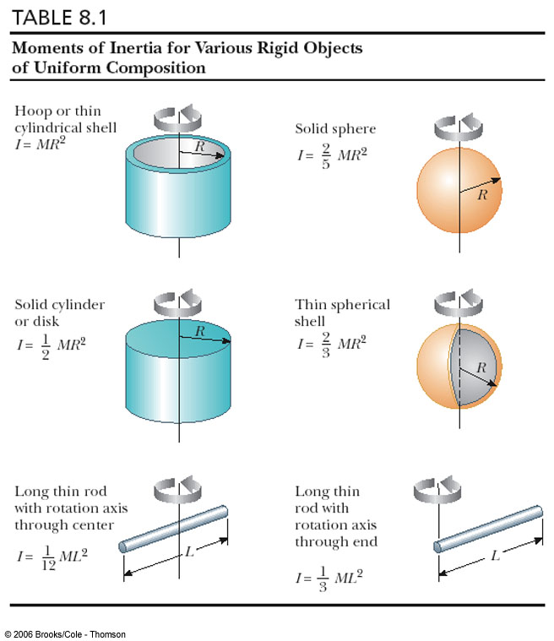
Other object’s Moments of Inertia:

Slide 36
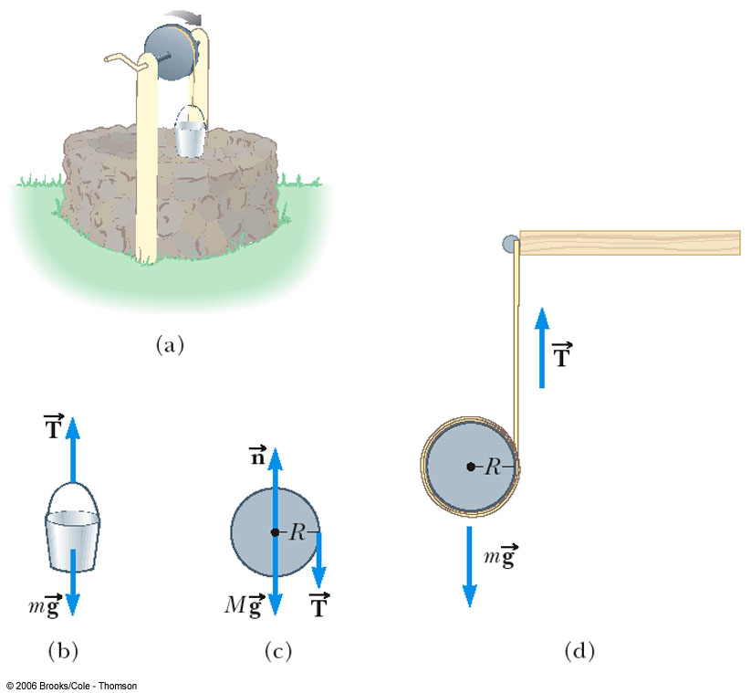
Example, Newton’s Second Law for Rotation:
Draw free body diagrams of each object
Only the cylinder is rotating, so apply Στ = I α
The bucket is falling, but not rotating, so apply ΣF = m a
Remember that a= αr and solve the resulting equations.

Slide 37
Rotational Kinetic Energy:***
An object rotating about some axis with an angular speed, ω, has:
  rotational kinetic energy = ½Iω²

Slide 38
Total Energy of a System:
Conservation of Mechanical Energy
  This is for conservative forces, no dissipative forces such as friction can be present
  Potential energies of any other conservative forces could be added

Slide 39
Work-Energy in a Rotating System:
In the case where there are dissipative forces such as friction, use the generalized Work-Energy Theorem instead of Conservation of Energy
  W_{nc} = ΔKE_{t} + ΔKE_{R} + ΔPE
  Nonconservative work is equal to the sum of the changes in transitional kinetic energy, rotational kinetic energy, and protentional energy. (Wheel rolls down a ramp)

Slide 40
General Problem Solving Hints
The same basic techniques that were used in linear motion can be applied to rotational motion.
  Analogies: F becomes , m becomes I and a becomes , v becomes ω and x becomes θ

Slide 41
Problem Solving Hints for Energy Methods
Choose two points of interest
  One where all the necessary information is given
  The other where information is desired
Identify the conservative and nonconservative forces

Slide 42
Problem Solving Hints for Energy Methods, cont
Write the general equation for the Work-Energy theorem if there are nonconservative forces
  Use Conservation of Energy if there are no nonconservative forces
Use v = ω to combine terms
Solve for the unknown

Slide 43
Angular Momentum
Similarly to the relationship between force and momentum in a linear system, we can show the relationship between torque and angular momentum
Angular momentum (L) is defined as:
  L = I ω
  and

Slide 44
If the net torque is zero, the angular momentum remains constant.
Conservation of Angular Momentum states: The angular momentum of a system is conserved when the net external torque acting on the systems is zero.
  That is, when (VERY IMPORTANT)

Slide 45
Conservation Rules, Summary
In an isolated system, the following quantities are conserved:
  Mechanical energy
  Linear momentum
  Angular momentum

Slide 46
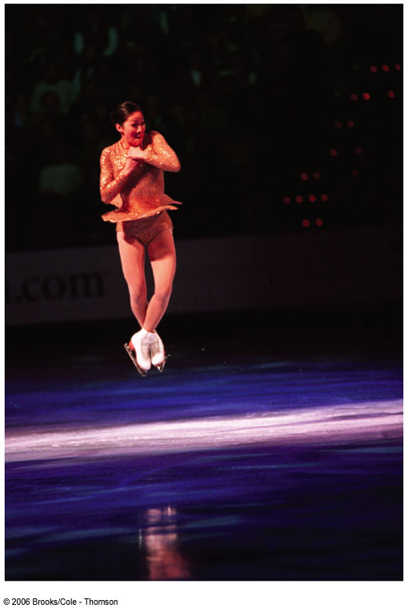
Conservation of Angular Momentum, Example
With hands and feet drawn closer to the body, the skater’s angular speed increases
  L is conserved, I decreases, ω increases

